Slide 1
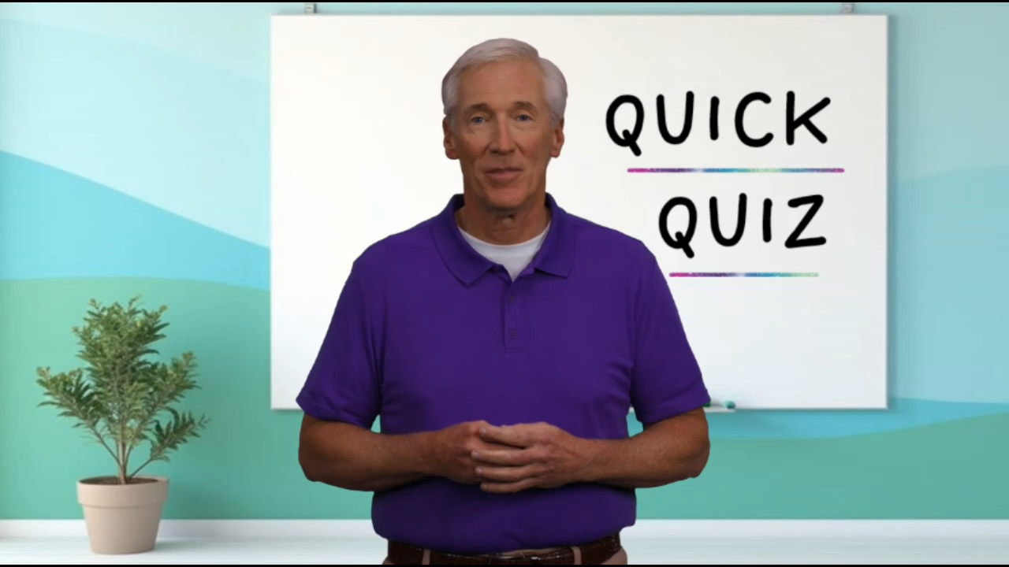

Slide 2


Slide 3


QUICK QUIZ
on
Nehemiah 13

Slide 4

1. On his return to Jerusalem, Nehemiah corrected four specific areas of failure. What were they?

Slide 5
1. On his return to Jerusalem, Nehemiah corrected four specific areas of failure. What were they?
Forbidden ecclesiastical alliances, a lack of financial giving, breaking the Sabbath, and intermarriage with non-believers.

Slide 6
2. What was the “eviction from the temple” problem in Nehemiah 13:4-5? What was Nehemiah's response when he heard about the situation?

Slide 7
2. What was the “eviction from the temple” problem in Nehemiah 13:4-5? What was Nehemiah's response when he heard about the situation?
While Nehemiah was in Babylon, the High Priest allowed Tobiah to reside in the Temple. Nehemiah threw him and his things out.

Slide 8
3. Who was Balaam? Who hired him? What was he hired to do? What happened instead? (See Numbers 22-24.)

Slide 9
3. Who was Balaam? Who hired him? What was he hired to do? What happened instead? (See Numbers 22-24.)
Balaam was a “prophet for hire” obtained by the Moabites to curse the Israelites. God turned that curse into a blessing.

Slide 10
4. The people had stopped keeping their financial commitments to God. How did Nehemiah handle this problem?

Slide 11
4. The people had stopped keeping their financial commitments to God. How did Nehemiah handle this problem?
First, he rebuked the people. Then he appointed treasurers and faithful overseers. This assured a system of checks and balances.

Slide 12
5. Which prophet, a contemporary of Nehemiah, also spoke of giving?

Slide 13
5. Which prophet, a contemporary of Nehemiah, also spoke of giving?
Malachi. (Malachi 3:10 - Bring the whole tithe into the storehouse, that there may be food in my house. Test me in this,” says the Lord Almighty, “and see if I will not throw open the floodgates of heaven and pour out so much blessing that there will not be room enough to store it.)

Slide 14
6. What are the purposes of the Sabbath? How did Nehemiah deal with the failure to keep the Sabbath?

Slide 15
6. What are the purposes of the Sabbath? How did Nehemiah deal with the failure to keep the Sabbath?
The Sabbath was for rest and worship. Nehemiah rebuked the offenders and forbade any trade on the day.

Slide 16
7. What happened because of "spiritually mixed marriages" in Nehemiah's day?

Slide 17
7. What happened because of "spiritually mixed marriages" in Nehemiah's day?
The people intermarried and brought problems on themselves. The Word of God became diluted, loyalty became diffused, and families became less united around God.

Slide 18
8. How did Nehemiah handle those who had married outside of the people of God? (25 ff)

Slide 19
8. How did Nehemiah handle those who had married outside of the people of God? (25 ff)
He rebuked them, physically punished the sinners, and drove off the most prominent offender.

Slide 20
9. How did Ezra deal with the same problem years earlier? (Ezra 10)

Slide 21
9. How did Ezra deal with the same problem years earlier? (Ezra 10)
He tearfully rent his clothes, tore out parts of his hair and beard, fell in the dirt, and publicly repented of the sin of the people.

Slide 22
10. These tough leadership acts must have made Nehemiah unpopular with the people. What was the motivation for him doing them anyway?

Slide 23
10. These tough leadership acts must have made Nehemiah unpopular with the people. What was the motivation for him doing them anyway?
He wasn’t a man-pleaser; he was a God-pleaser. He just wanted God to remember His faithfulness.

Slide 24

Now it’s time for our lesson…

Slide 25

6
REFORMATION
How to Revive a Crumbling Revival
(Nehemiah 13)

Slide 26

I. Rebuild the Spiritual Walls That Often Crumble After a Revival
The Broken Wall of Forbidden Alliances
The Broken Wall of Unfaithful Stewardship
The Broken Wall of Disregarded Standards
The Broken Wall of Unholy Unions
II. Remember the One Who Will Remember You

Slide 27

The Broken Wall of
Forbidden Alliances
(13:1-9)

Slide 28
The Broken Wall of Unfaithful Stewardship (13:10-14)

Slide 29
The Broken Wall of Disregarded Standards (13:15-22)

Slide 30
The Broken Wall of Unholy Unions
(13:23-31)

Slide 31

Remember the One
Who Will Remember You

Slide 32
Review
Revival Phase | Revival Lesson | Revival Imperative
1. PROCLAMATION | How to Ignite Spiritual Revival with God's Word | Proclaim God’s Word
2. INTERACTION | How to Listen and Talk to God | Pray for God’s Working
3. CONSECRATION | How to Cement Your Loyalty to God | Call for a Commitment
4. PARTICIPATION | How to Honor God’s Workers | Honor God’s Workers
5. CELEBRATION | How to Celebrate God and His Goodness | Celebrate God’s Victories
6. REFORMATION | How to Repair a Crumbling Revival | Repeatedly Refresh Revival

