Slide 1
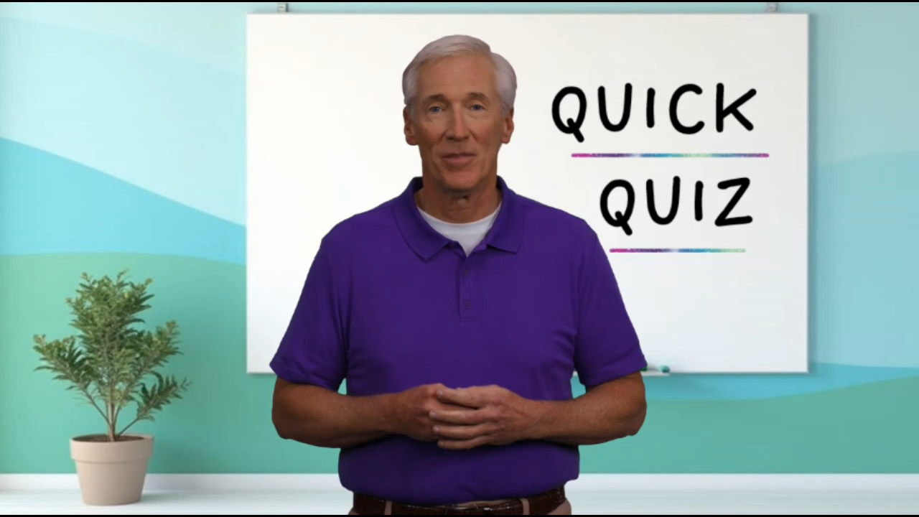

Slide 2


Slide 3


QUICK QUIZ
on
Nehemiah 12:27 ff

Slide 4

1. The singers and musicians were all members of which tribe?

Slide 5
1. The singers and musicians were all members of which tribe?
Levites

Slide 6
2. What musical instruments are mentioned in this chapter?

Slide 7
2. What musical instruments are mentioned in this chapter?
Cymbals, harps, lyres and trumpets.

Slide 8
3. How many priests were in each of the praise parades? And how many Levites?

Slide 9
3. How many priests were in each of the praise parades? And how many Levites?
7 Priests and 8 Levites

Slide 10
4. Who were some of the other people who were on the wall?

Slide 11
4. Who were some of the other people who were on the wall?
Each group had a choir, a civic official leading half of the lay leaders, 7 priests, and 8 Levites. Ezra led one group. Nehemiah followed the other.

Slide 12
5. Who was involved in the rejoicing that was going on?

Slide 13
5. Who was involved in the rejoicing that was going on?
Everyone—men, women and children.

Slide 14
6. People brought their “offerings, firstfruits, and tithes” to the storehouse. What is the difference between these three donations?

Slide 15
6. People brought their “offerings, firstfruits, and tithes” to the storehouse. What is the difference between these three donations?
Offerings are gifts or sacrifices presented to God as an act of worship or gratitude. Firstfruits are the initial portion of a harvest or income that is offered to God before any other part is used or consumed. Tithes are a tenth of one's income or produce that is set aside to support the priesthood and Temple.

Slide 16
7. Who got a daily portion?

Slide 17
7. Who got a daily portion?
The Levites were provided for by the tithe, which was their due (Lev 27:32, 33; Num 18:21, 24ff.), but a tenth of it had to be given to the priests (Num 18:26-28).

Slide 18
8. How loud was the sound of their joyful celebration?

Slide 19
8. How loud was the sound of their joyful celebration?
It could be heard “far off!”

Slide 20

Now it’s time for our lesson…

Slide 21

5
CELEBRATION
How to Celebrate God and His Goodness
(Nehemiah 12:27-47)
Throwing God a Party

Slide 22
Psalm 137
¹ By the rivers of Babylon we sat and wept
when we remembered Zion.
² There on the poplars
we hung our harps,
³ for there our captors asked us for songs,
our tormentors demanded songs of joy;
they said, “Sing us one of the songs of Zion!”
⁴ How can we sing the songs of the Lord
while in a foreign land?
⁵ If I forget you, Jerusalem,
may my right hand forget its skill.
⁶ May my tongue cling to the roof of my mouth
if I do not remember you,
if I do not consider Jerusalem
my highest joy.

Slide 23
Celebrating God’s Goodness
Celebration Begins With Spiritual Purification
(27-30)
Celebration Continues With Jubilant Praise
(31-39)
Celebration Culminates in Joyful Generosity
(40-47)

Slide 24
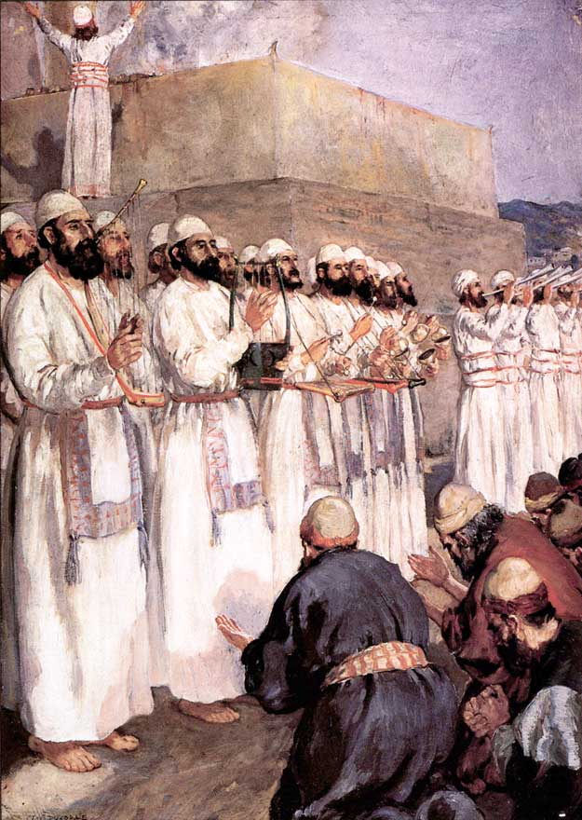
I. Celebration Begins With Spiritual Purification
(27-30)

Slide 25
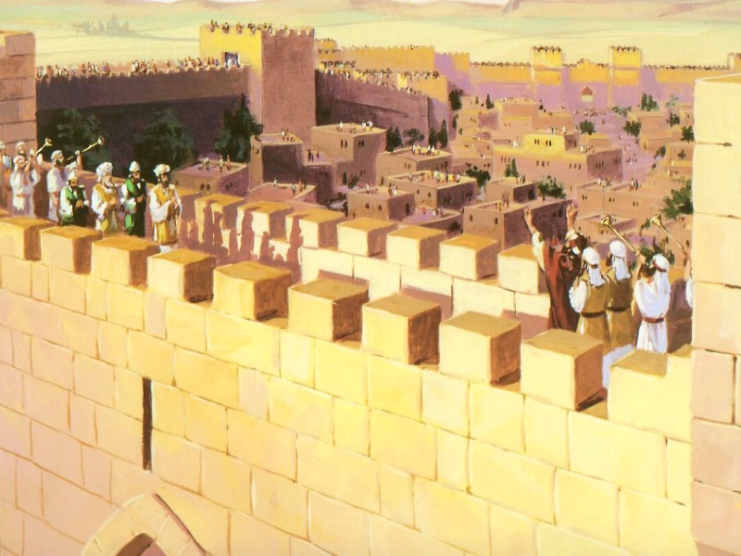
II. Celebration Continues With Jubilant Praise (31-39)

Slide 26
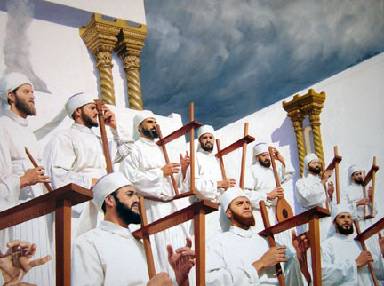

Slide 27

III. Celebration
Culminates in
Joyful Generosity
(40-47)

