Slide 1
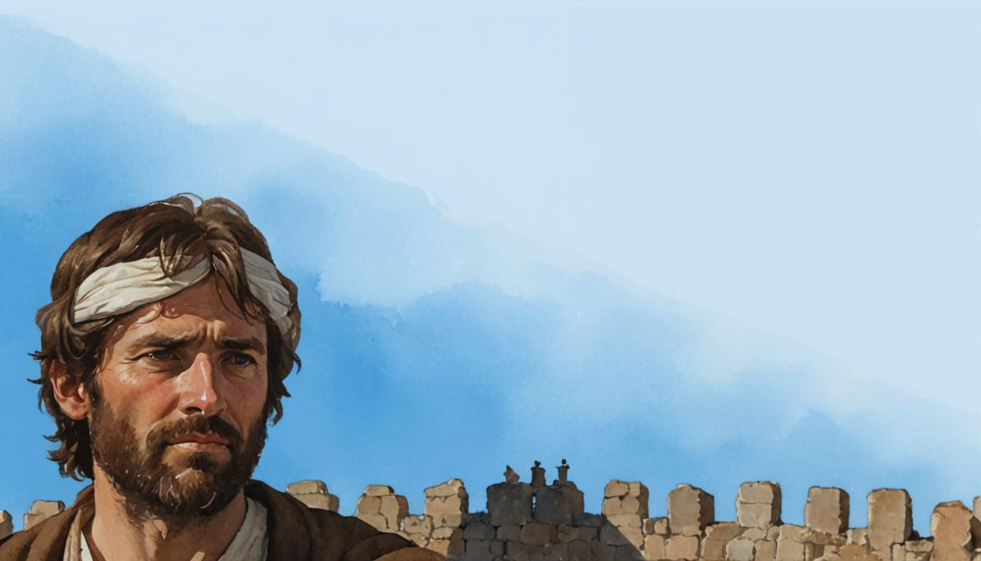

The Nehemiah Model Of Successful Leadership
Leading a Great Endeavor
A Guide to Strategic Action
Nehemiah 1-7

Slide 2
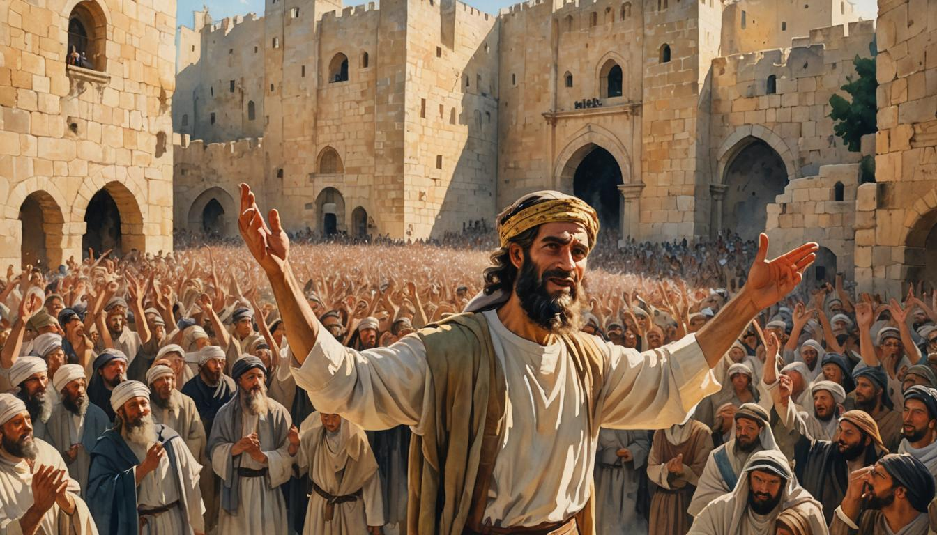

Phase # 8
How to Gain and Guard the Victory
Neh. 6-7

Slide 3


Slide 4
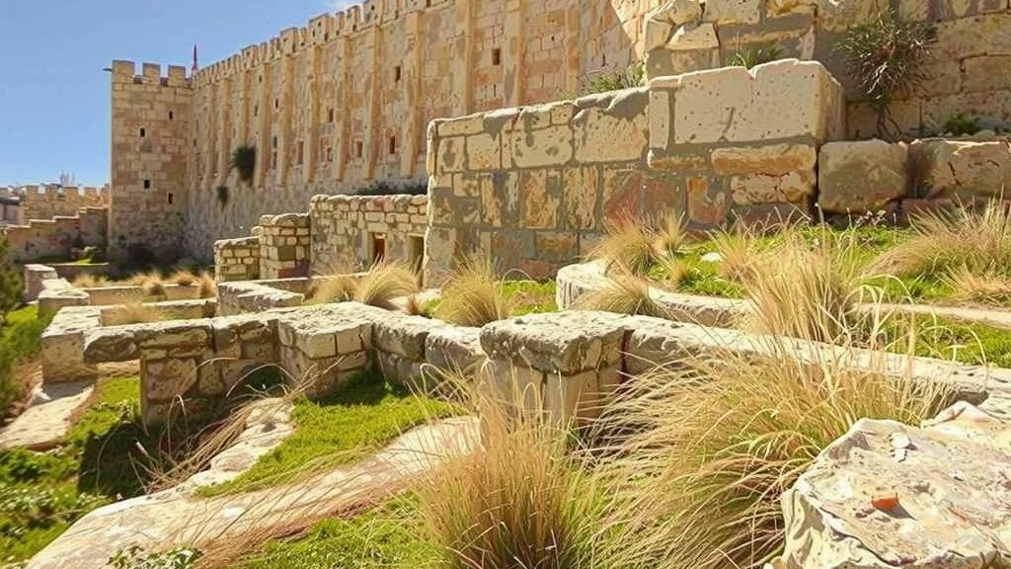

Slide 5

SUCCESS:
Achieving the Victory
with God’s Help
(6:15-16)

Slide 6

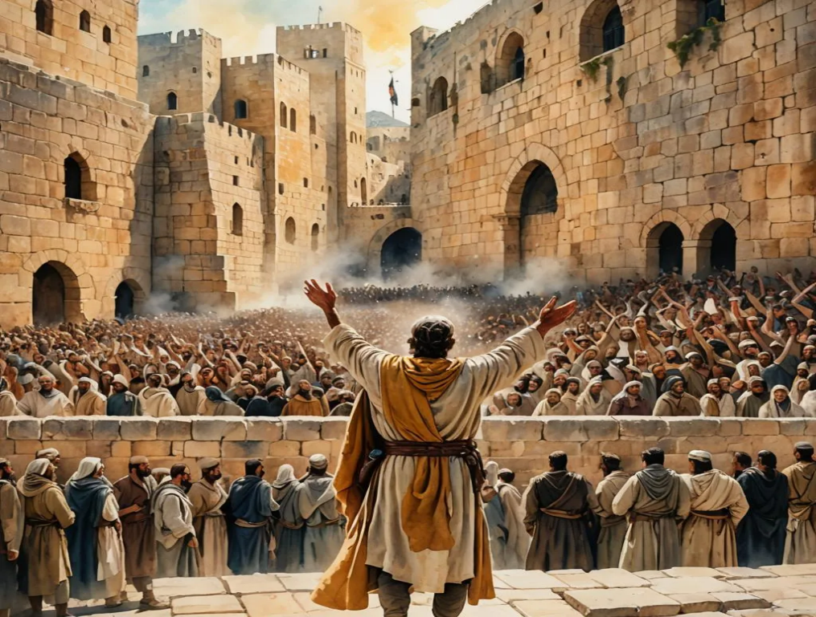
The Walls Are Completed!
So the wall was completed on the twenty-fifth of Elul, in fifty-two days. When all our enemies heard about this, all the surrounding nations were afraid and lost their self-confidence, because they realized that this work had been done with the help of our God.
(Nehemiah 6:15-16)

Slide 7
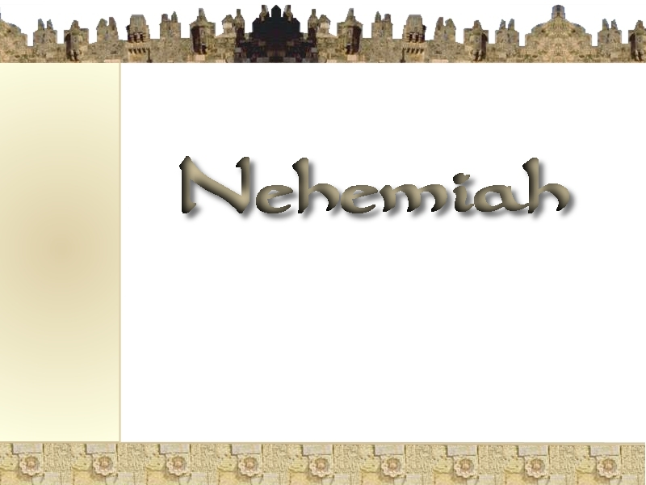

The
"Give your servant success today..." Nehemiah 1:11
"The God of Heaven
will give us success..."
Nehemiah 2:20
all the surrounding nations were afraid and lost their self-confidence, because they realized that this work had been done with the help of our God.
Nehemiah 6:16
Model of
Successful Leadership
www.BiblePlusHangouts.com

Slide 8
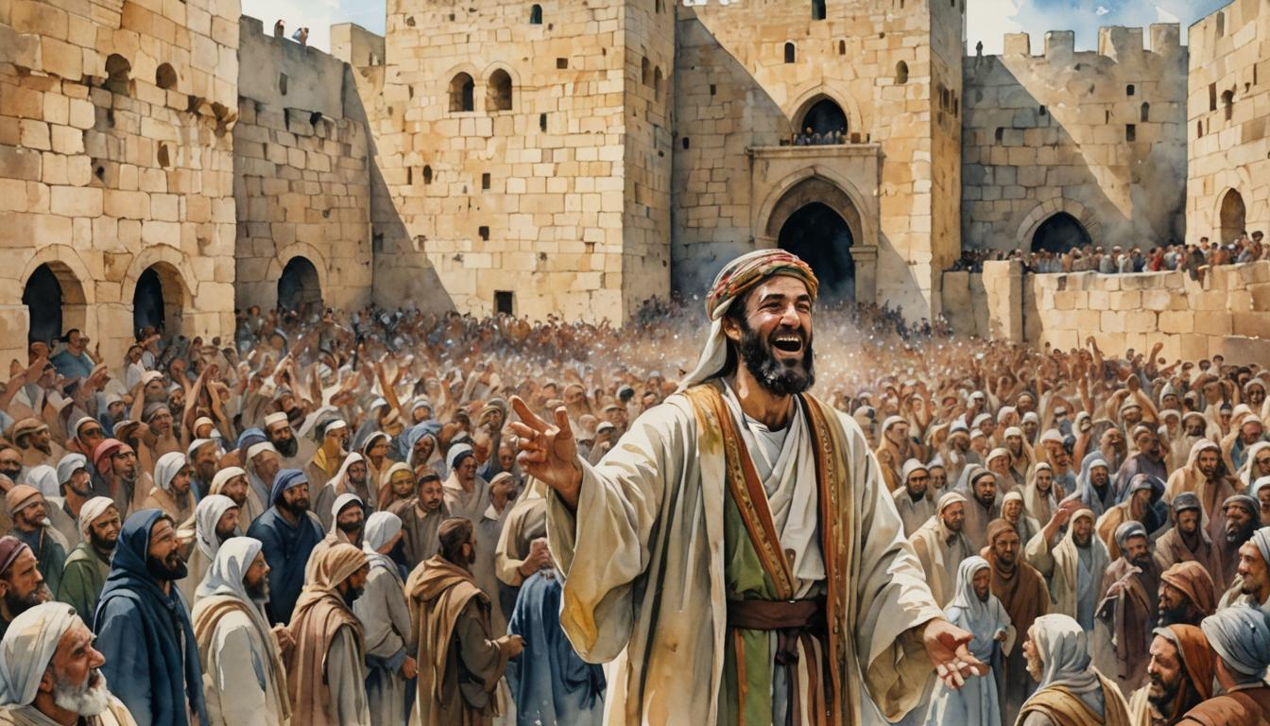
What made Nehemiah so successful?
His spiritual qualities
His strategic approach

Slide 9
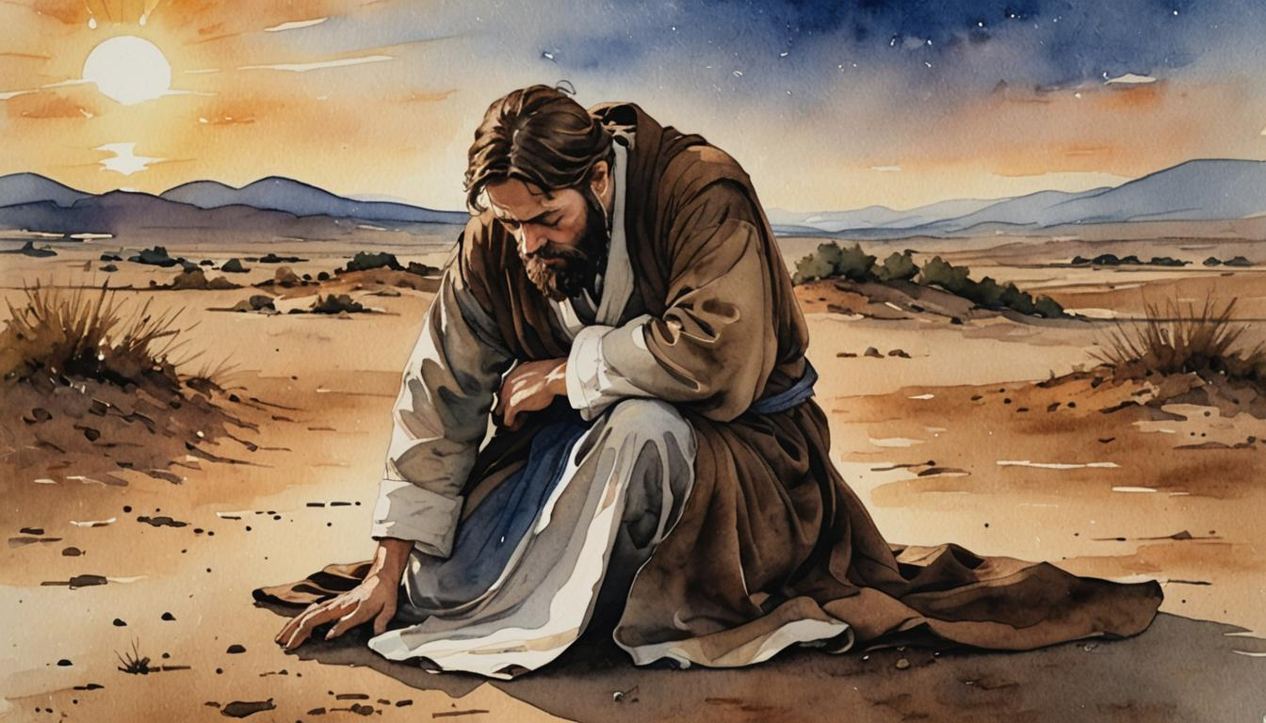

Slide 10

Phase #1 – PASSION
Phase #2 – INTERCESSION
Phase #3 – PROMOTION
Phase #4 – MOBILIZATION
Phase #5 – FORTIFICATION
Phase #6 – MEDIATION
Phase #7 – PROTECTION
Phase #8 -- COMPLETION
The
Success
Process

Slide 11
SECURITY:
Guarding the Future
through Godly Leaders
(6:17-7:3)

Slide 12
SECURITY:
There were still enemies
so they had to stay on guard.
Precautions needed to be made
To guard Jerusalem.

Slide 13
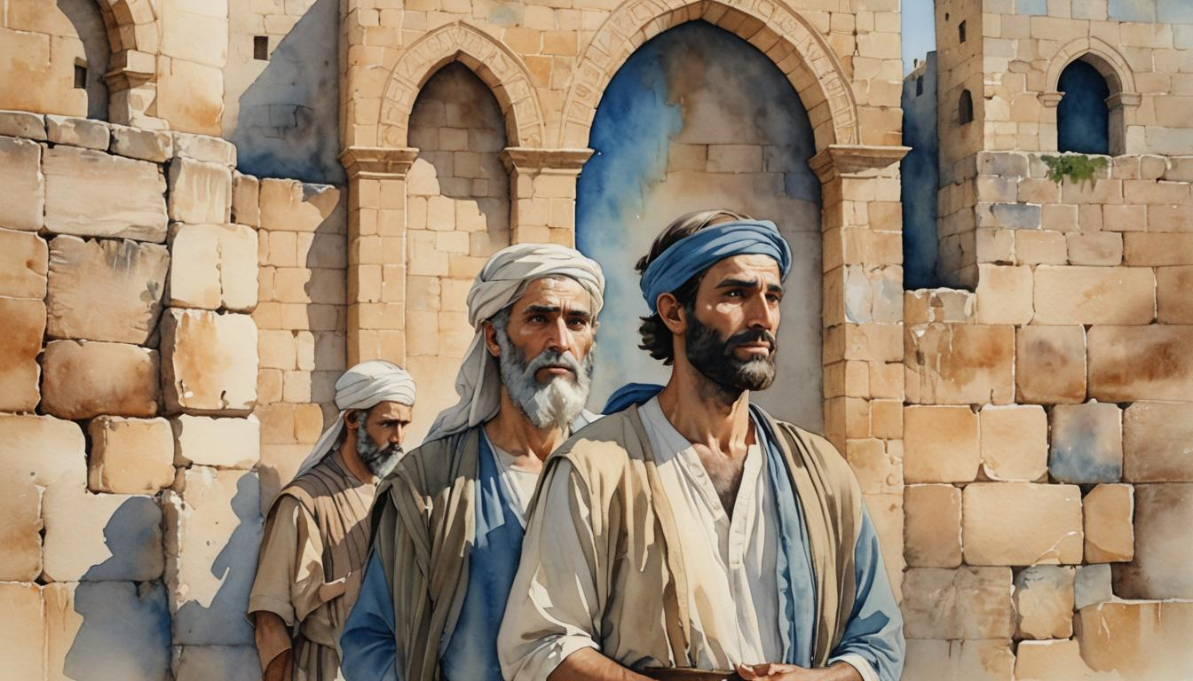

Nehemiah guarded the victory with
spiritual leaders and strategic policies.

Slide 14
SIGNIFICANCE:
Capitalizing the Victory
for God’s People
(7:4-73)

Slide 15
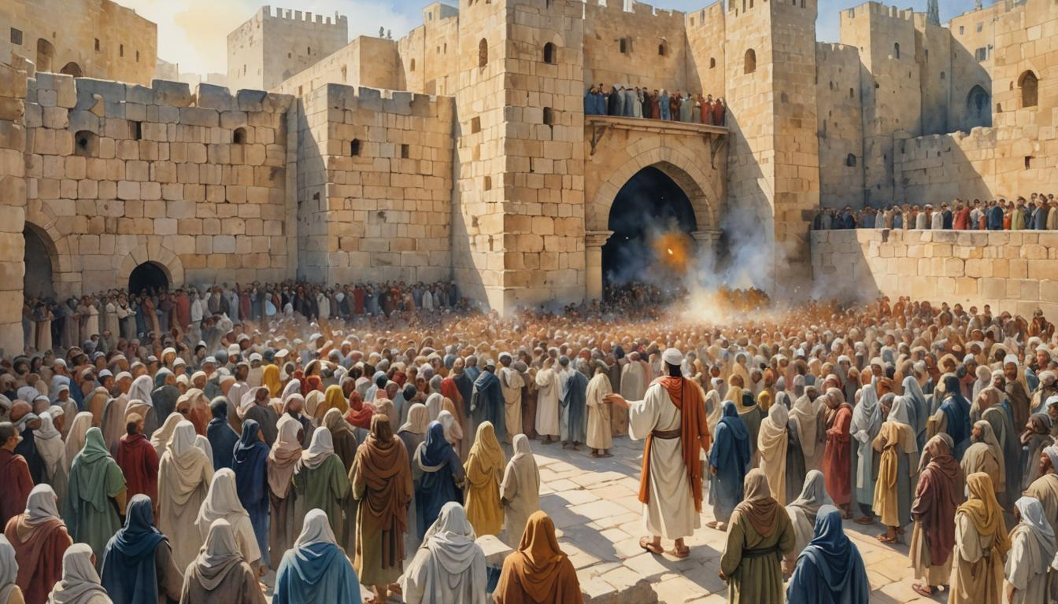
People are important.
This project was for the people.

Slide 16
“This work was
done by our God.”
Nehemiah 6:16

Slide 17
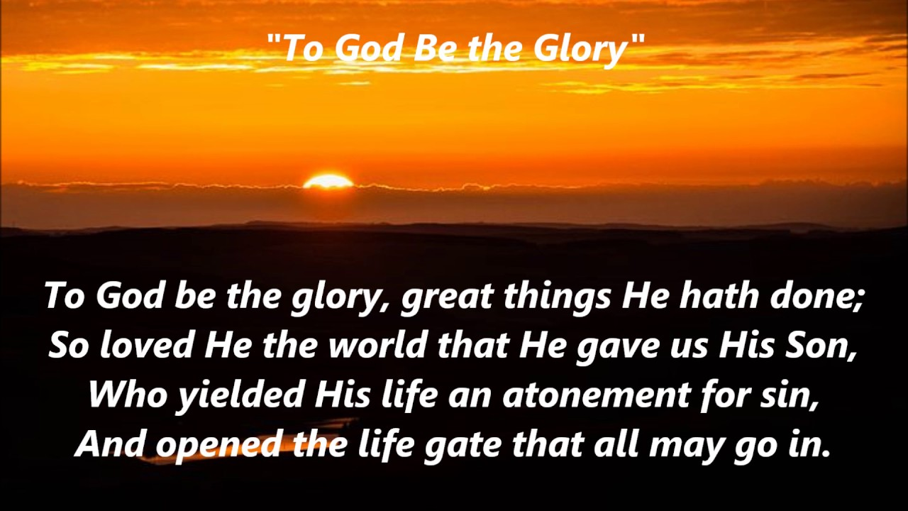

Slide 18


