Slide 1
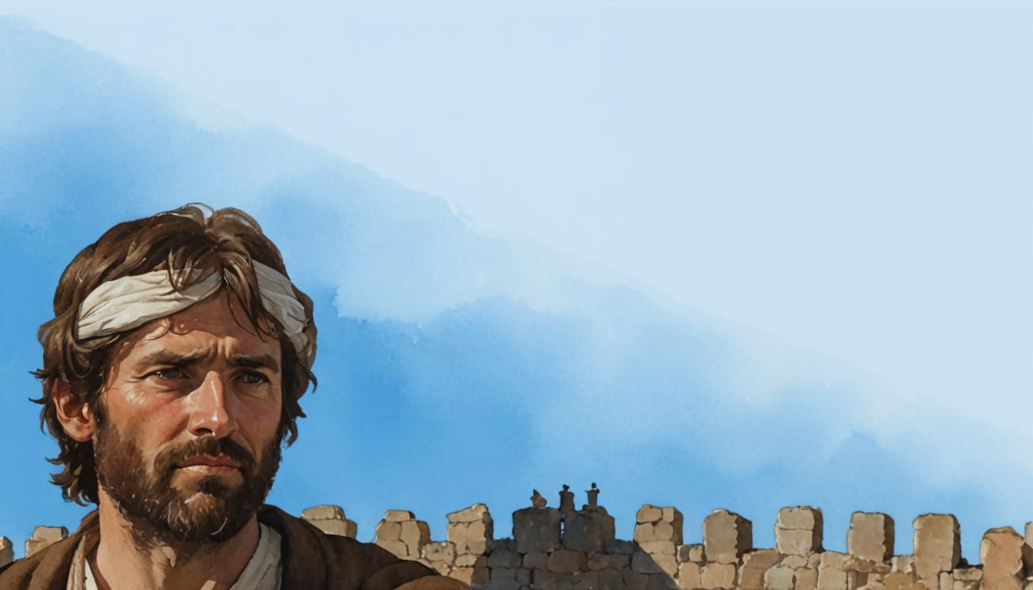

The Nehemiah Model Of Successful Leadership
Leading a Great Endeavor
A Guide to Strategic Action
Nehemiah 1-7

Slide 2


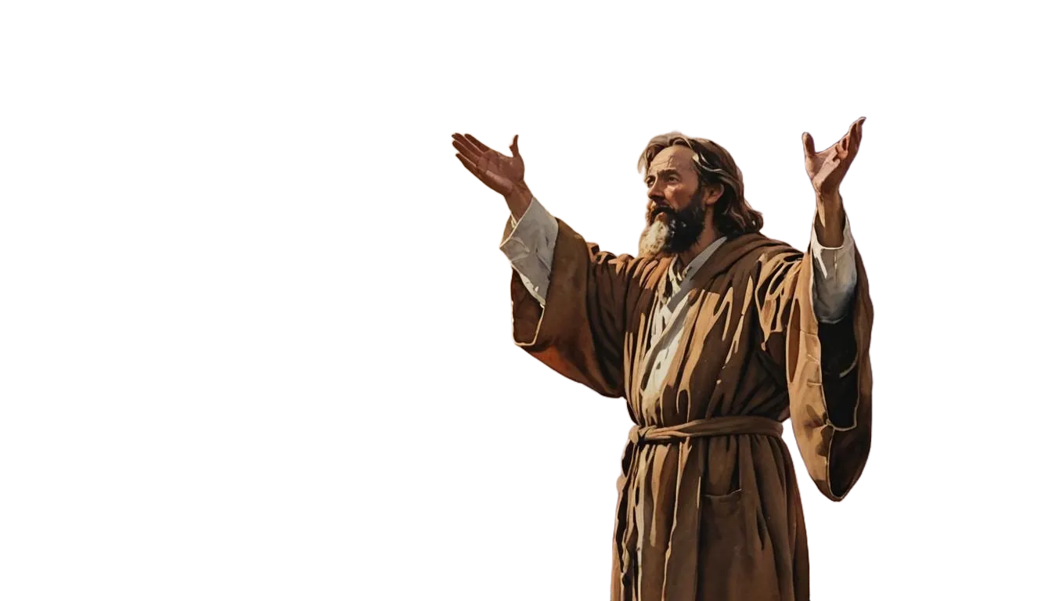
Phase # 7
How to Practice
Godly Self Defense
Nehemiah 6:1-14

Slide 3
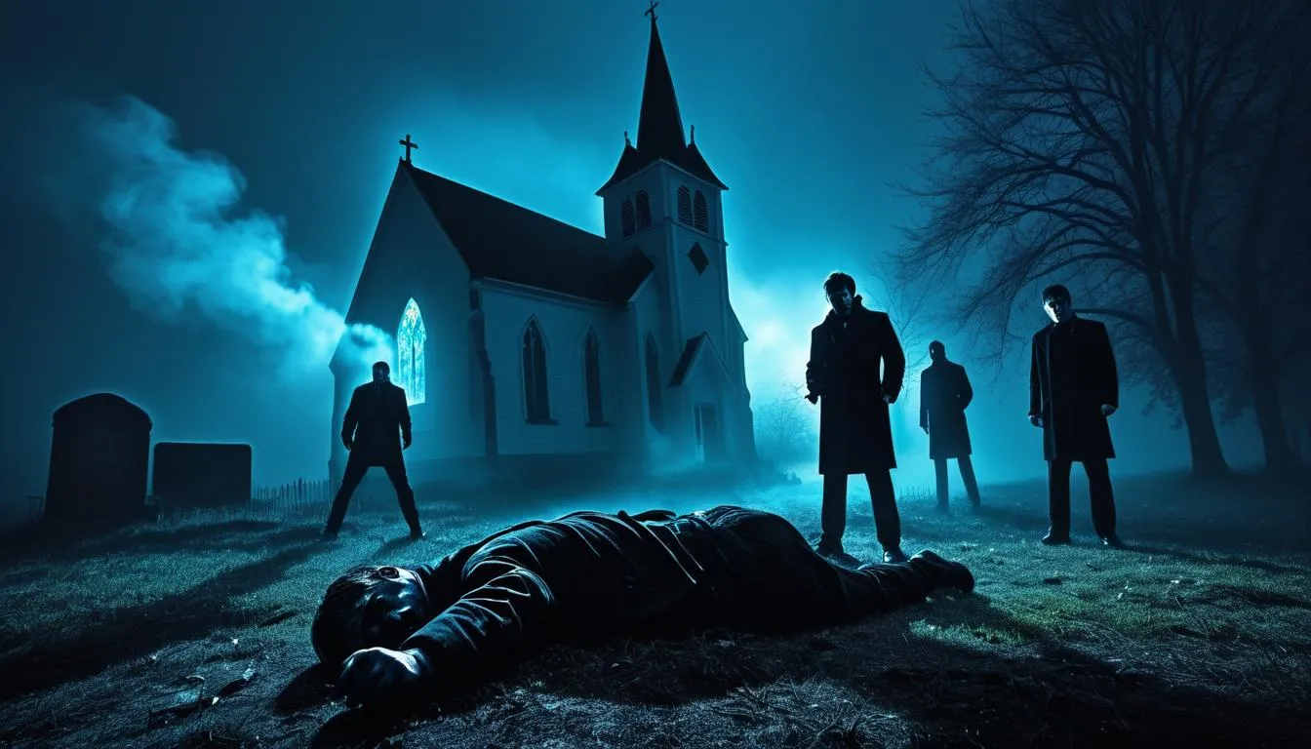

Slide 4
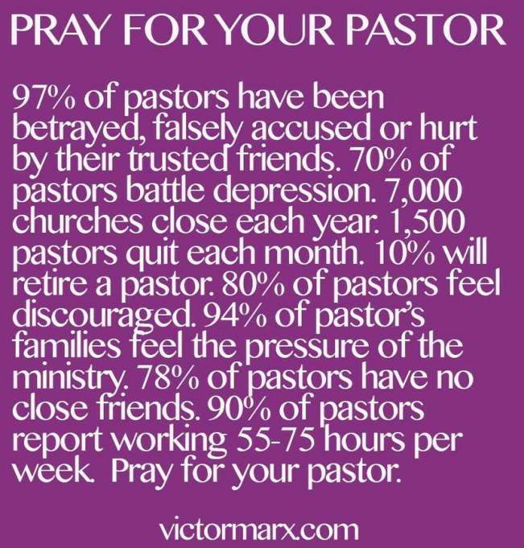
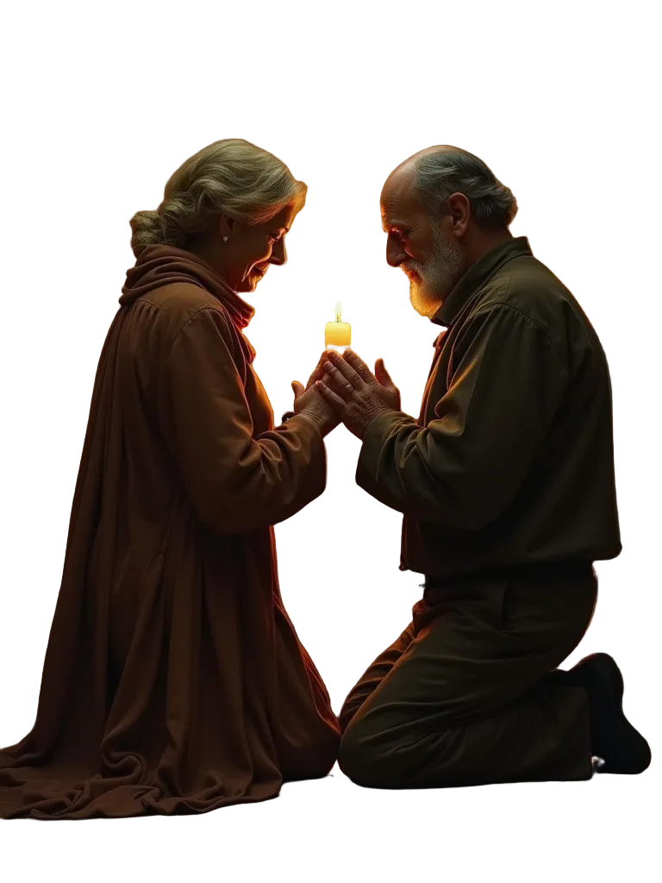

Slide 5
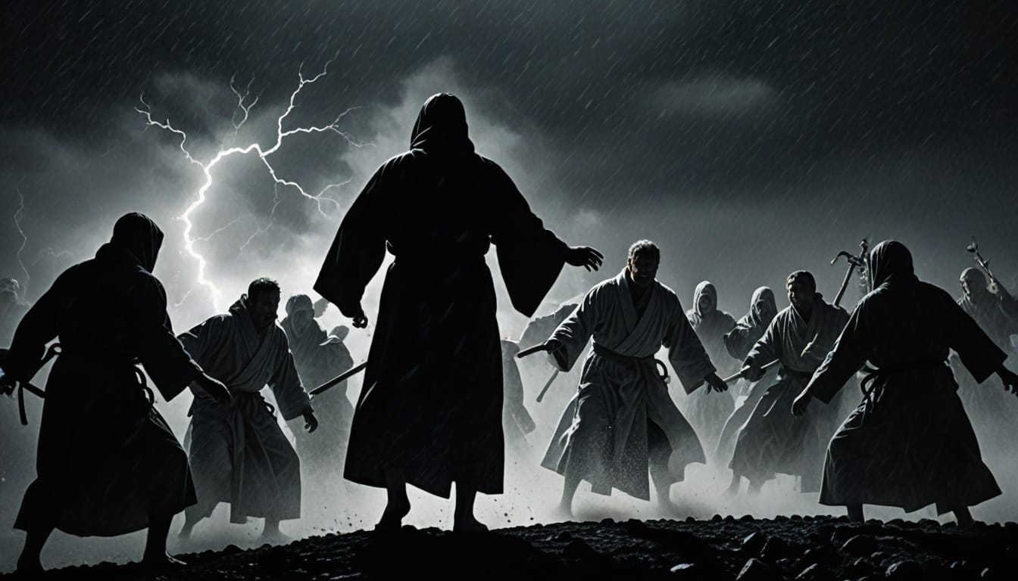
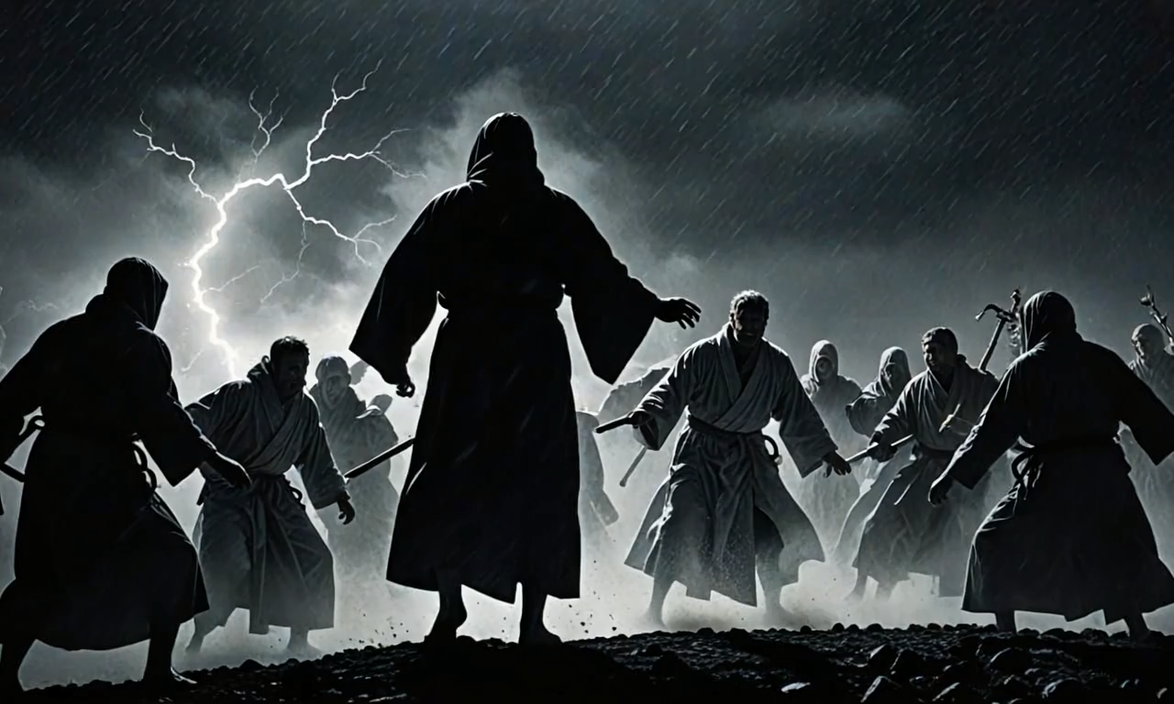
Phase # 7
How to Practice
Godly Self Defense
Nehemiah 6:1-14

Slide 6

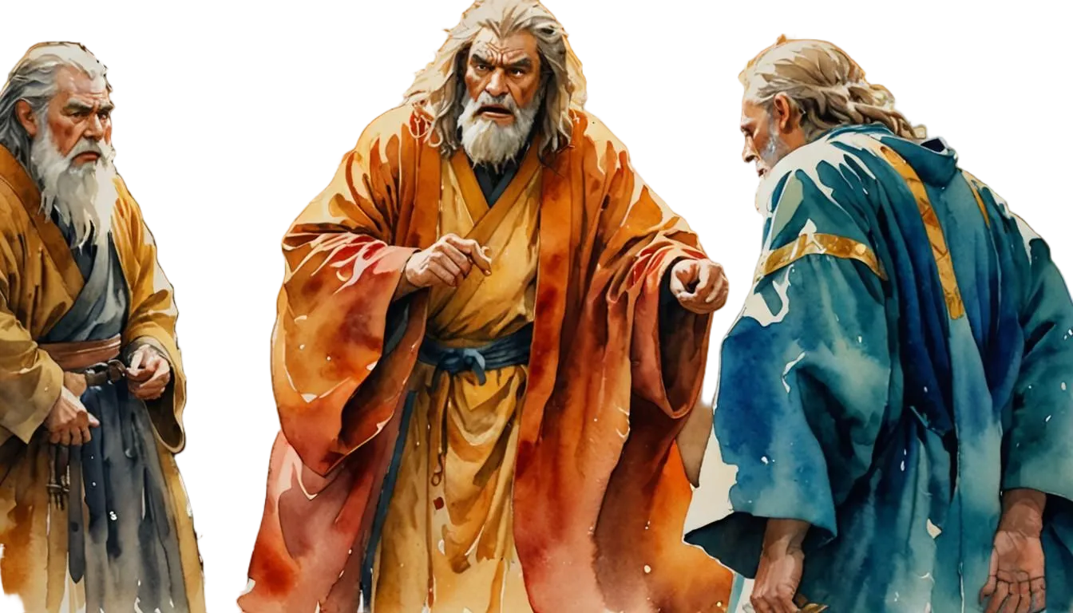
The Enemy’s Strategy is to Destroy the Leader (6:1-4)
The Appeal (2)
The Response (3-4)

Slide 7
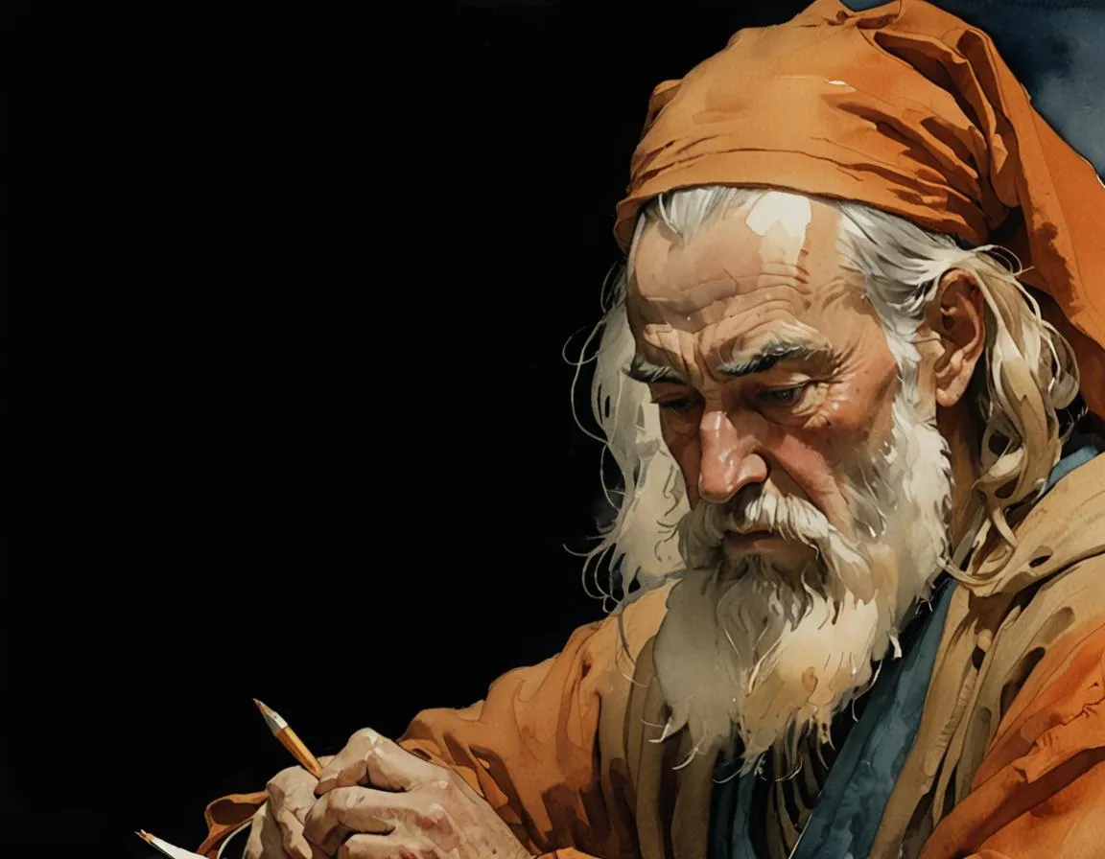
The Enemy’s Strategy is to Discourage the Leader (6:5-9)
The Appeal (5-7)
The Response (8-9)

Slide 8
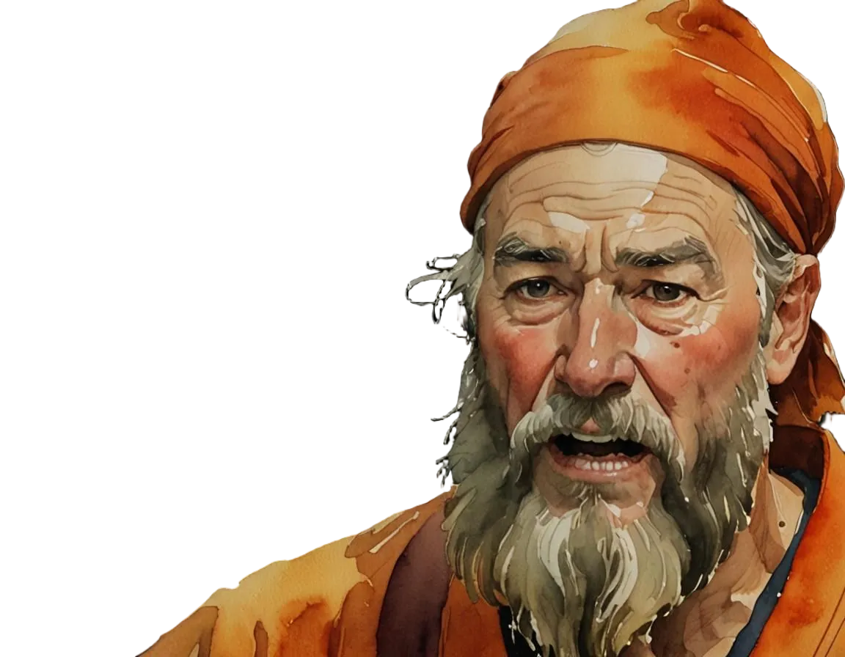
The Enemy’s Strategy is to Discredit the Leader
(6:10-14)
The Appeal (10)
The Response (11-14)

Slide 9
Nehemiah Stood Firm
During Attack 1, Nehemiah stood firm
because he knew this was God’s task.
During Attack 2, Nehemiah stood firm
because he knew he had God’s strength.
During Attack 3, Nehemiah stood firm
because he knew this was God’s battle.

Slide 10
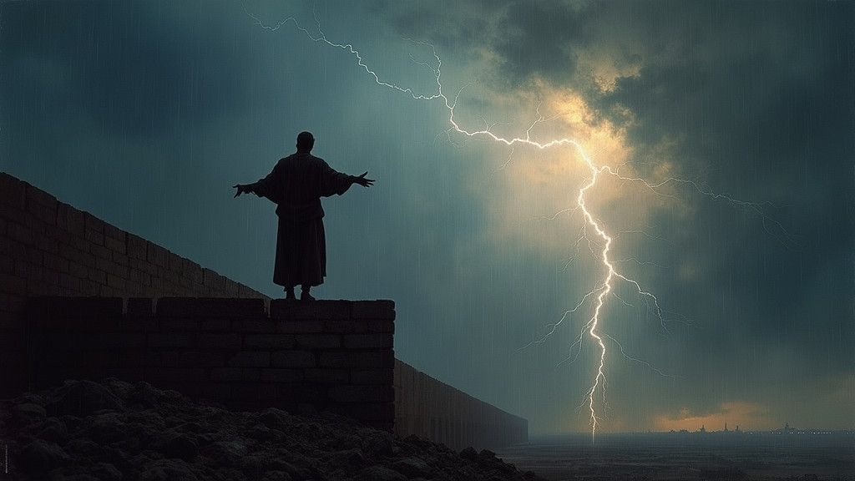
1 Corinthians 16:13
Be watchful, stand firm in the faith, act like men, be strong.

Slide 11


APPLICATION QUESTIONS
You can do these by yourself, but it would be better to discuss them with others.

