Slide 1


The Nehemiah Model Of Successful Leadership
Leading a Great Endeavor
A Guide to Strategic Action
Nehemiah 1-7

Slide 2


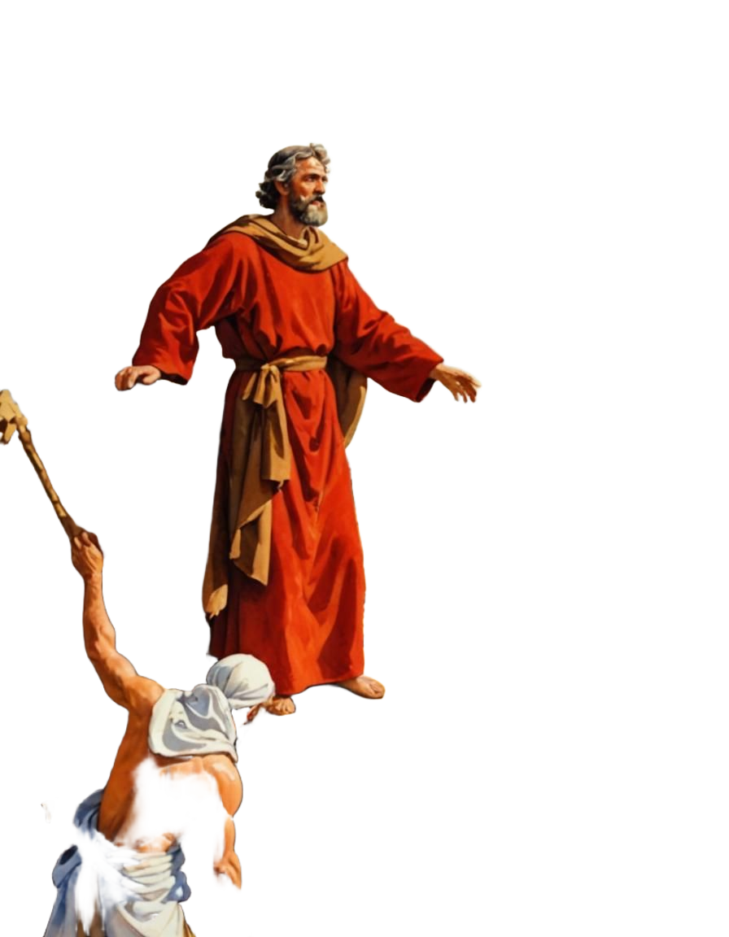
Phase # 5
How to Withstand and
Counter Opposition
Neh. 4
The 8 Phases of Strategic Action

Slide 3



Slide 4

How to Proceed When You Are Threatened by Attacks

Slide 5
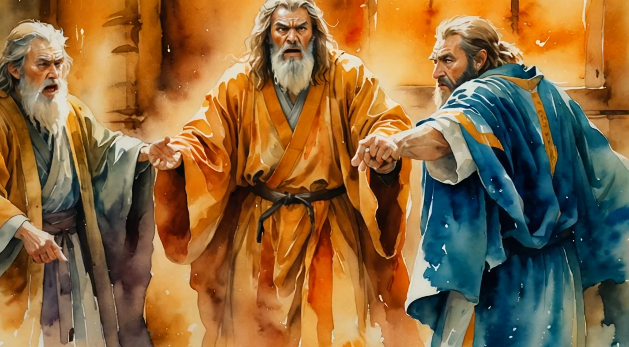
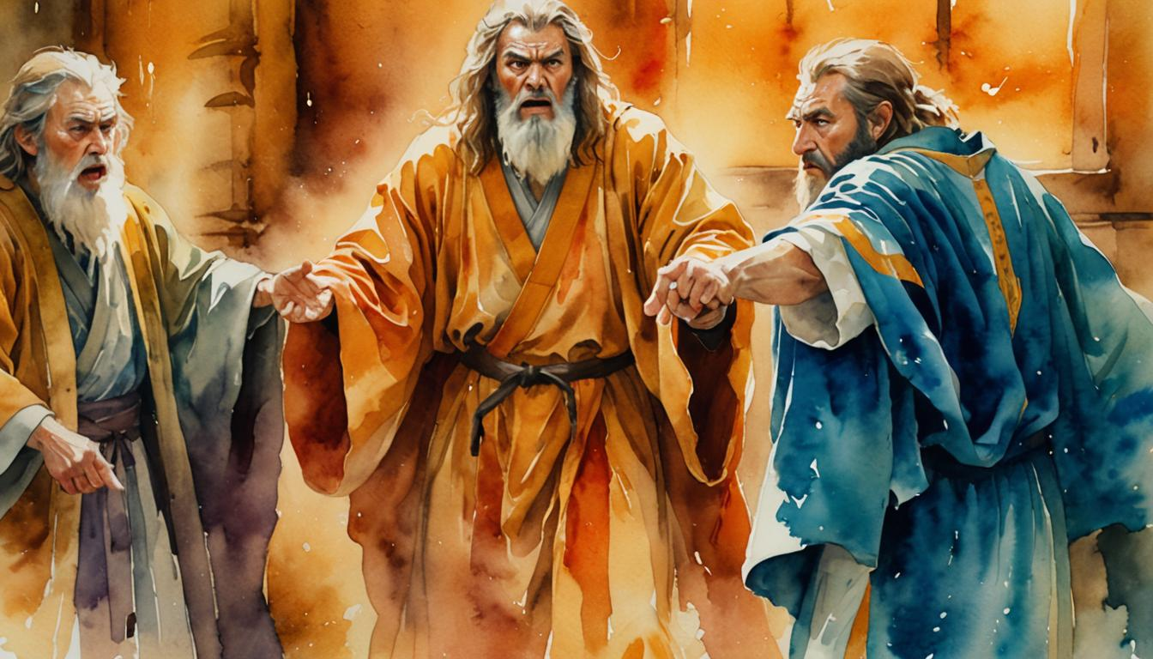
Sanballet,
Tobiah, &
Geshem

Slide 6
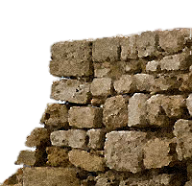
I. The First Attack Phase
A. The Attack: Spirit-Breaking Remarks
B. The Defense:
1. Prayer
2. Action

Slide 7
I. The First Attack Phase
A. The Attack: Spirit-Breaking Remarks
B. The Defense:
1. Prayer
2. Action

Slide 8
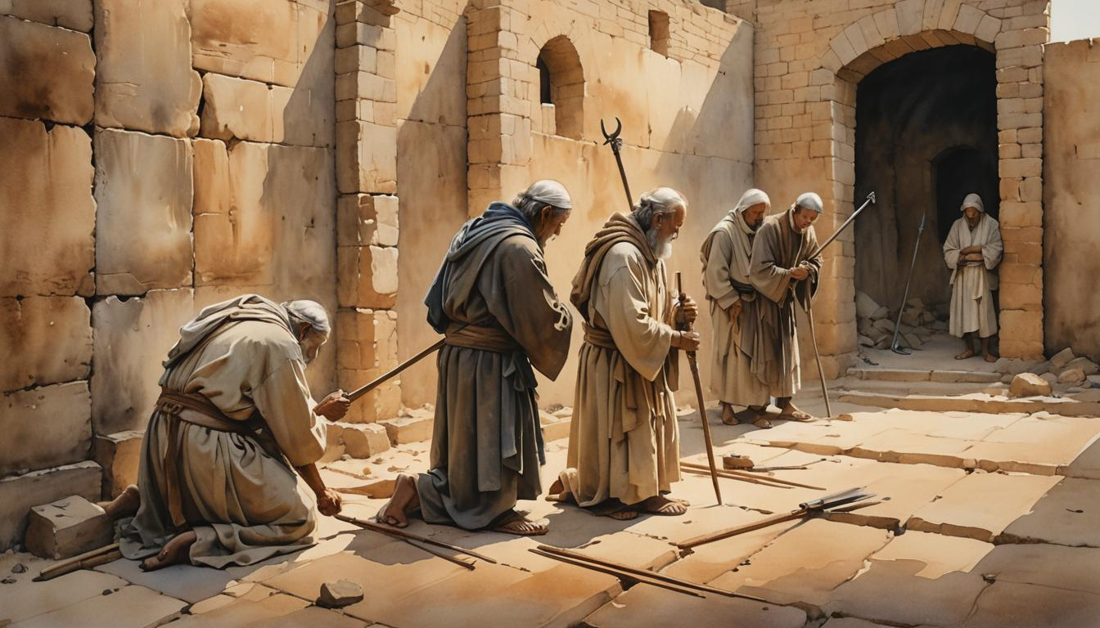
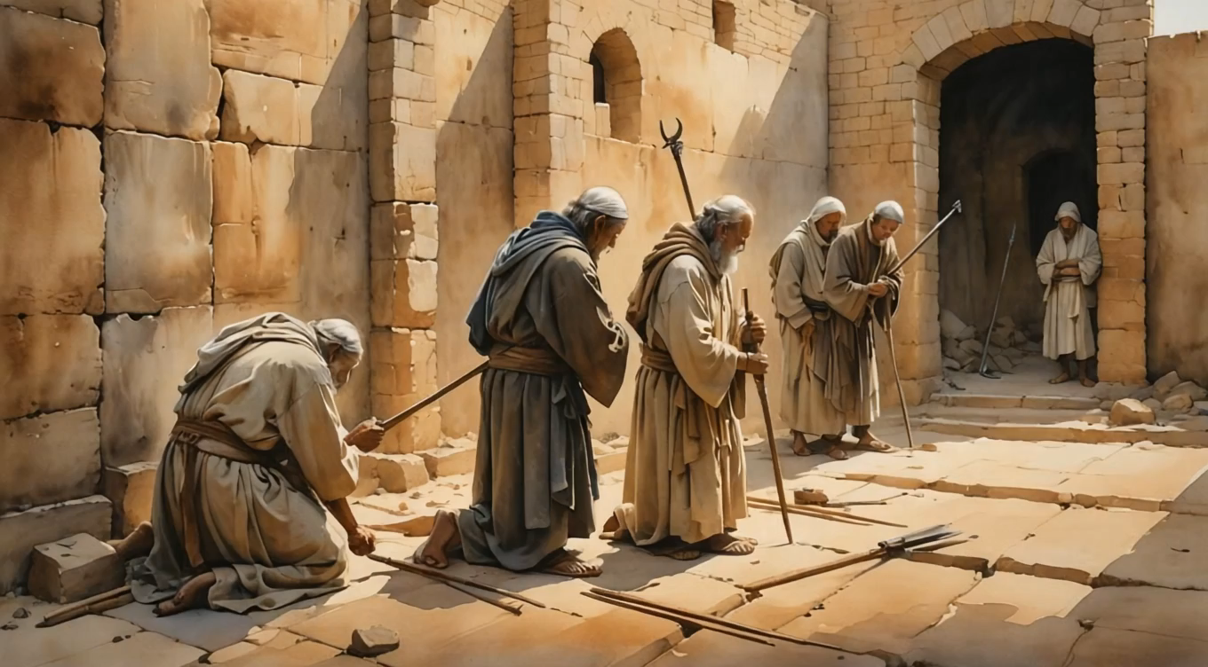

Slide 9
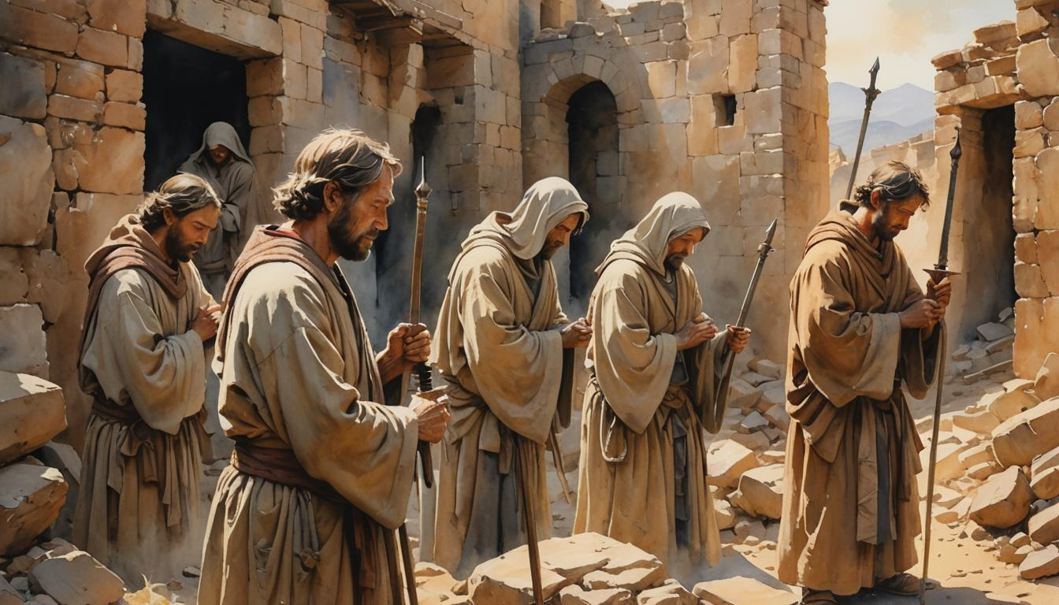
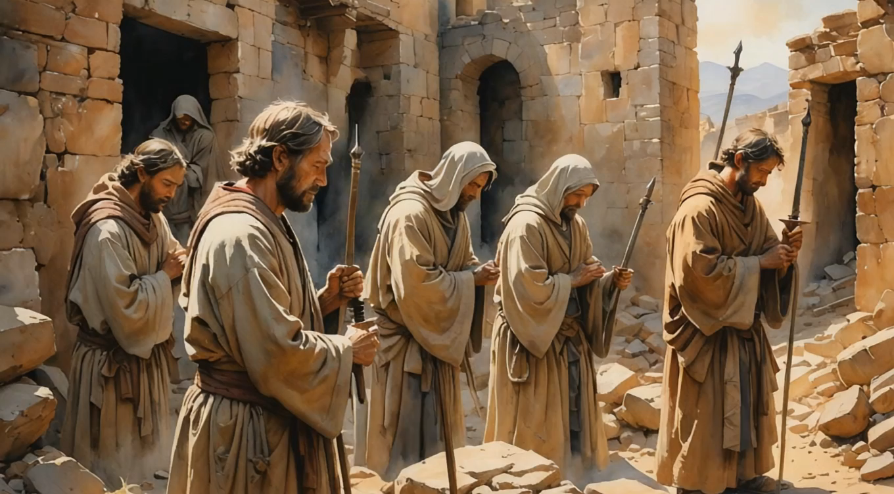

Slide 10
II. The Second Attack Phase
A. The Attack: Fear Producing Threats
B. The Defense:
1. Prayer
2. Action

Slide 11
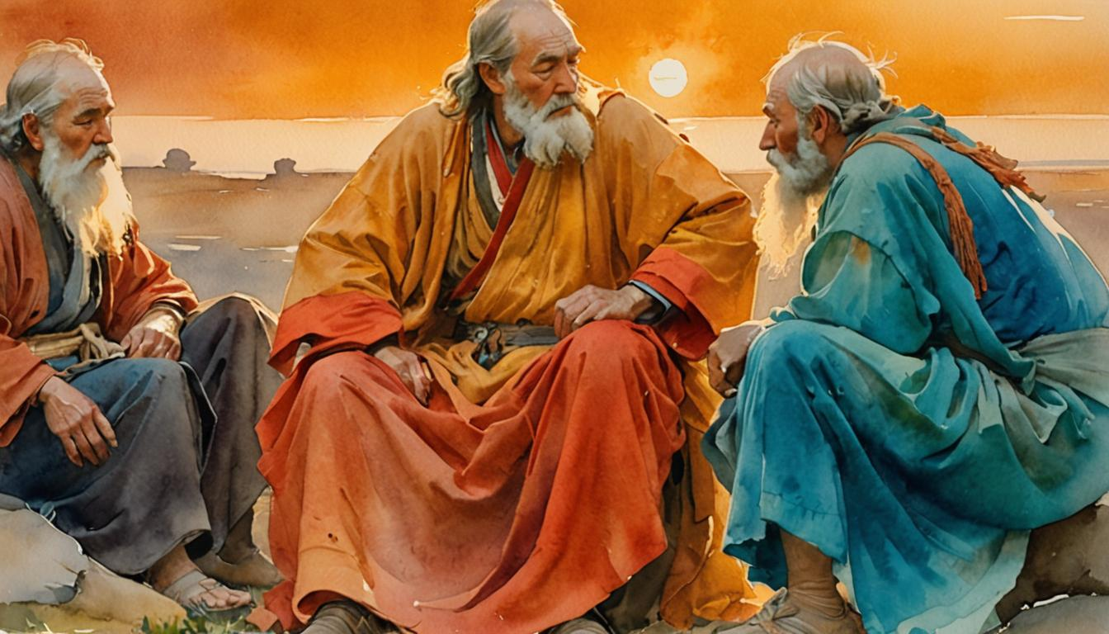
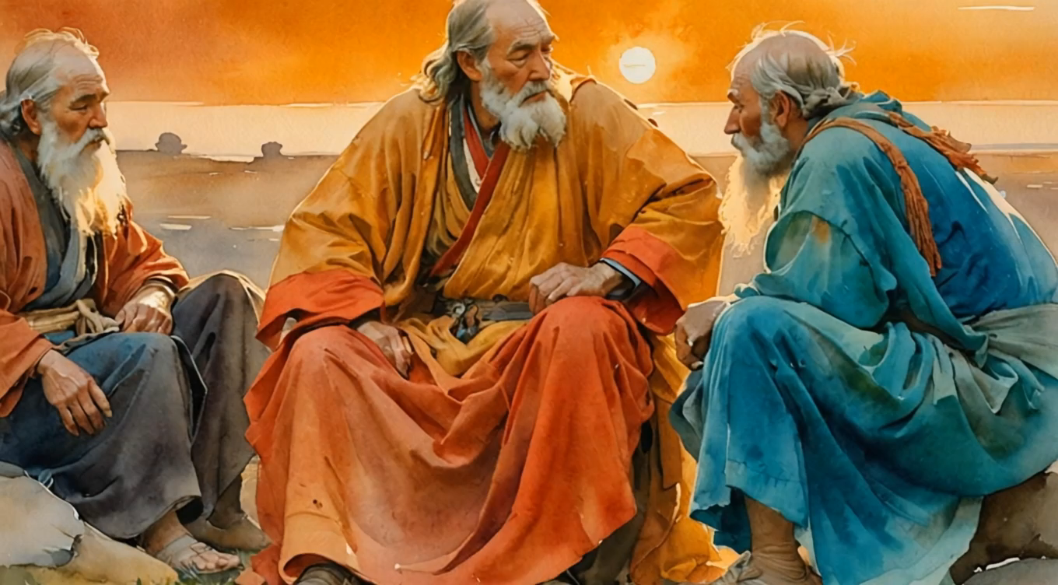

Slide 12
II. The Second Attack Phase
A. The Attack: Fear Producing Threats
B. The Defense:
1. Prayer
2. Action

Slide 13
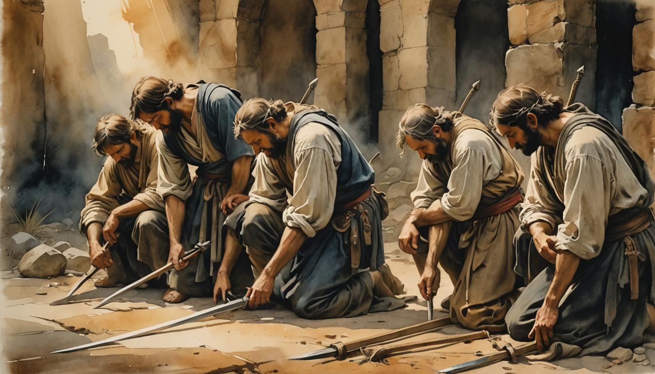
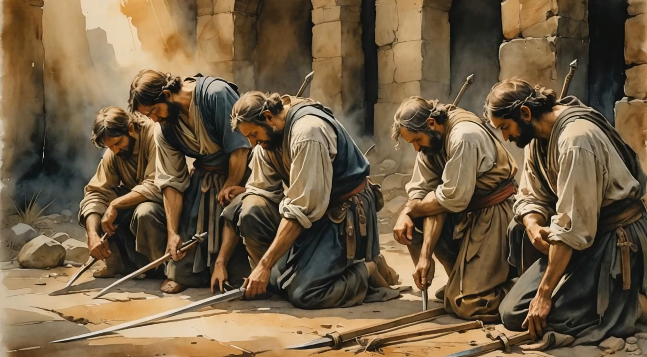

Slide 14
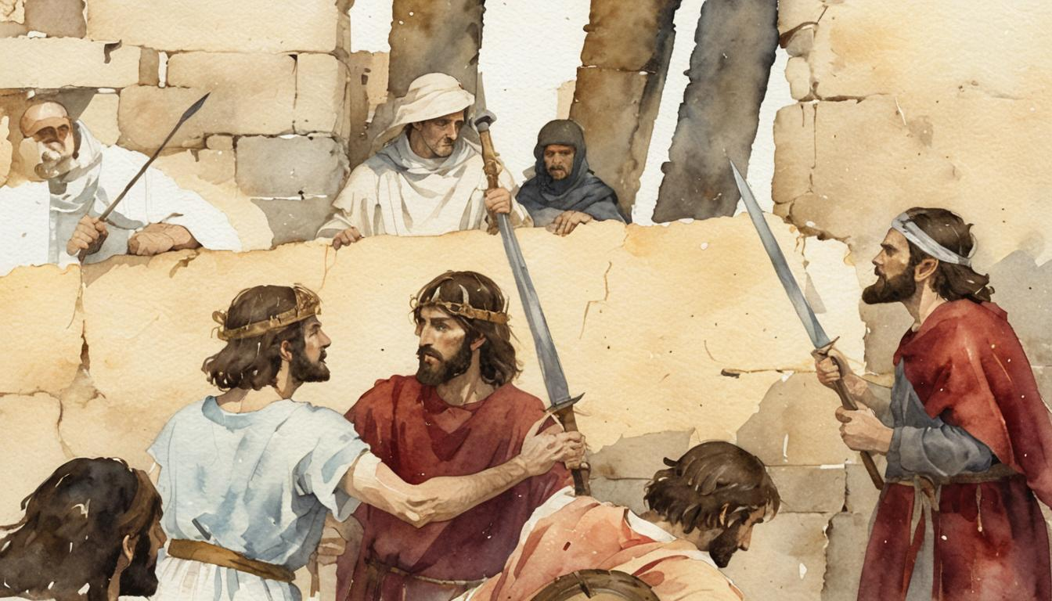
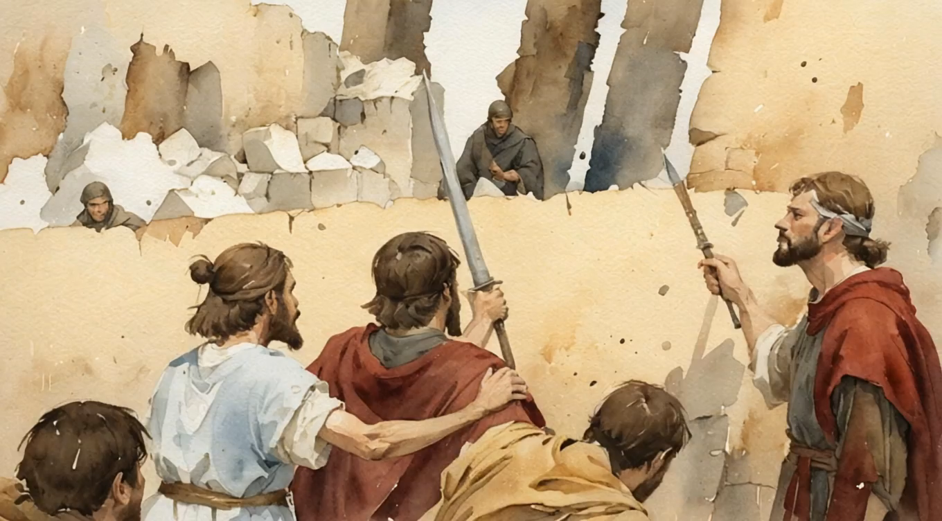
Verses10-23

Slide 15
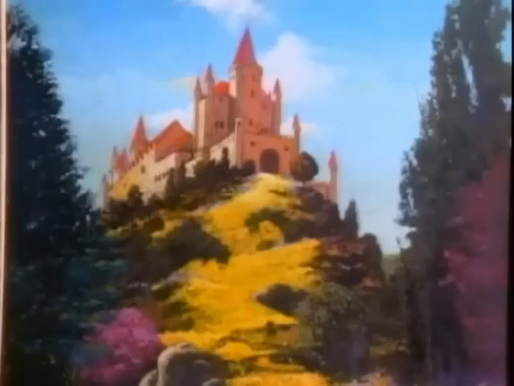
This is no time for fear
This is the time for faith and determination
Don't lose the vision here carried away by the motion
Hold on to all that you hide in your heart
There is one thing that has always been true
It holds the world together
God is in control
We believe that His children will not be forsaken
God is in control
We will choose to remember and never be shaken
There is no power above or beside Him, we know
Oh, God is in control, oh God is in control
Oh God is in control
Oh God is in control
Twila Paris

Slide 16
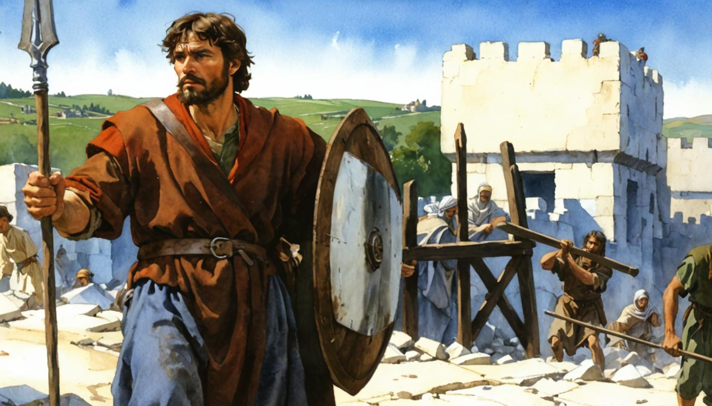
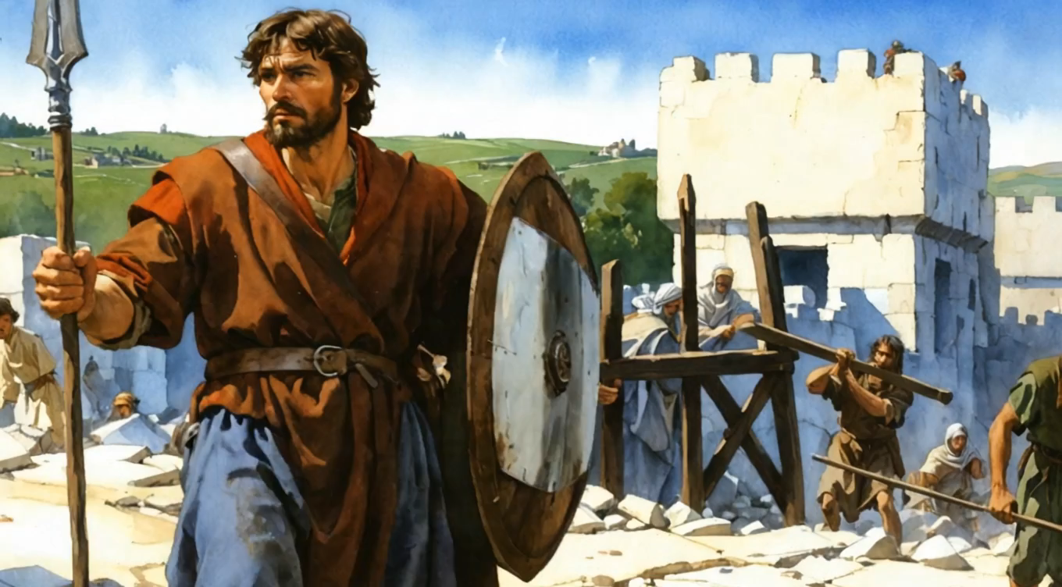
We are God’s workers!
We are God’s Warriors!

Slide 17


Slide 18




APPLICATION QUESTIONS
APPLICATION QUESTIONS
Please find others you can discuss these questions with.

