Slide 1

The Nehemiah Model Of Successful Leadership
Leading a Great Endeavor
A Guide to Strategic Action
Nehemiah 1-7

Slide 2


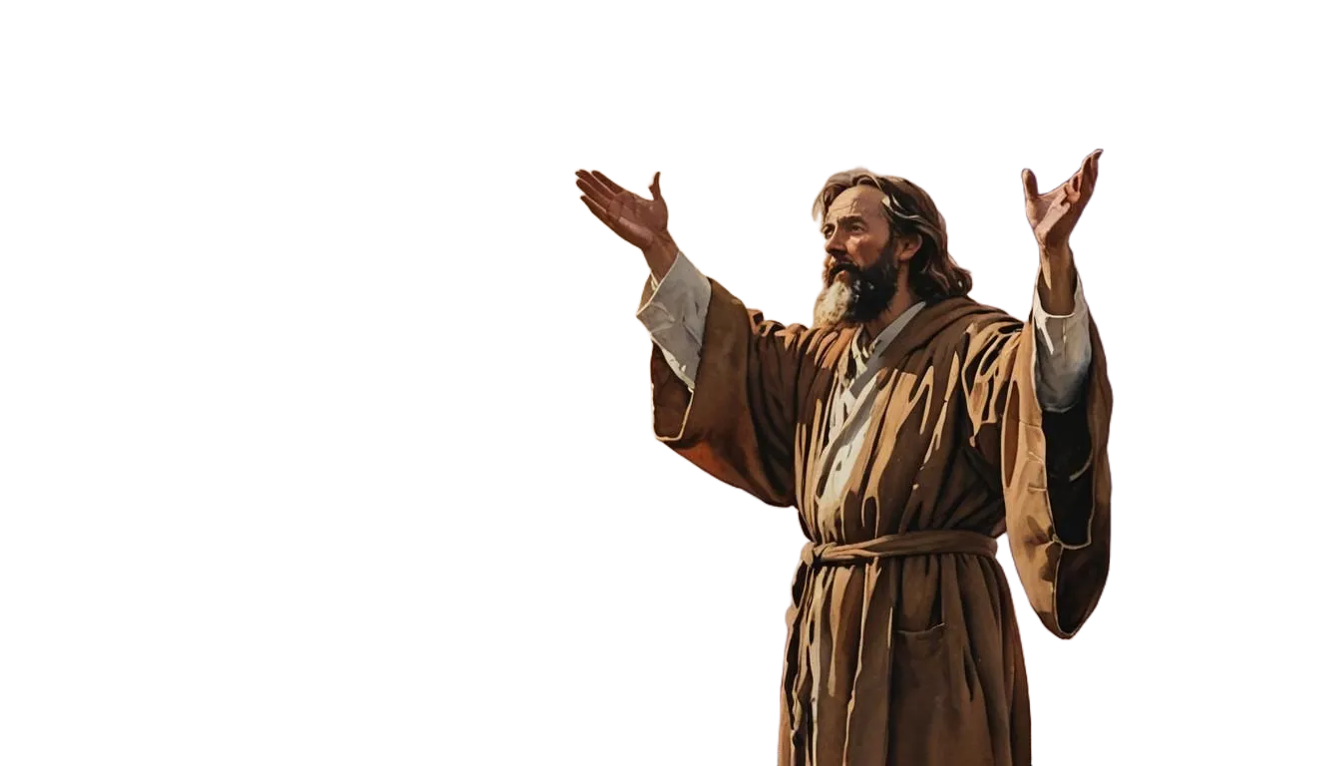
Phase # 4
How to Mobilize People
for Maximum Productivity
Nehemiah 3

Slide 3
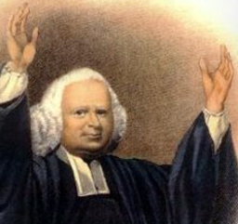
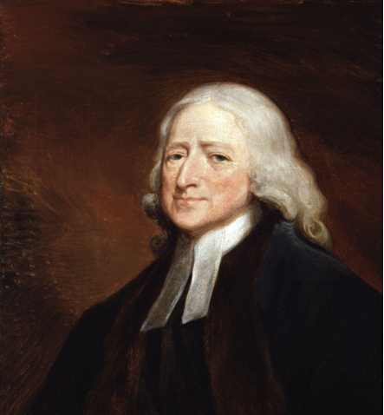
George Whitefield and John Wesley

Slide 4

The Success Process
Phase #4 – MOBILIZATION
For maximum productivity, organize your project into achievable tasks and mobilize your workers into effective teams.

Slide 5

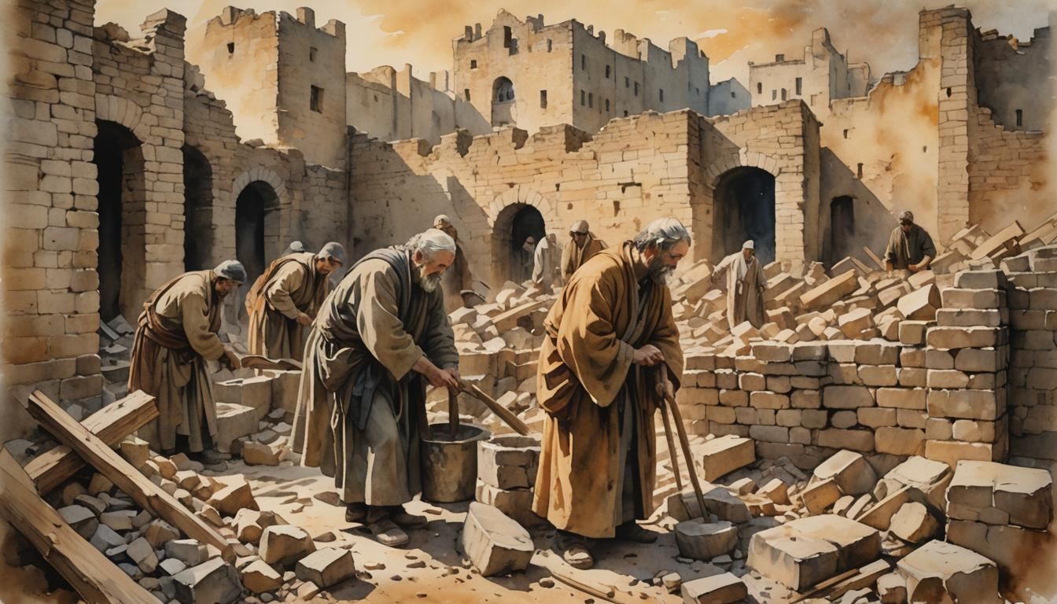
I. Organize the Project into Achievable Tasks
A. The Tasks should be Divided

Slide 6
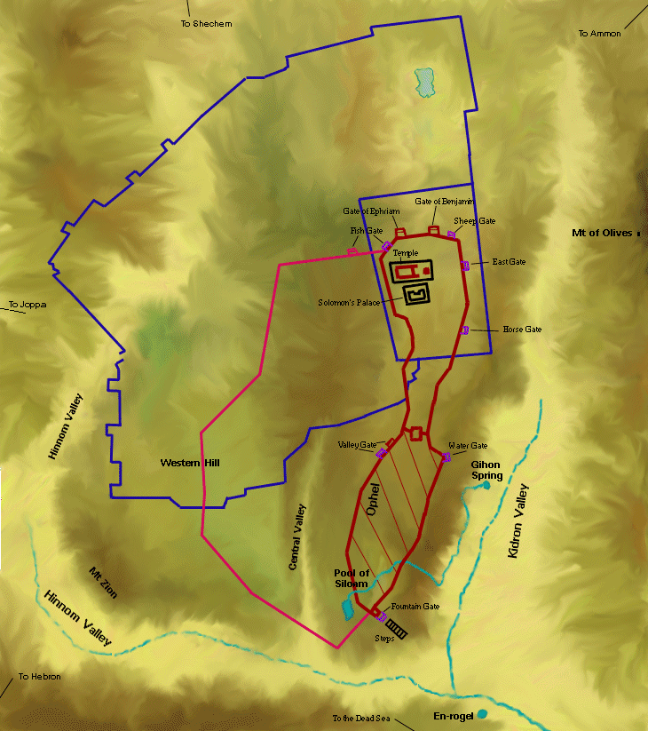
Tower of Hananel
Tower of 100
Sheep Gate
Walls
and
Gates
(Neh 3)
Fish Gate
Inspection Gate
Jeshanah (Old Gate?)
East Gate
Horse Gate
Broad Wall
Wall of Ophel
Tower of the Ovens?
Great Projecting Tower
Valley Gate
Water Gate
The Angle
Dung Gate
Pool of Shelah (Siloam)
Fountain Gate

Slide 7
Neh 3 ¹ Then Eliashib the high priest rose up with his brothers the priests, and they built the Sheep Gate. They consecrated it and set its doors. They consecrated it as far as the Tower of the Hundred, as far as the Tower of Hananel. ² And next to him the men of Jericho built. And next to them Zaccur the son of Imri built.
³ The sons of Hassenaah built the Fish Gate. They laid its beams and set its doors, its bolts, and its bars. ⁴ And next to them Meremoth the son of Uriah, son of Hakkoz repaired. And next to them Meshullam the son of Berechiah, son of Meshezabel repaired. And next to them Zadok the son of Baana repaired. ⁵ And next to them the Tekoites repaired, but their nobles would not stoop to serve their Lord.

Slide 8

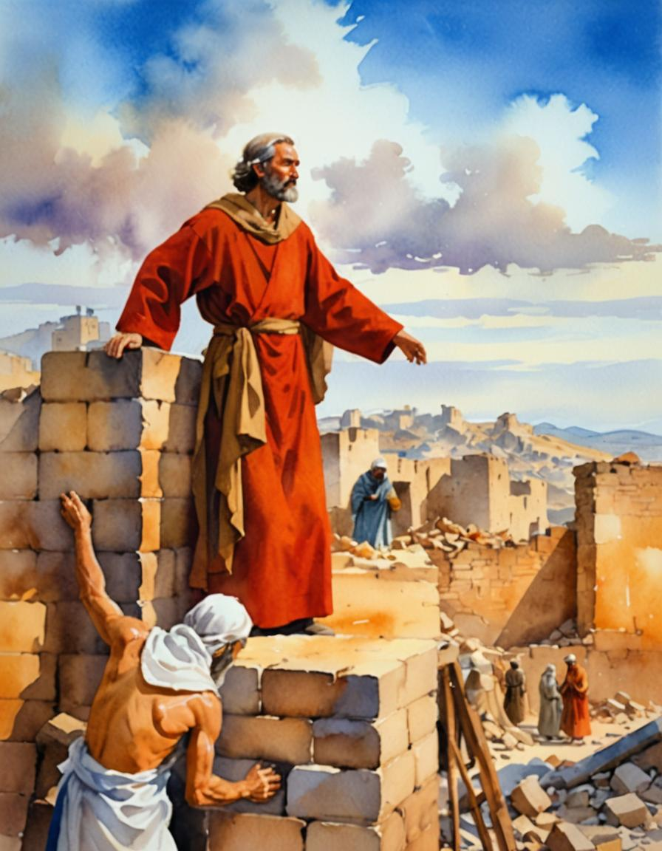
Mobilization
Ministry can be an all-out, cooperative effort done by organized teams.
But that is often difficult to achieve. How did Nehemiah do it?

Slide 9
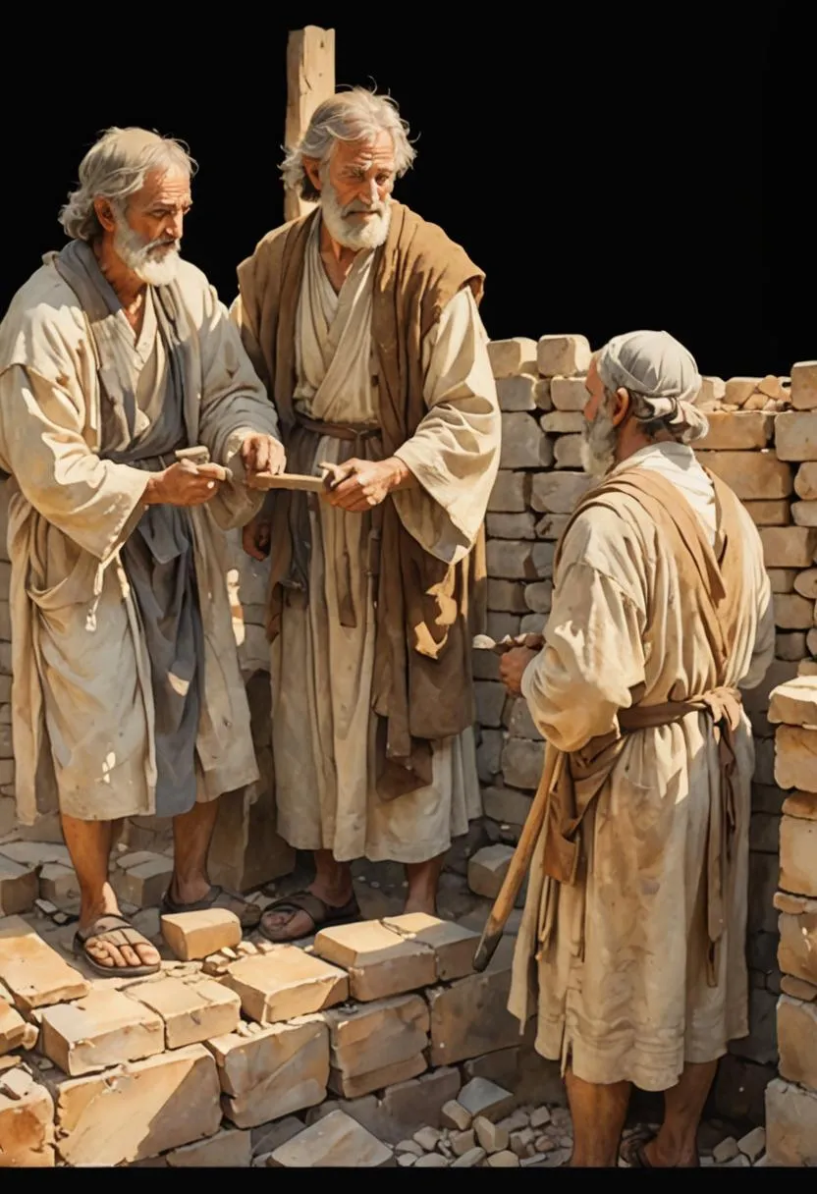
I. Organize the Project into Achievable Tasks

Slide 10
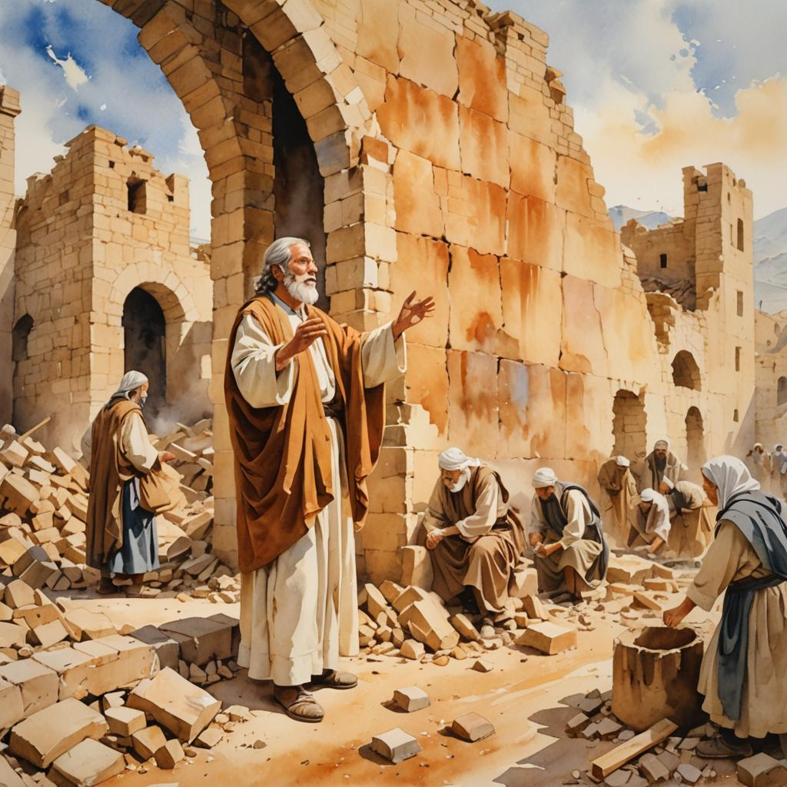
I. Organize the Project into Achievable Tasks
A. The Tasks should be Divided

Slide 11
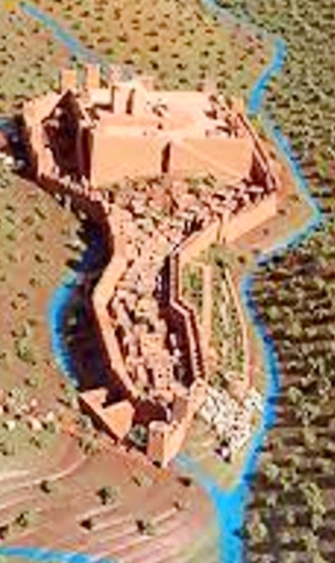
I. Organize the Project into Achievable Tasks
A. The Tasks should be Divided
B. The Tasks should be Defined

Slide 12
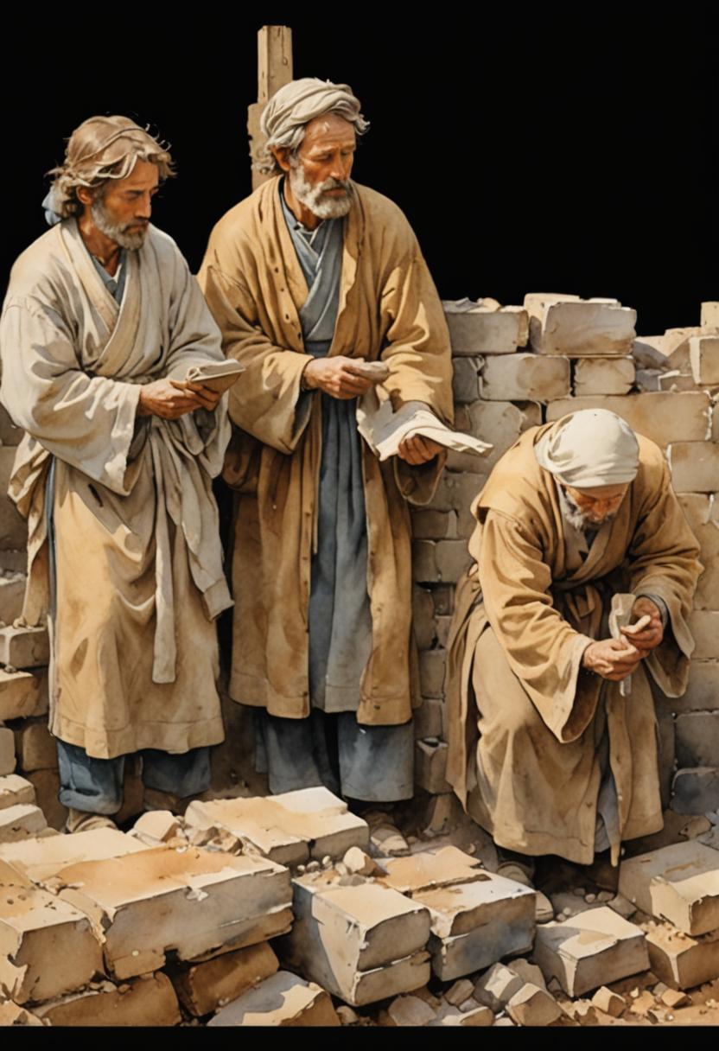
I. Organize the Project into Achievable Tasks
A. The Tasks should be Divided
B. The Tasks should be Defined
C. The Tasks should be Distributed

Slide 13
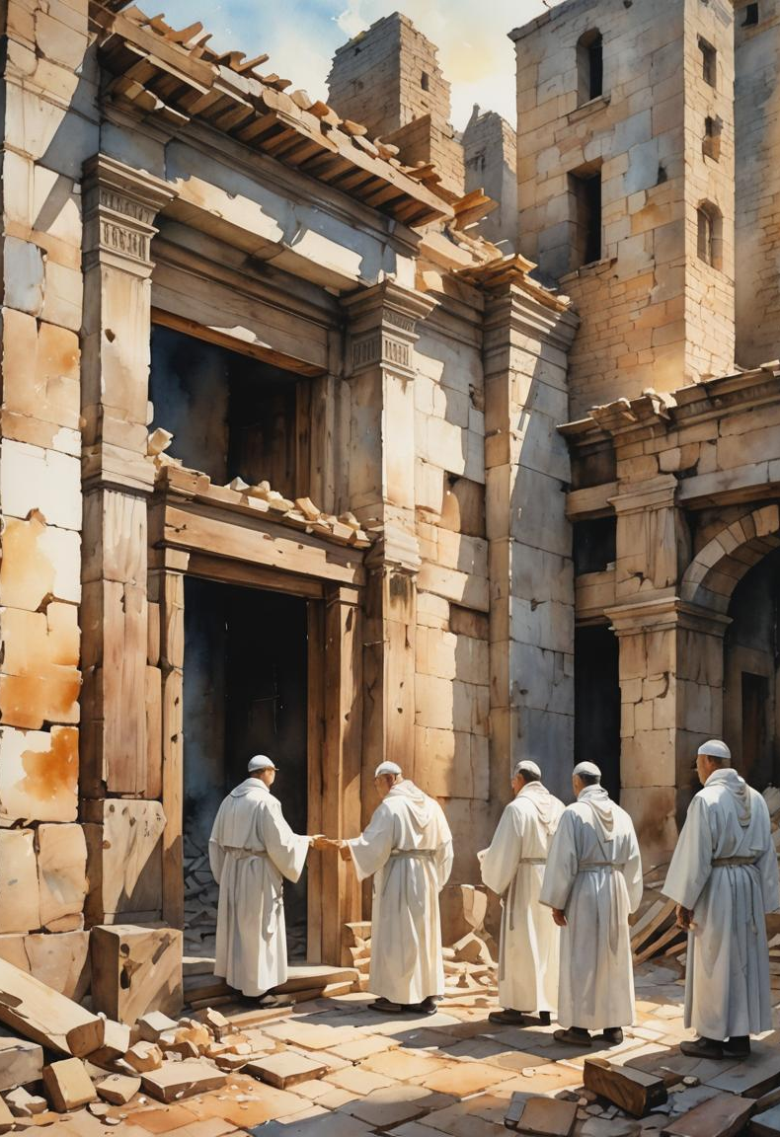
I. Organize the Project into Achievable Tasks
A. The Tasks should be Divided
B. The Tasks should be Defined
C. The Tasks should be Distributed
D. The Tasks should be Dedicated

Slide 14

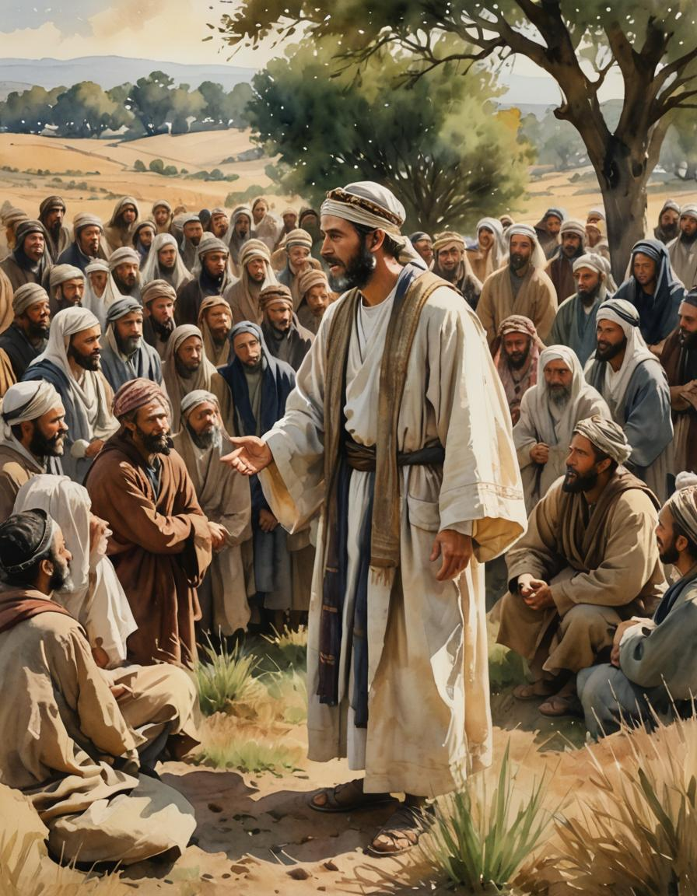
II. Mobilize the People into Manageable Task Forces

Slide 15
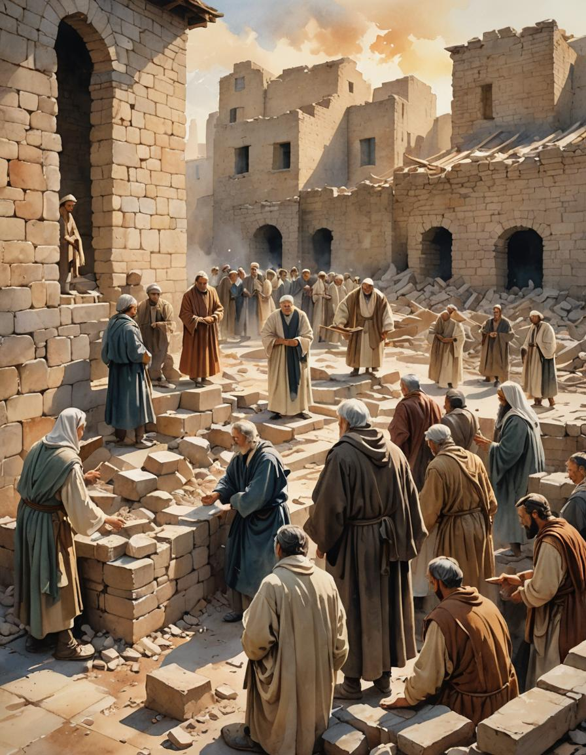
II. Mobilize the People into Manageable Task Forces
A. The Task Forces should be
Incentivized

Slide 16
II. Mobilize the People into Manageable Task Forces
A. The Task Forces should be
Incentivized
B. The Task Forces should be
Optimized

Slide 17
II. Mobilize the People into Manageable Task Forces
A. The Task Forces should be
Incentivized
B. The Task Forces should be
Optimized
C. The Task Forces should be Supervised

Slide 18
II. Mobilize the People into Manageable Task Forces
A. The Task Forces should be
Incentivized
B. The Task Forces should be
Optimized
C. The Task Forces should be Supervised
D. The Task Forces should be Recognized

Slide 19
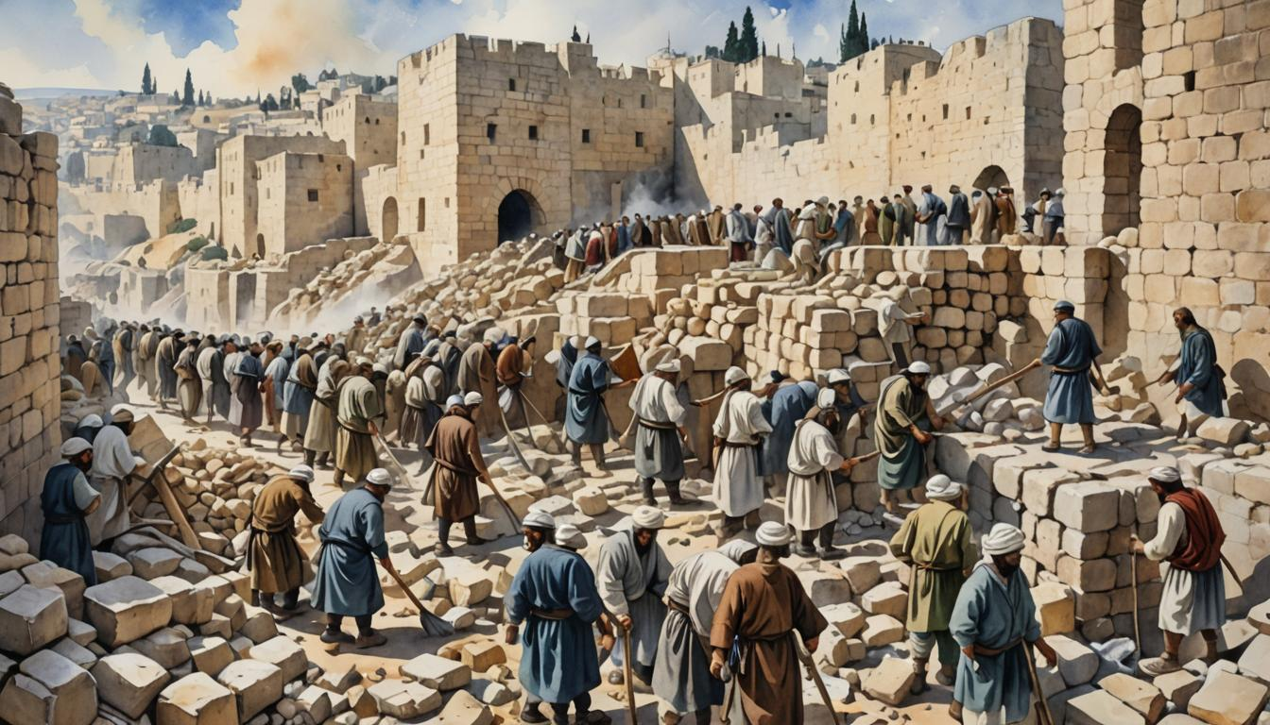
II. Mobilize the People into Manageable Task Forces
A. The Task Forces should be
Organized

Slide 20


APPLICATION QUESTIONS
You can do these by yourself, but it would be better to discuss them with others.

