Slide 1

The Nehemiah Model
Of Successful Leadership
"Give your servant success today..." Neh. 1:11
"The God of Heaven will give us success..." Neh. 2:20

Slide 2
The Nehemiah Model Of Successful Leadership
Leading a Great Endeavor
A Guide to Strategic Action
Nehemiah 1-7

Slide 3

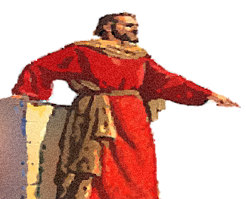
Phase # 3
PROMOTION
How to Raise Resources
and Recruit Partners
Neh. 2

Slide 4

How Raise Resources
Nehemiah 2:1-10

Slide 5
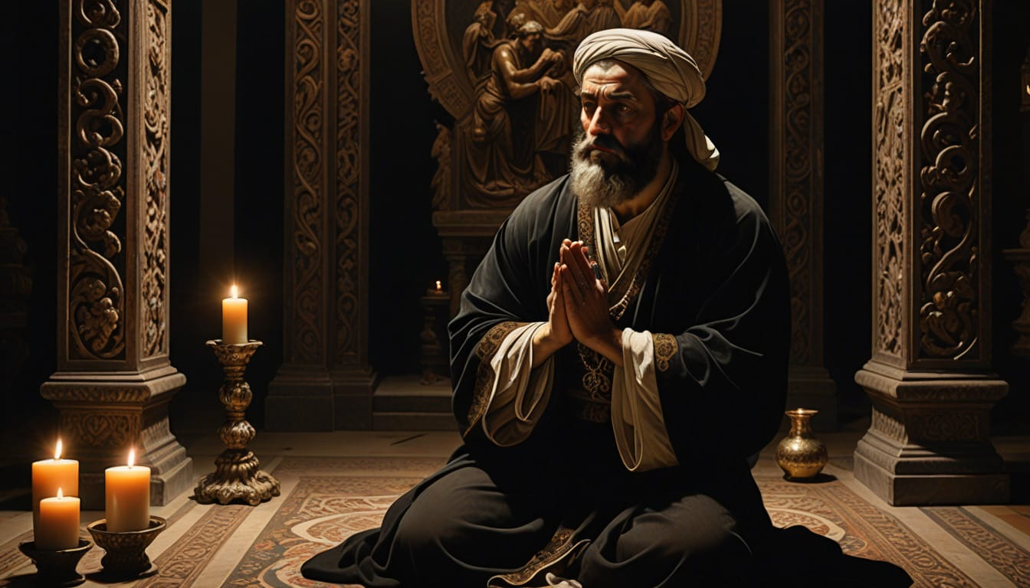

Slide 6
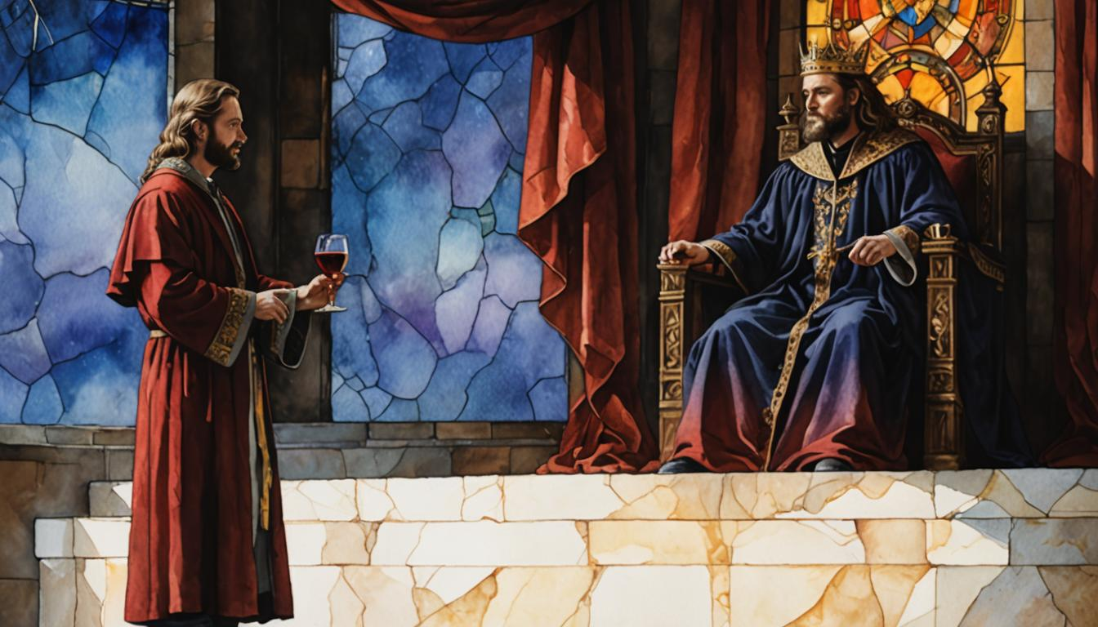

Slide 7
How to Raise Resources
A. Your Requests Should Include the Approvals Needed (2:5)

Slide 8
How Raise Resources
A. Your Requests Should Include the Approvals Needed (2:5)
B. Your Requests Should Include the Time Needed (2:5-6)

Slide 9
How Raise Resources
A. Your Requests Should Include the Approvals Needed (2:5)
B. Your Requests Should Include the Time Needed (2:5-6)
C. Your Requests Should Include the Donations Needed (2:7-9)

Slide 10
How Raise Resources
A. Your Requests Should Include the Approvals Needed (2:5)
B. Your Requests Should Include the Time Needed (2:5-6)
C. Your Requests Should Include the Donations Needed (2:7-9)
D. Your Requests Should Be Dependent Upon God’s Generosity (2:8)

Slide 11
II. How to Recruit Ministry Partners
Nehemiah 2:11-20

Slide 12


Slide 13
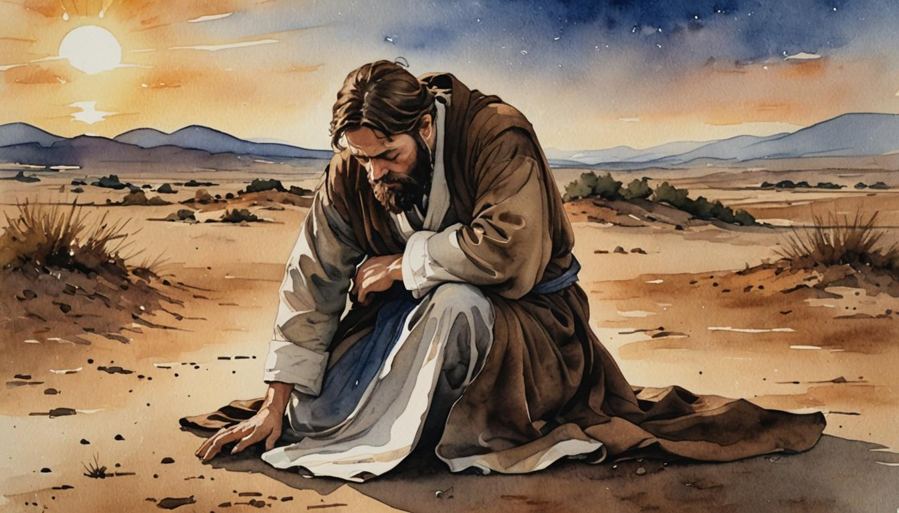

Slide 14


Slide 15
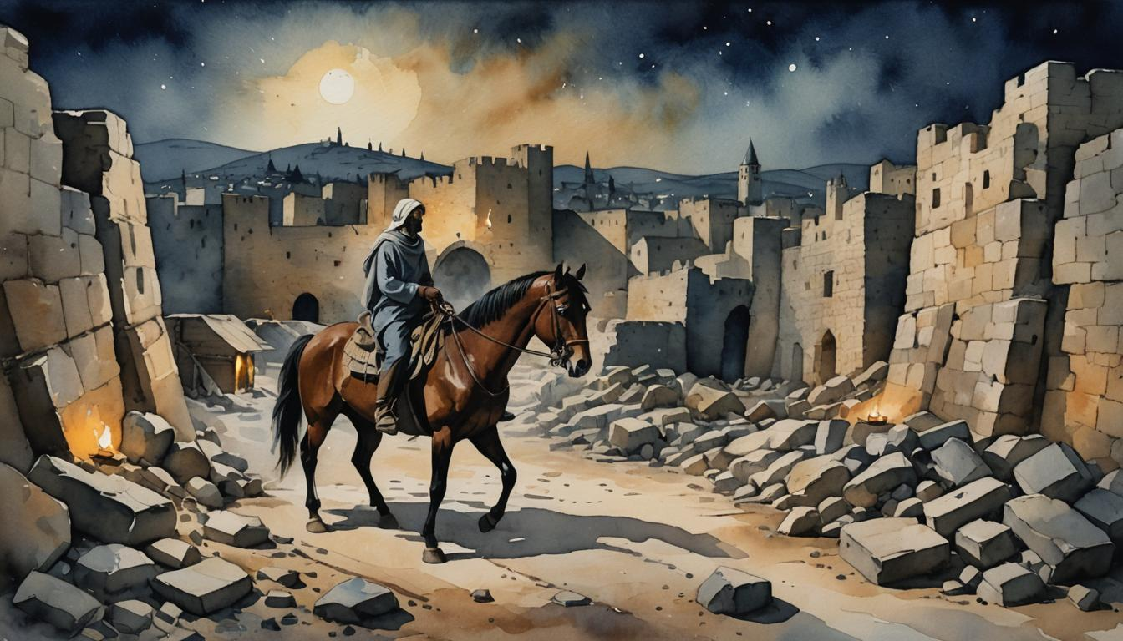

Slide 16
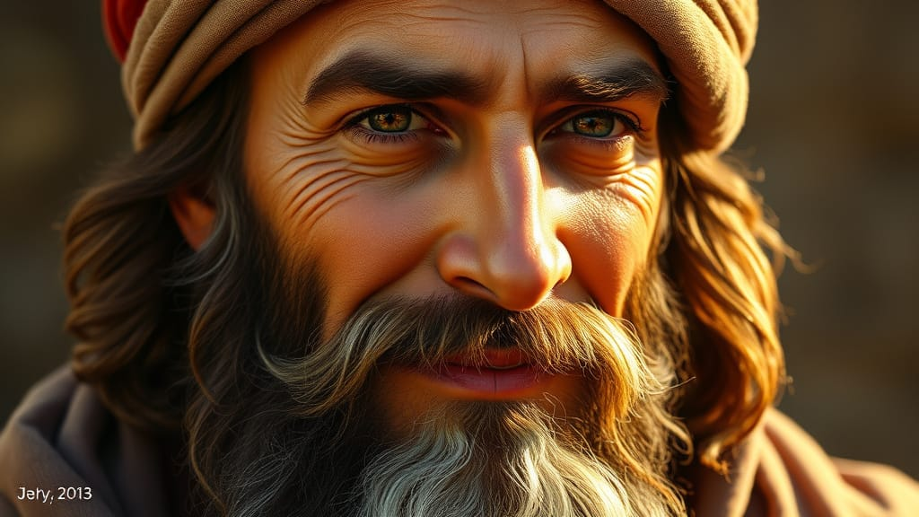


Slide 17
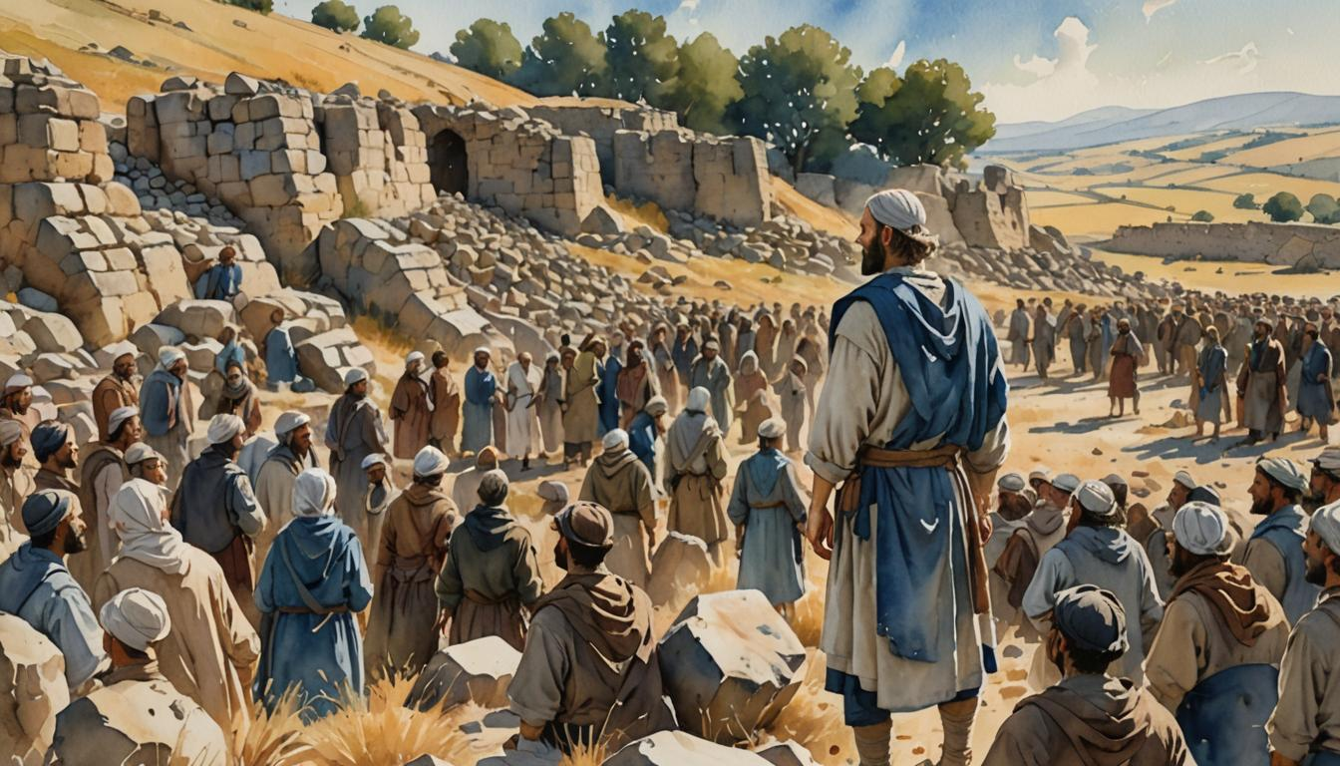

Slide 18
II. How to Recruit Partners
A. Help People Grasp the Problem that Exists.

Slide 19
II. How to Recruit Partners
A. Help People Grasp the Problem that Exists.
B. Display a Plan that Will Solve the Problem.

Slide 20
II. How to Recruit Partners
A. Help People Grasp the Problem that Exists.
B. Display a Plan that Will Solve the Problem.
C. Describe the Provisions that Are Available in God.

Slide 21
II. How to Recruit Partners
Help People Grasp the Problem that Exists.
Display a Plan that Will Solve the Problem.
C. Describe the Provisions that Are Available in God.
D. Boldly Invite Participation.

Slide 22
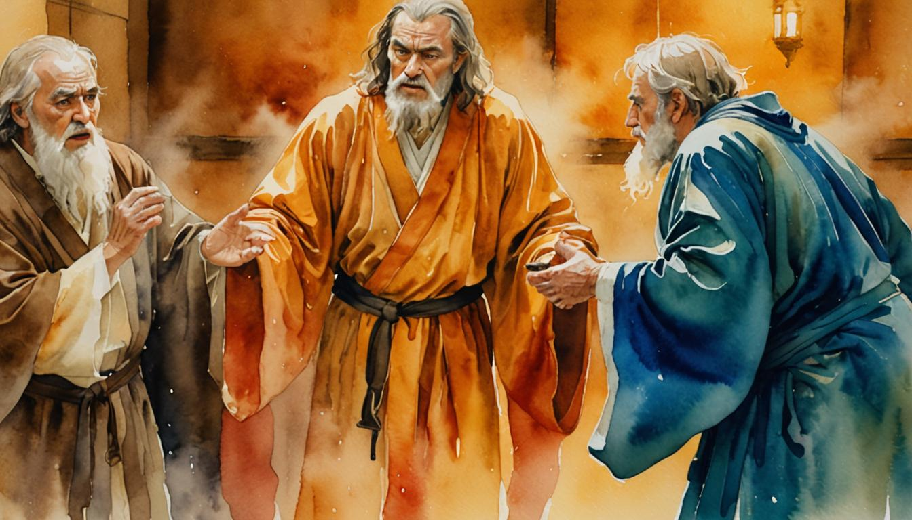

Slide 23


APPLICATION QUESTIONS
You can do these by yourself, but it would be better to discuss them with others.

