Slide 1
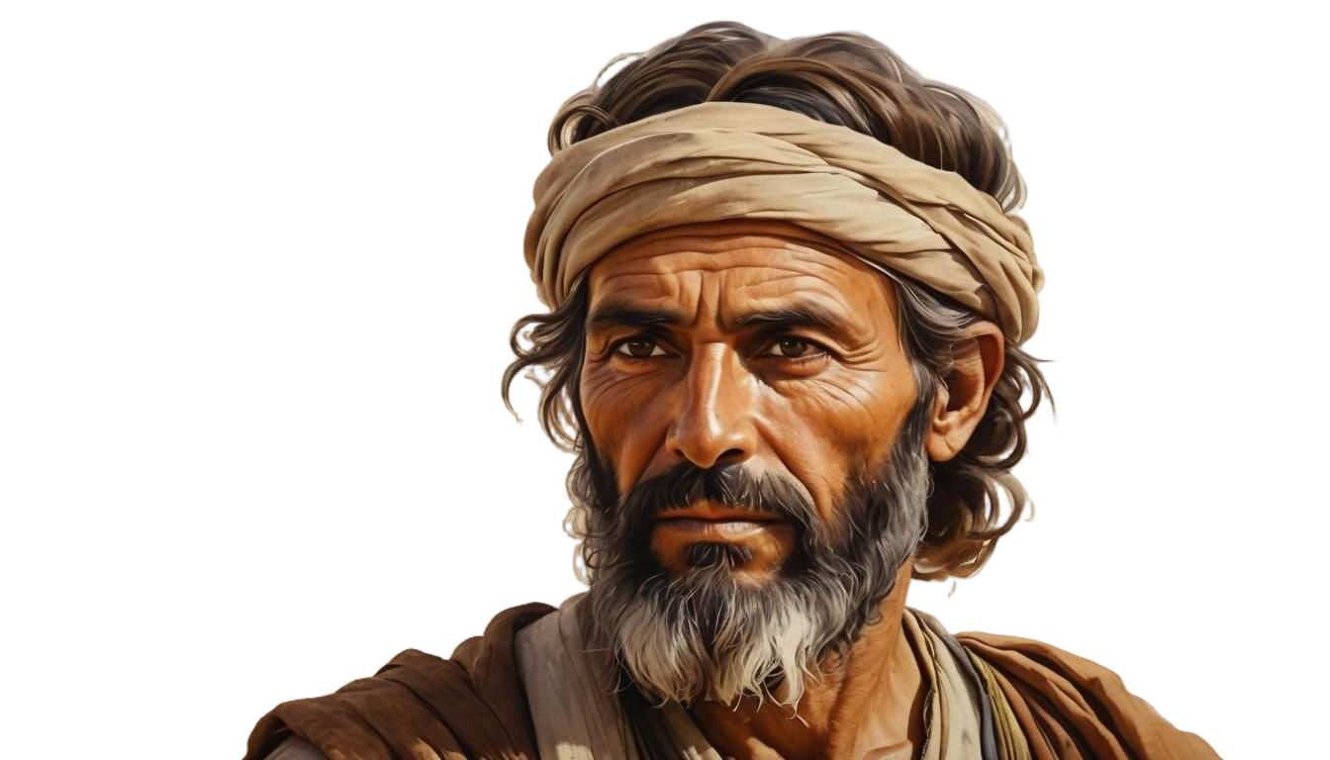

The
Nehemiah Model Of
Spiritual Revitalization
Nehemiah 8-13

Slide 2

6 KEYS FOR SPIRITUAL RENEWAL
#1 PROCLAMATION: Proclaim God’s Word
#2 INTERACTION: Pray for God’s Working
#3 CONSECRATION: Call for a Commitment
#4 PARTICIPATION: Honor God’s Workers
#5 CELEBRATION: Celebrate God’s Victories
#6 REFORMATION: Repeatedly Refresh Revival

Slide 3
Phase #3
CONSECRATION
How to Cement Your
Loyalty to God
Nehemiah 10

Slide 4
I. Your Spiritual Commitment Should Be Reinforced With A
Public Covenant
(9:38‑10:28)

Slide 5
A. The Purpose for Adopting a Covenant
B. The People Who Should Adopt a Covenant

Slide 6
II. Your Spiritual Commitment Should Involve Every Dimension Of Your Life
10:29‑39

Slide 7
A. You Will Want to Make a Total Surrender to God and His Word (10:29)
B. You Will Want Your Surrender to be Applied to Specific Areas in Your Life (30‑39)
1. In Your Home (10:30)
2. In Your Business (10:31)
3. In Your Church (10:32‑39)

Slide 8
We join together with our Christian brothers and sisters to publicly bind ourselves to a wholehearted commitment to the Lord. We endeavor to follow His Word and carefully obey all His commands, regulations and decrees.
In our homes we determine to recognize God's ownership over our families. We will therefore separate ourselves from worldly values and allegiances and recognize Christ's presence and Lordship.
AN UPDATED COVENANT OF COMMITMENT

Slide 9
In our business dealings we will make the sacrifices necessary to keep Christ and His principles foremost in our lives. We recognize the effect this commitment may have on the practices we follow, the hours we work and the income we receive.
In our church we renew our commitment to exalting God, building up fellow believers and reaching our world for Jesus Christ.
AN UPDATED COVENANT OF COMMITMENT

Slide 10
Discussion

Slide 11
1. What is commitment and what does it involve?
2. Are the focal points of commitment of the Israelites the focal points of commitment in your life? Would you be willing to sign a Commitment Contract with God?
DISCUSSION

Slide 12
3. Is it common for modern churches challenge their people to publicly make commitments like the Israelites did here? Should they? Should we?
DISCUSSION

Slide 13
4. In your opinion, which parts of their commitment were the hardest for them to make? Ask yourself, "What do I value most in life? Am I willing to sacrifice it to the Lord?"
DISCUSSION

Slide 14
5. Take inventory of your possessions, and what you do with them. Take stock of your time, and how you spend it. Assess your abilities, and how you use them. What are the sacrifices you are willing to make to honor the Lord in these areas?
DISCUSSION

Slide 15
6. Is tithing just for the Old Testament or is it for Christians today? If, like some people believe, tithing wasn’t required for the New Testament church, do you think early Christians were more or less generous than their OT counterparts?
DISCUSSION

Slide 16
7. Memorize:
"Freely you have received, freely give." (Matthew 10:8)
DISCUSSION

Slide 17
8. Can your group remember the words to the chorus, “I Surrender All.” If so, recite it together with the rest of the group. But only do so if you really mean it. You may also want to say the updated “covenant of commitment” together.
DISCUSSION

Slide 18



TRAINING

Slide 19
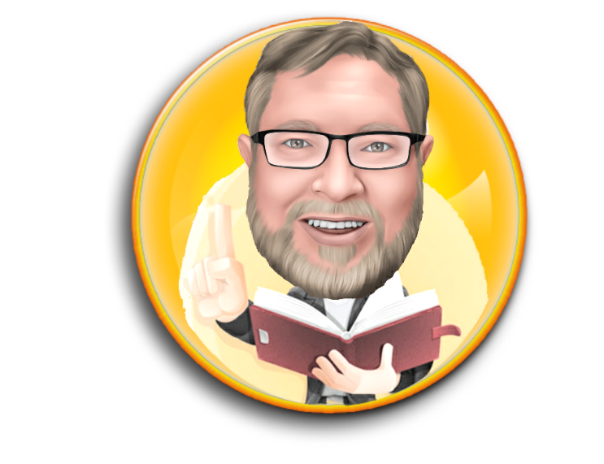
Dr. Ron Sheveland
www.i-training.info

