Slide 1

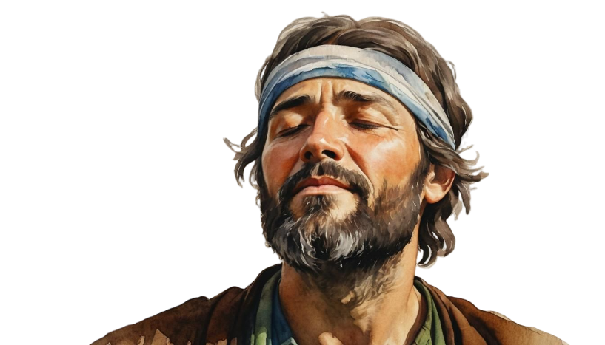
Phase # 2
INTERCESSION
How to Saturate Your
Mission with Prayer
Neh. 1:5-10
The 8 Phases of Strategic Action

Slide 2
Nehemiah 1:5 And I said, “O Lord God of heaven, the great and awesome God who keeps covenant and steadfast love with those who love him and keep his commandments, ⁶ let your ear be attentive and your eyes open, to hear the prayer of your servant that I now pray before you day and night for the people of Israel your servants, confessing the sins of the people of Israel, which we have sinned against you. Even I and my father's house have sinned. ⁷ We have acted very corruptly against you and have not kept the commandments, the statutes, and the rules that you commanded your servant Moses.

Slide 3
⁸ Remember the word that you commanded your servant Moses, saying, ‘If you are unfaithful, I will scatter you among the peoples, ⁹ but if you return to me and keep my commandments and do them, though your outcasts are in the uttermost parts of heaven, from there I will gather them and bring them to the place that I have chosen, to make my name dwell there.’ ¹⁰ They are your servants and your people, whom you have redeemed by your great power and by your strong hand. ¹¹ O Lord, let your ear be attentive to the prayer of your servant, and to the prayer of your servants who delight to fear your name, and give success to your servant today, and grant him mercy in the sight of this man.” Now I was cupbearer to the king.

Slide 4
ADORATION:
Proclaiming God’s Character

Slide 5
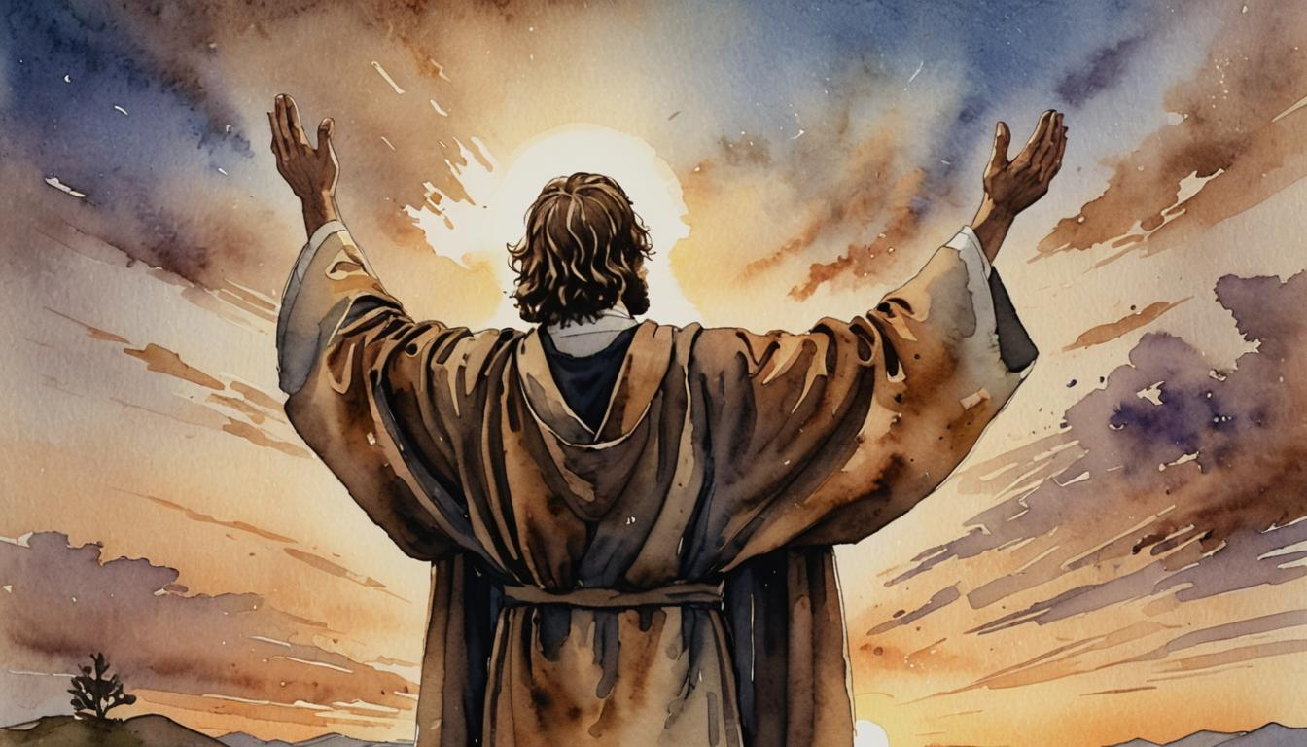

Slide 6
II. AFFIRMATION:
Claiming God’s Promises

Slide 7
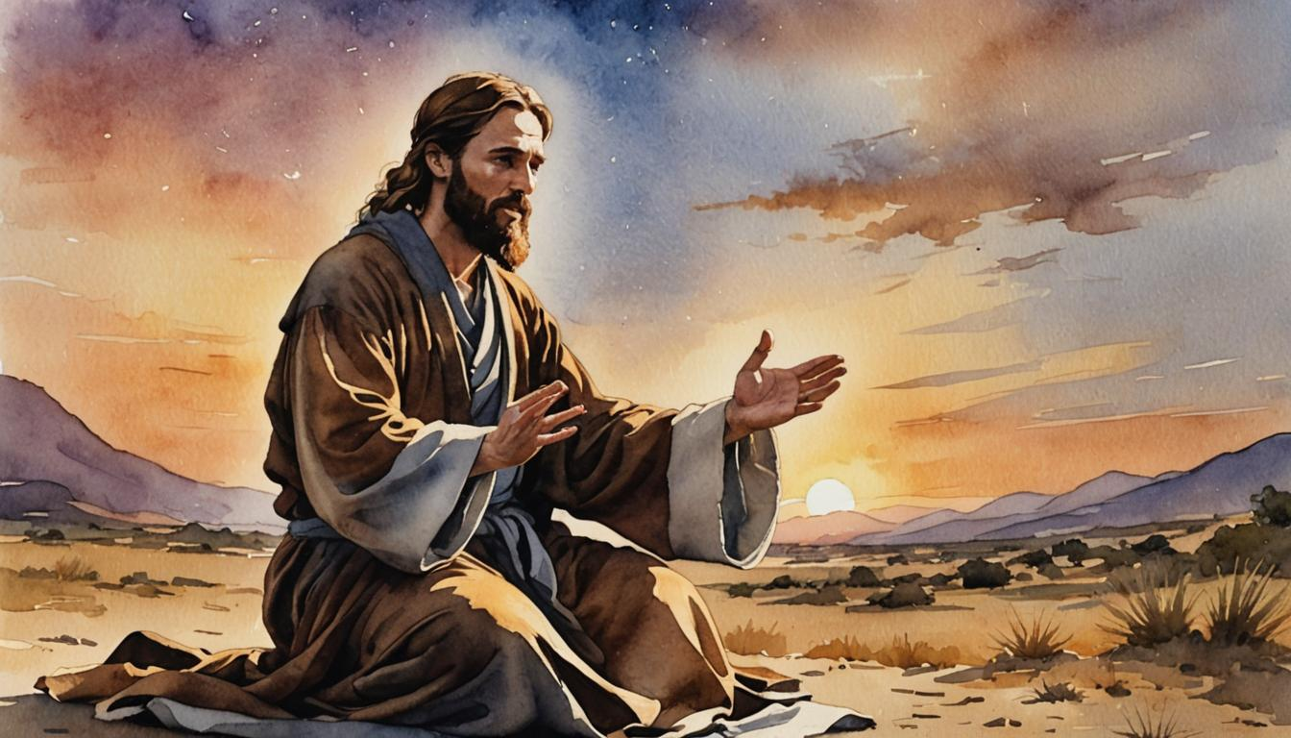

Slide 8
III. CONFESSION:
Acting on God’s Mercy

Slide 9
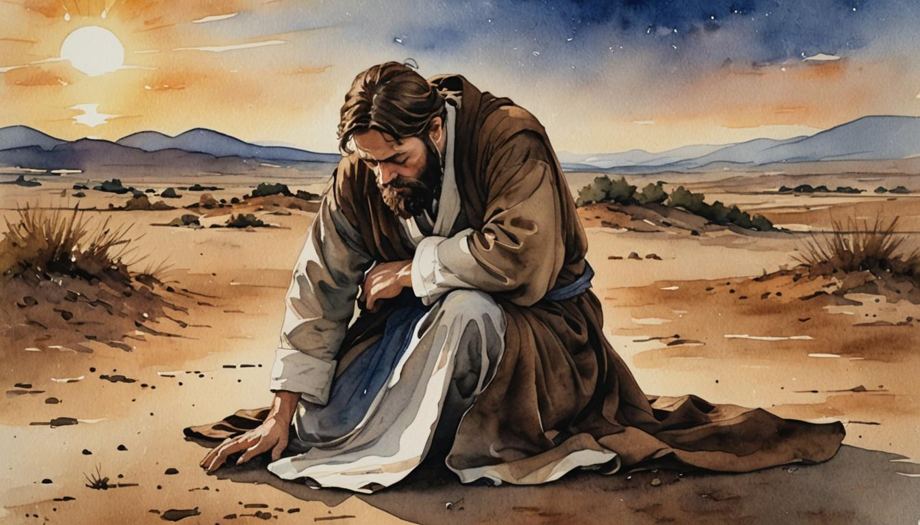

Slide 10
IV. PETITION:
Asking for God’s Power

Slide 11
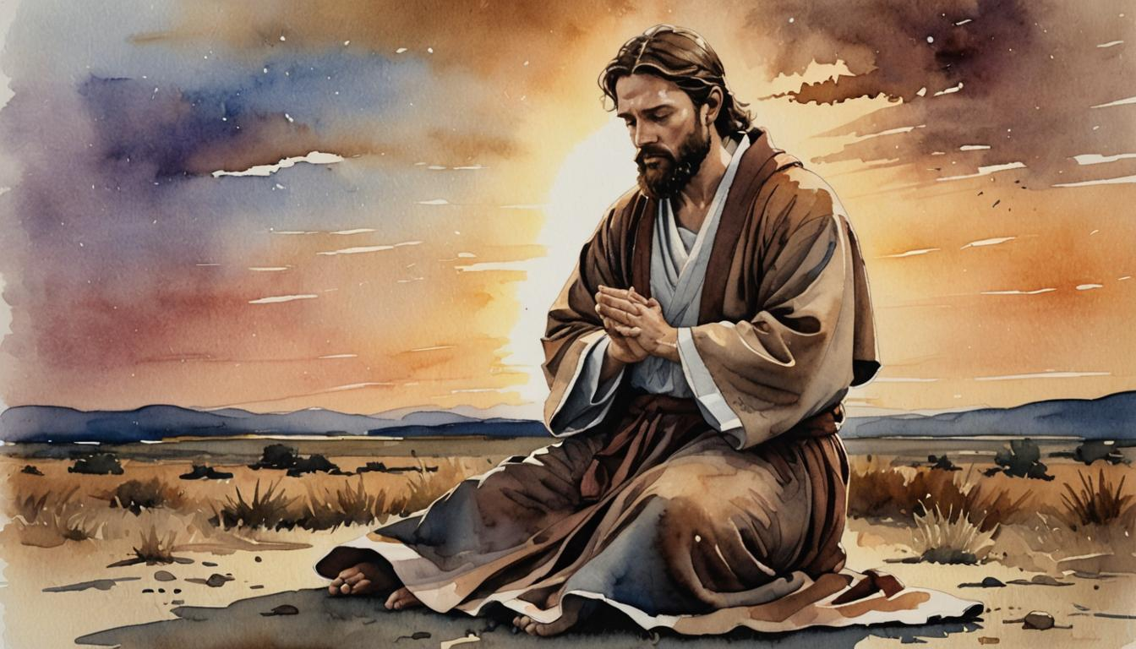

Slide 12
V. ANTICIPATION:
Waiting for God’s Timing

Slide 13
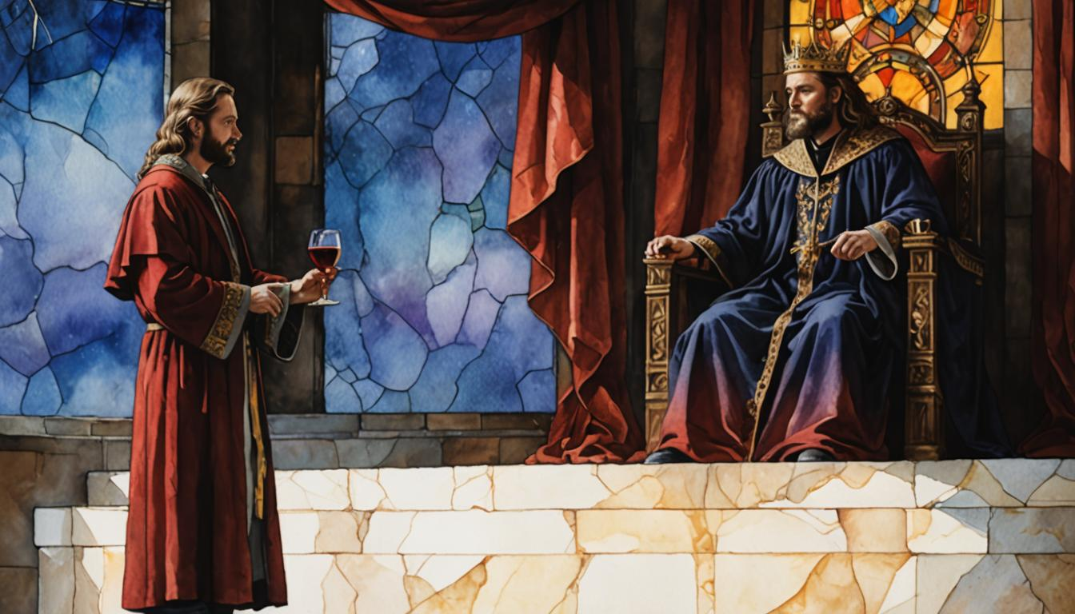

Slide 14


You can do these by yourself, but it would be better to discuss them with your family or a small group.

Slide 15
1. Describe your times of praying alone and with others. In what ways are those prayer times wonderful? In what ways do they need improvement?

Slide 16

2. What are some good reasons for beginning our prayers with praise? Quickly make a list of 20 things about God that you can praise Him for.

Slide 17

3. Under the subject of confession, three types of confession were mentioned: personal, people, and predecessors. This is a new concept for some Christians. How might these three aspects be emphasized in your personal and group prayers?
.

Slide 18

4. Will you, like Nehemiah, diligently pray for success? Pray about those needs using Nehemiah’s prayer as your guide. If you are in a group, have people pray short prayers of “Adoration” first. Then after a few minutes, move to “Affirmation” and so forth.
.

Slide 19

Adoration: Proclaiming God’s Character
Affirmation: Claiming God’s Promises
Confession: Acting on God’s Mercy
Petition: Asking for God’s Power
Anticipation: Waiting for God’s Timing
.

Slide 20



Slide 21
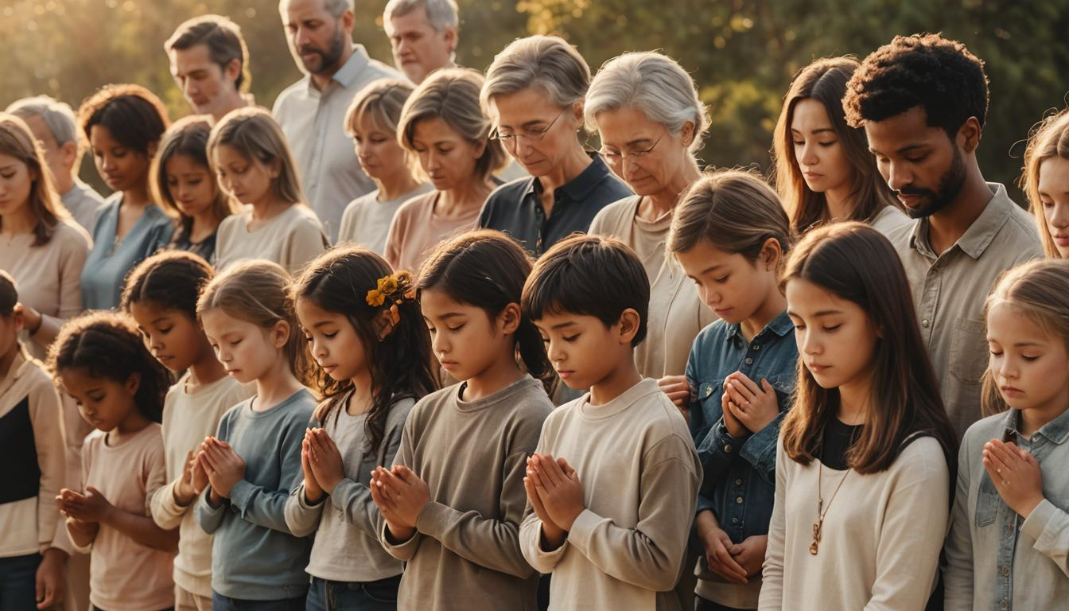

Slide 22
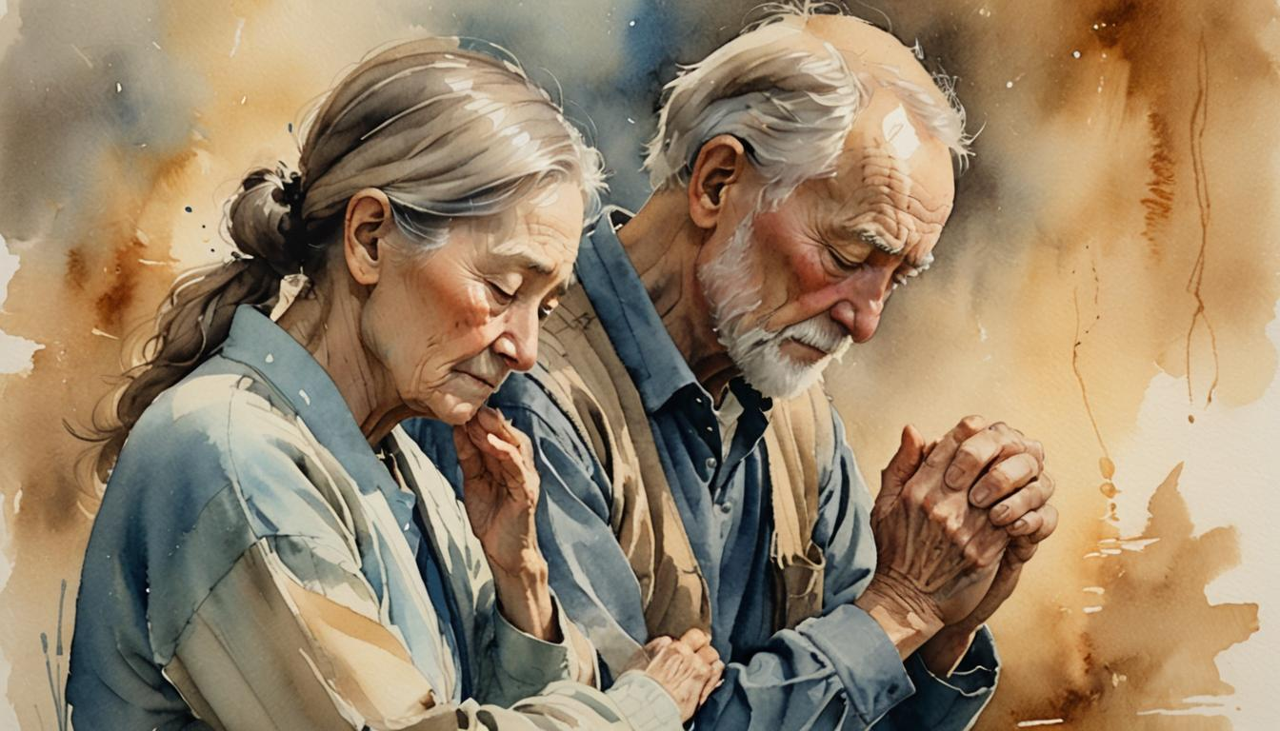

Slide 23
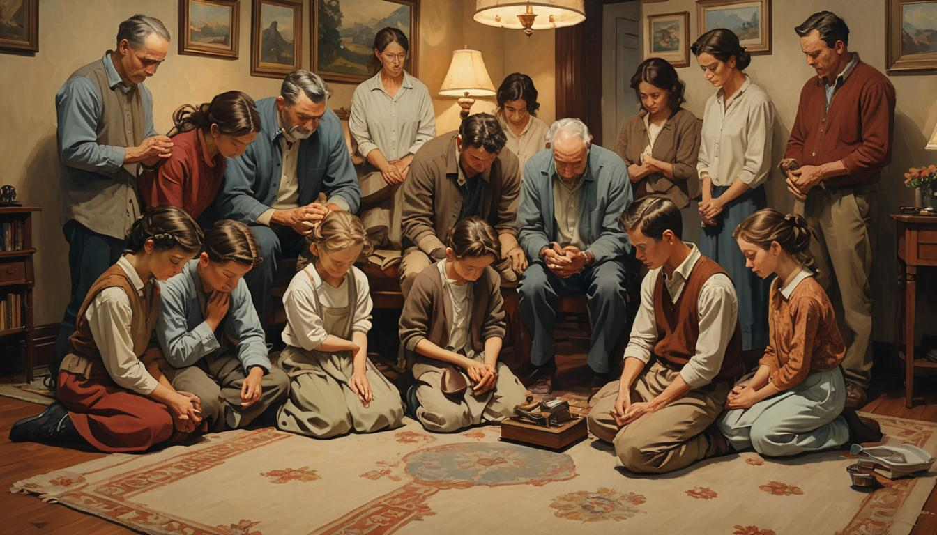

Slide 24
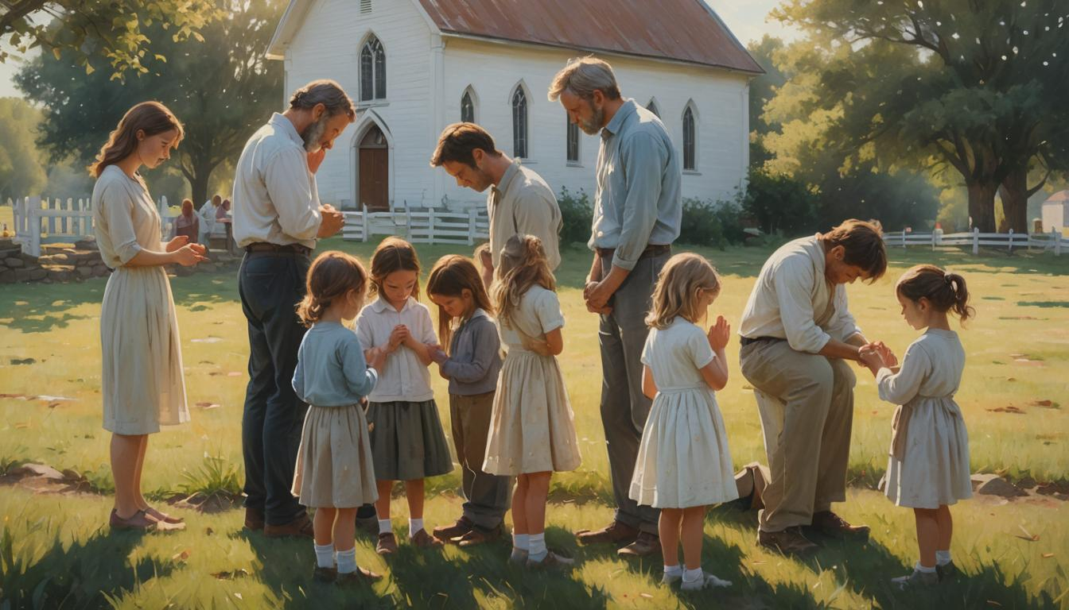

Slide 25
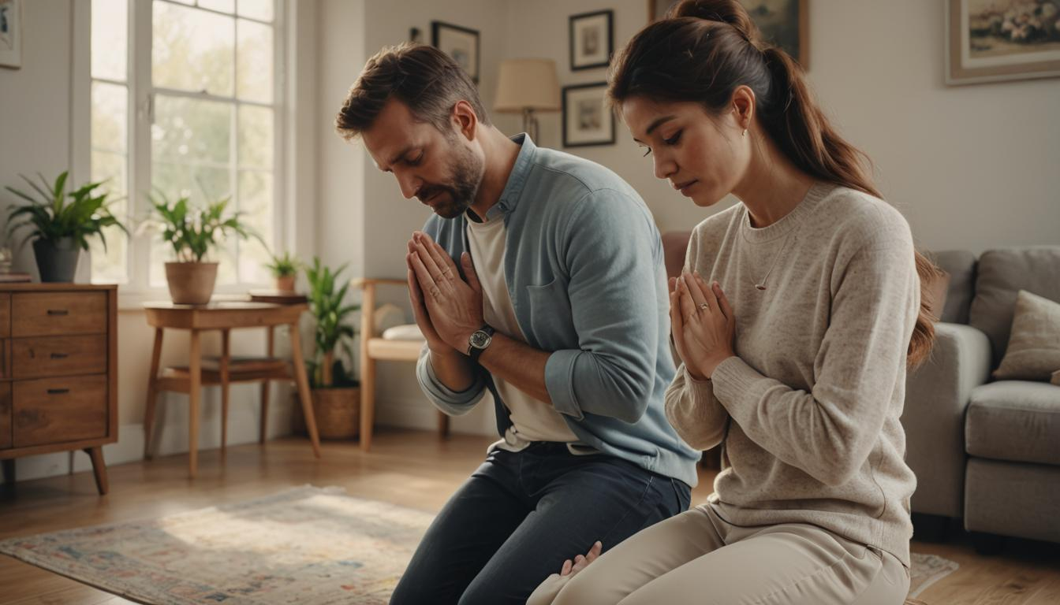

Slide 26
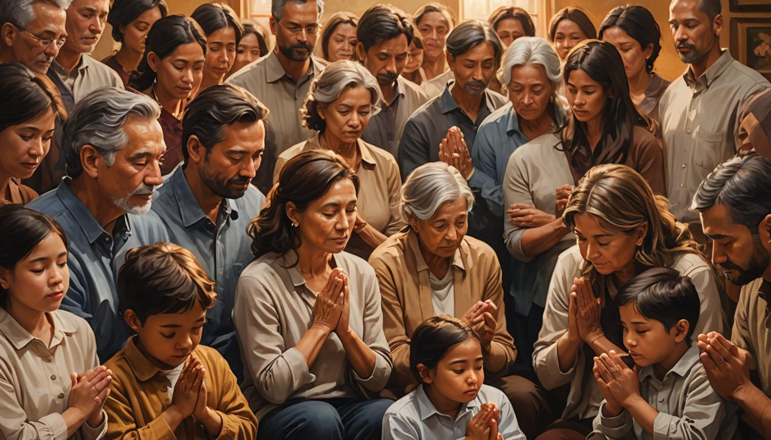

Slide 27
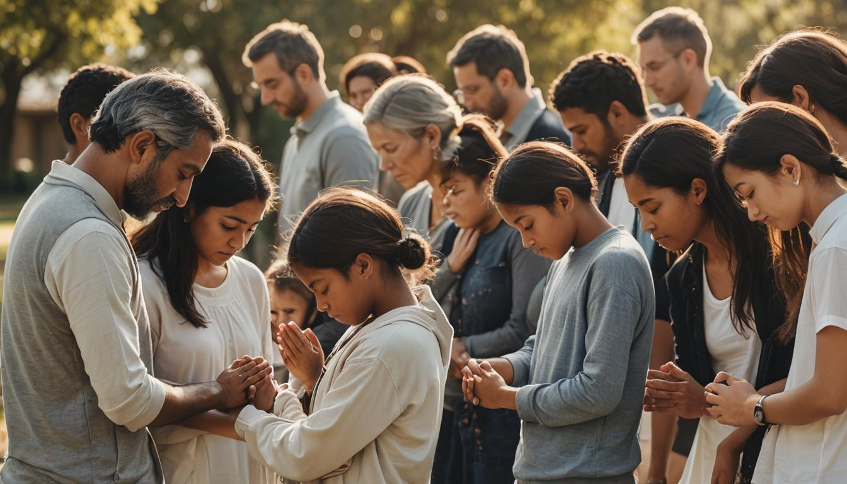

Slide 28


Slide 29


Slide 30


