Slide 1
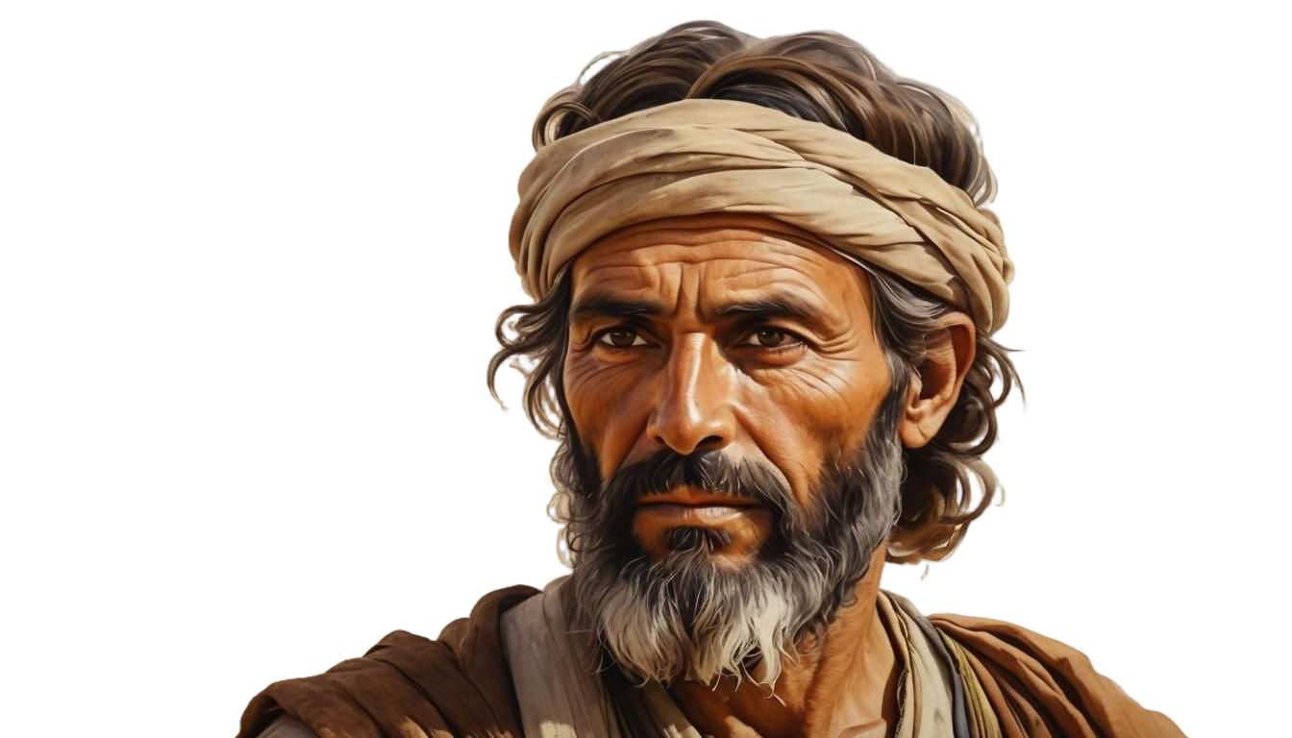

The
Nehemiah Model Of
Spiritual Revitalization
Nehemiah 8-13

Slide 2

6 KEYS FOR SPIRITUAL RENEWAL
#1 PROCLAMATION: Proclaim God’s Word
#2 INTERACTION: Pray for God’s Working
#3 CONSECRATION: Call for a Commitment
#4 PARTICIPATION: Honor God’s Workers
#5 CELEBRATION: Celebrate God’s Victories
#6 REFORMATION: Repeatedly Refresh Revival

Slide 3
#2 INTERACTION
Listening and Talking to God
Nehemiah 9

Slide 4
I. Come Humbly Before the Lord and Listen to Him (9:1-3)
Approach God with a Humble Contrite Heart
B. Saturate Yourself with God's Word

Slide 5
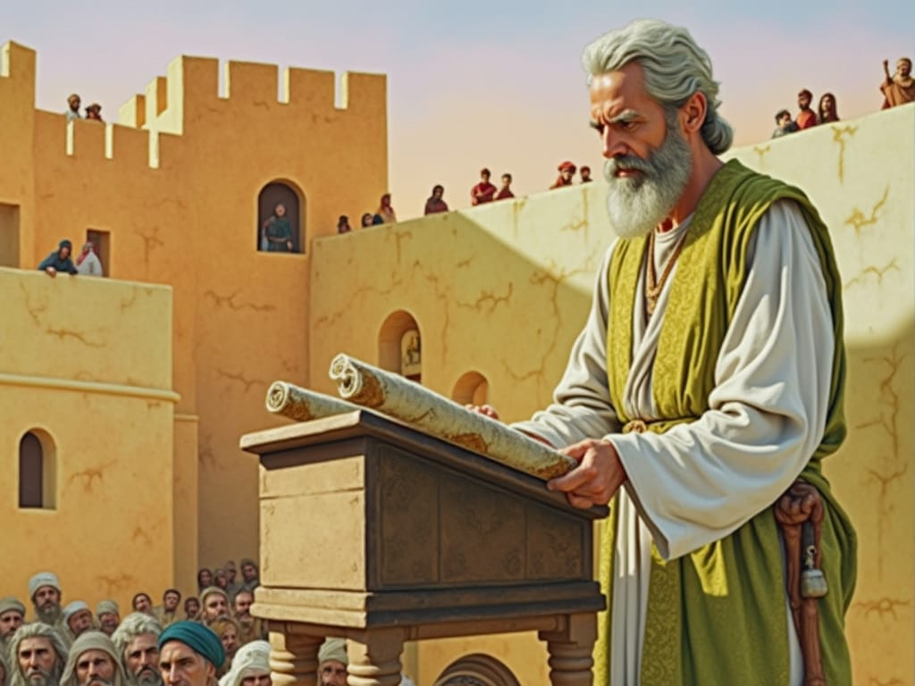


Slide 6
II. Respond to God with Passionate Prayer (9:4-37)
A. Profess God's Greatness
B. Confess Your Sinfulness
C. Consecrate Yourself to God

Slide 7
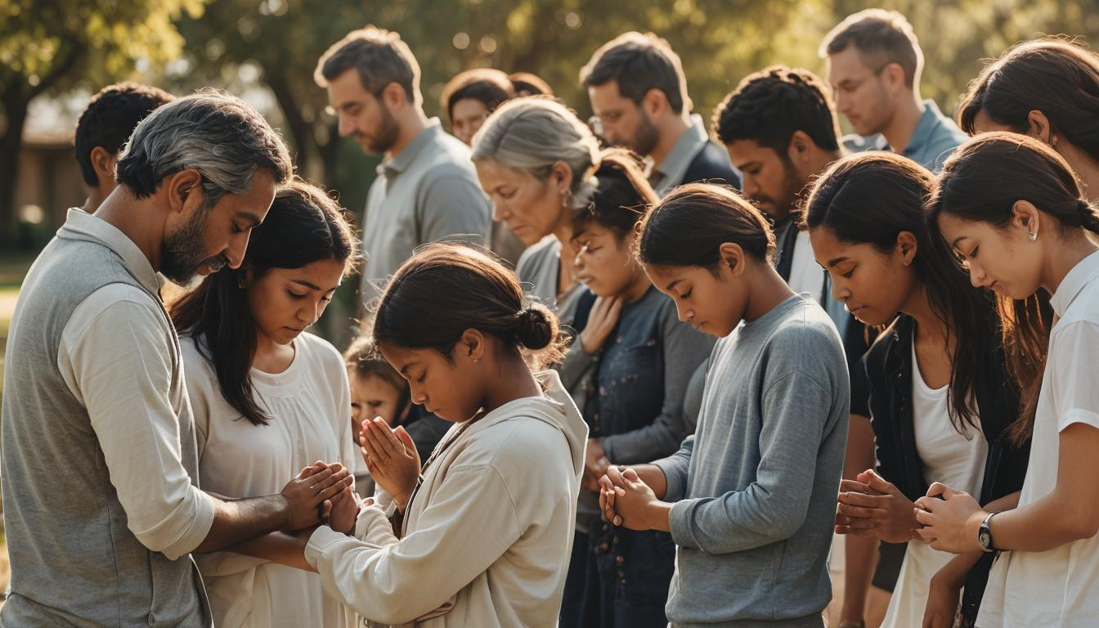

Slide 8
1. Rather than wearing sackcloth, how can we show humility and submission to God?
2. In your devotional times with God how can you practice “Interactive Prayer” where you both listen and speak to God?
APPLICATION QUESTIONS
Nehemiah Chapter 9
DISCUSSION

Slide 9
3. How does profession of God’s faithfulness and confessing our unfaithfulness work together? How can we better with these two priorities of prayer?
4. Meditate and discuss Corinthians 11.28 “Everyone ought to examine themselves before they eat of the bread and drink from the cup.”
APPLICATION QUESTIONS
Nehemiah Chapter 9
DISCUSSION

Slide 10
5. Does God lead us through the wilderness today? Recall examples of God's leading in your life.
6. Even when believers are unfaithful, God is faithful. Consider God's faithfulness to you, even when you have been unfaithful to Him.
APPLICATION QUESTIONS
Nehemiah Chapter 9
DISCUSSION

Slide 11
7. The Persians exacted tribute in crops and livestock from the Jews (v36-37), so they were "slaves in their own land." How could we be slaves in the land God has given to us?
8. Can we escape God's discipline? No, and we should value it! Consider what your life would be like if you were not disciplined by God.
APPLICATION QUESTIONS
Nehemiah Chapter 9
DISCUSSION

Slide 12
9. What are the benefits of God's laws? Why do some people consider God's laws to be oppressive?
10. If you were to memorize one verse or sentence from Nehemiah 9, which one would it be? See samples below:
"Praise the Lord your God, who is from everlasting to everlasting!" (Neh 9:5)
"You are a forgiving God, gracious and merciful, slow to anger, abounding in love.... (9.17)
APPLICATION QUESTIONS
Nehemiah Chapter 9
DISCUSSION

Slide 13


TRAINING

