Slide 1
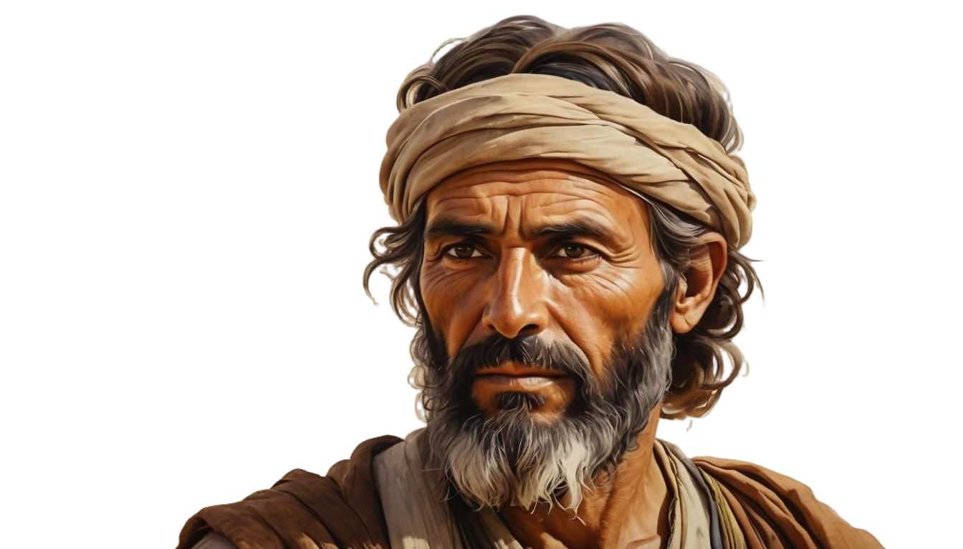

The
Nehemiah Model Of
Spiritual Revitalization
Nehemiah 8-13

Slide 2

6 KEYS FOR SPIRITUAL RENEWAL
#1 PROCLAMATION: Proclaim God’s Word
#2 INTERACTION: Pray for God’s Working
#3 CONSECRATION: Call for a Commitment
#4 PARTICIPATION: Honor God’s Workers
#5 CELEBRATION: Celebrate God’s Victories
#6 REFORMATION: Repeatedly Refresh Revival

Slide 3
#1 PROCLAMATION
How to Ignite Spiritual Revival
with God's Word
Nehemiah 8

Slide 4
1. Rally Together around God’s Word. (8:1)

Slide 5
2. Give Scripture Your Focused Attention. (8:2-4)

Slide 6
3. Worship God and Revere His Word.
(8:5-6)

Slide 7
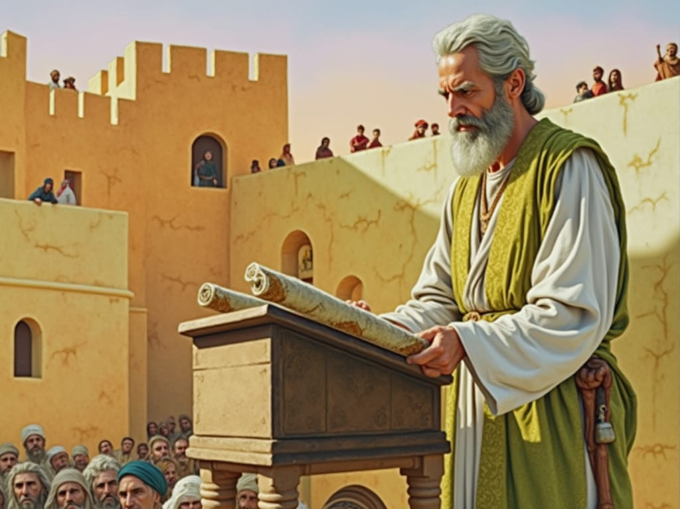
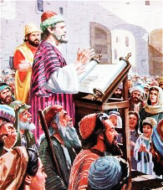

Slide 8
4. Strive for Full Understanding.
(8:7-8)

Slide 9
5. Celebrate What the Bible Teaches.
(8:9-12)

Slide 10
6. Joyfully Obey God’s Directions.
(8:13-18)

Slide 11

1. Rally Together around God’s Word. 2. Give Scripture Focused Attention.
3. Worship God and Revere His Word.
4. Strive for Full Understanding.
5. Celebrate What the Bible Teaches.
6. Joyfully Obey God’s Directions.
How to Ignite Spiritual Revival with God's Word

Slide 12
Discussion Questions
1. Do you have the kind of appreciation for the word of God that these people had? How do you evidence this in your life?
2. What are some steps we can take to improve our reactions to God’s Word?

Slide 13
Discussion Questions
3. Why were the people weeping? How and why did the people turn their weeping to celebration?
4. How is the joy of the Lord our strength?

Slide 14
Discussion Questions
5. What is your personal experience with revival? Are you familiar with some of the revivals of recent centuries or of those currently happening in various parts of the world?
6. If revival was to come to your church, how would you know it had arrived?

Slide 15


TRAINING

