Slide 1

The Nehemiah Model
Of Successful Leadership
"Give your servant success today..." Neh. 1:11
"The God of Heaven will give us success..." Neh. 2:20

Slide 2
The Nehemiah Model Of Successful Leadership
Leading a Great Endeavor
A Guide to Strategic Action
Nehemiah 1-7

Slide 3

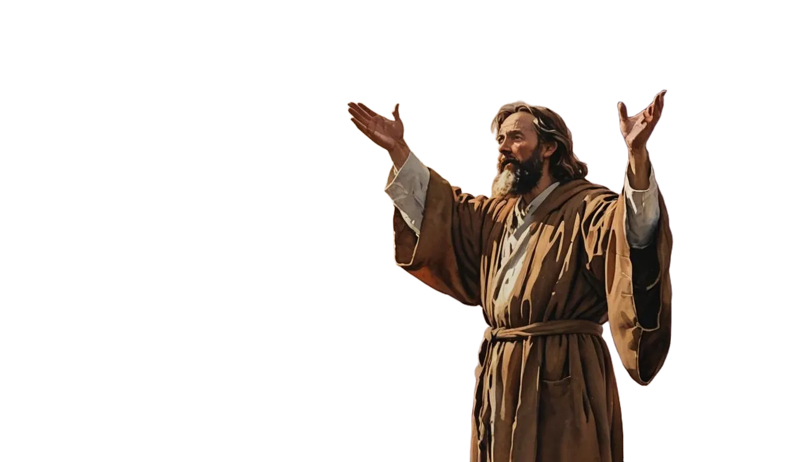
Phase # 1
PASSION
How to Become Committed
to a Great Endeavor
Neh. 1:1-11
The 8 Phases of Strategic Action

Slide 4
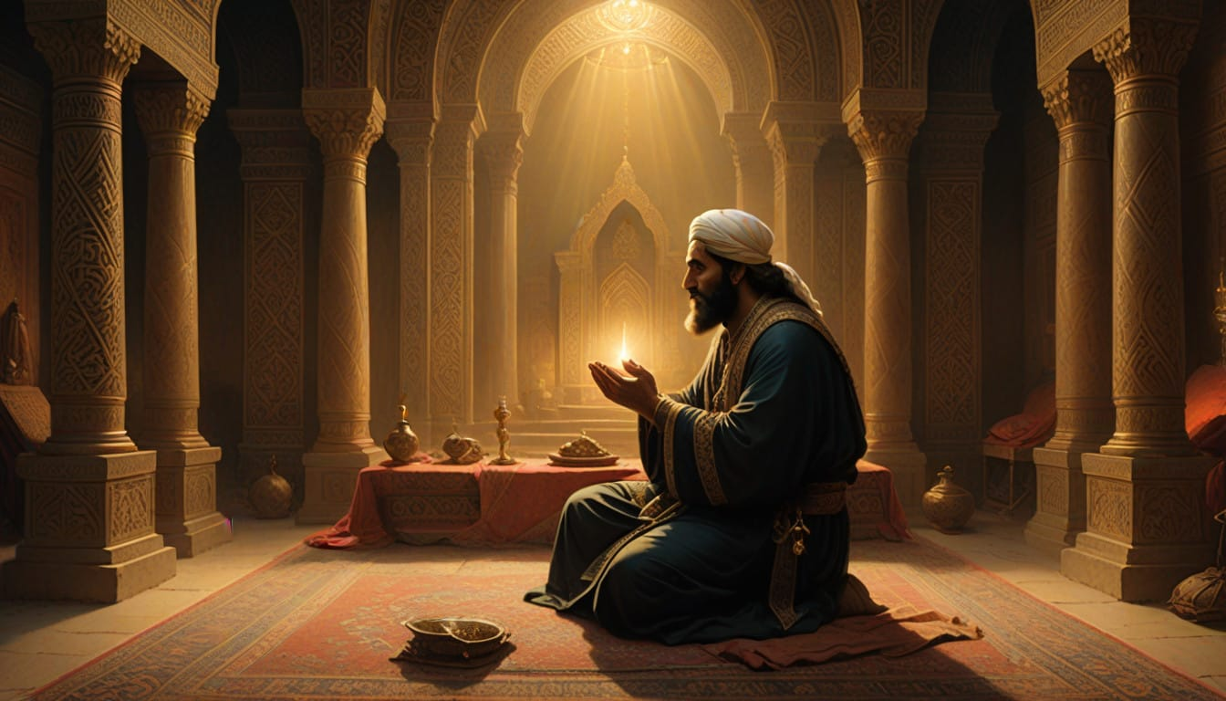
The Setting (Neh. 1:1)

Slide 5
Develop a Passion by Investigating the Needs of Others
(1:2-3)

Slide 6


Slide 7
Expand Your Passion by Empathizing with the Hurts of Others (1:4)

Slide 8
Link Your Passion with God’s Passion (1:5-11)

Slide 9



Slide 10
1. God gave Nehemiah the “great project” (Neh. 6:3) of rebuilding Jerusalem’s wall and restoring its spiritual and national prominence. Does God give great endeavors to all Christians or just some?
2. When your desire to be blessed by God is greater than your desire to be used by God, how do you get your life back in balance?
3. What is a great endeavor that God might be giving you right now?

Slide 11
4. How grieved are you about the physical and spiritual state of people? Of all the needs out there, which ones most grab your heart? List some situations that you are really concerned about.
5. How will you probe those needs?
6. Will you, like Nehemiah, diligently pray for success? Will you pray for others that they might find their great project and be successful in it?

Slide 12
The Nehemiah Model
Of Successful Leadership
"Give your servant success today..." Neh. 1:11
"The God of Heaven will give us success..." Neh. 2:20

