Slide 1
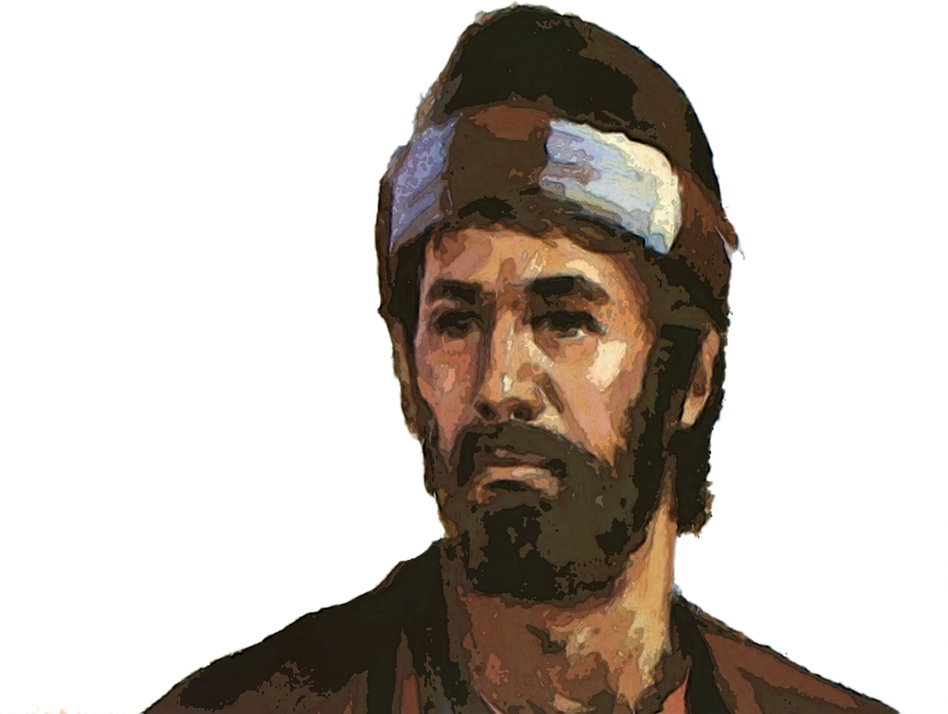
The
Nehemiah Model Of
Spiritual Revitalization
Nehemiah 8-13

Slide 2
The Renewal Process
Phase #1 – PROCLAMATION
Phase #2 – INTERACTION
Phase #3 – CONSECRATION
Phase #4 – PARTICIPATION
Phase #5 – CELEBRATION
Phase #6 – REIGNITION
THE GREAT AWAKENING

Slide 3
Phase #4
PARTICIPATION
How to Honor God’s People
Honorable Recognition (11-12:26)

Slide 4
I. A Revived People will Honor Fellow Partners with Open Recognition (11:1-12:26)
A. They Honored the People Dwelling in Jerusalem (11:1-24)
B. They Honored the People Dwelling Outside of Jerusalem (11:25-36)

Slide 5
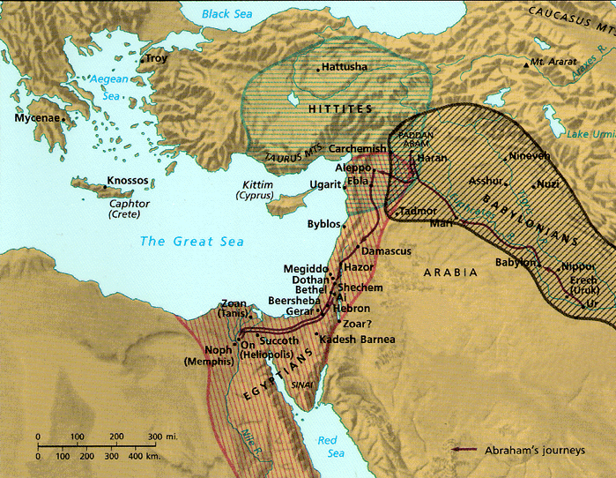
Jerusalem’s Strategic Location
“Thus says the Lord GOD: This is Jerusalem; I have set her in the center of the nations, with countries round about her”
Ezekiel 5:5
Notes:
5

Slide 6
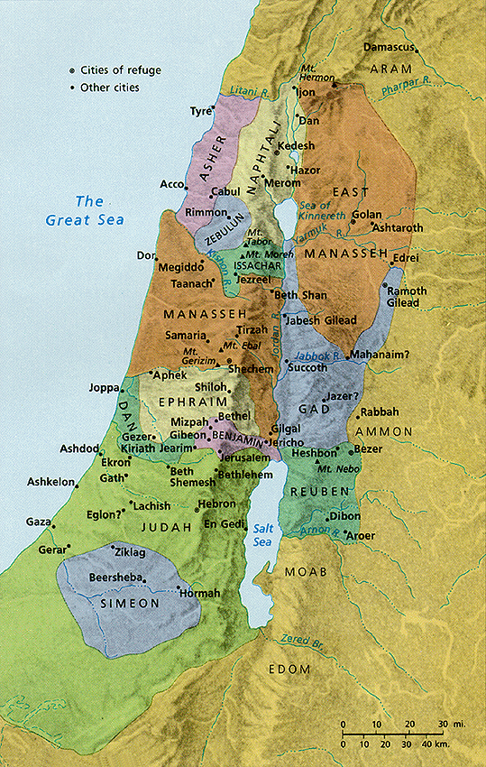
Central Location
Jerusalem was known as the “navel of Israel.”
Jerusalem
Notes:
6
Some say Jerusalem was in the “navel” of Israel, meaning the center!

Slide 7
Central Location
Jerusalem was in Benjamin next to Judah but close to the northern tribes
Jerusalem
Notes:
7
Some say Jerusalem was in the “navel” of Israel, meaning the center!

Slide 8
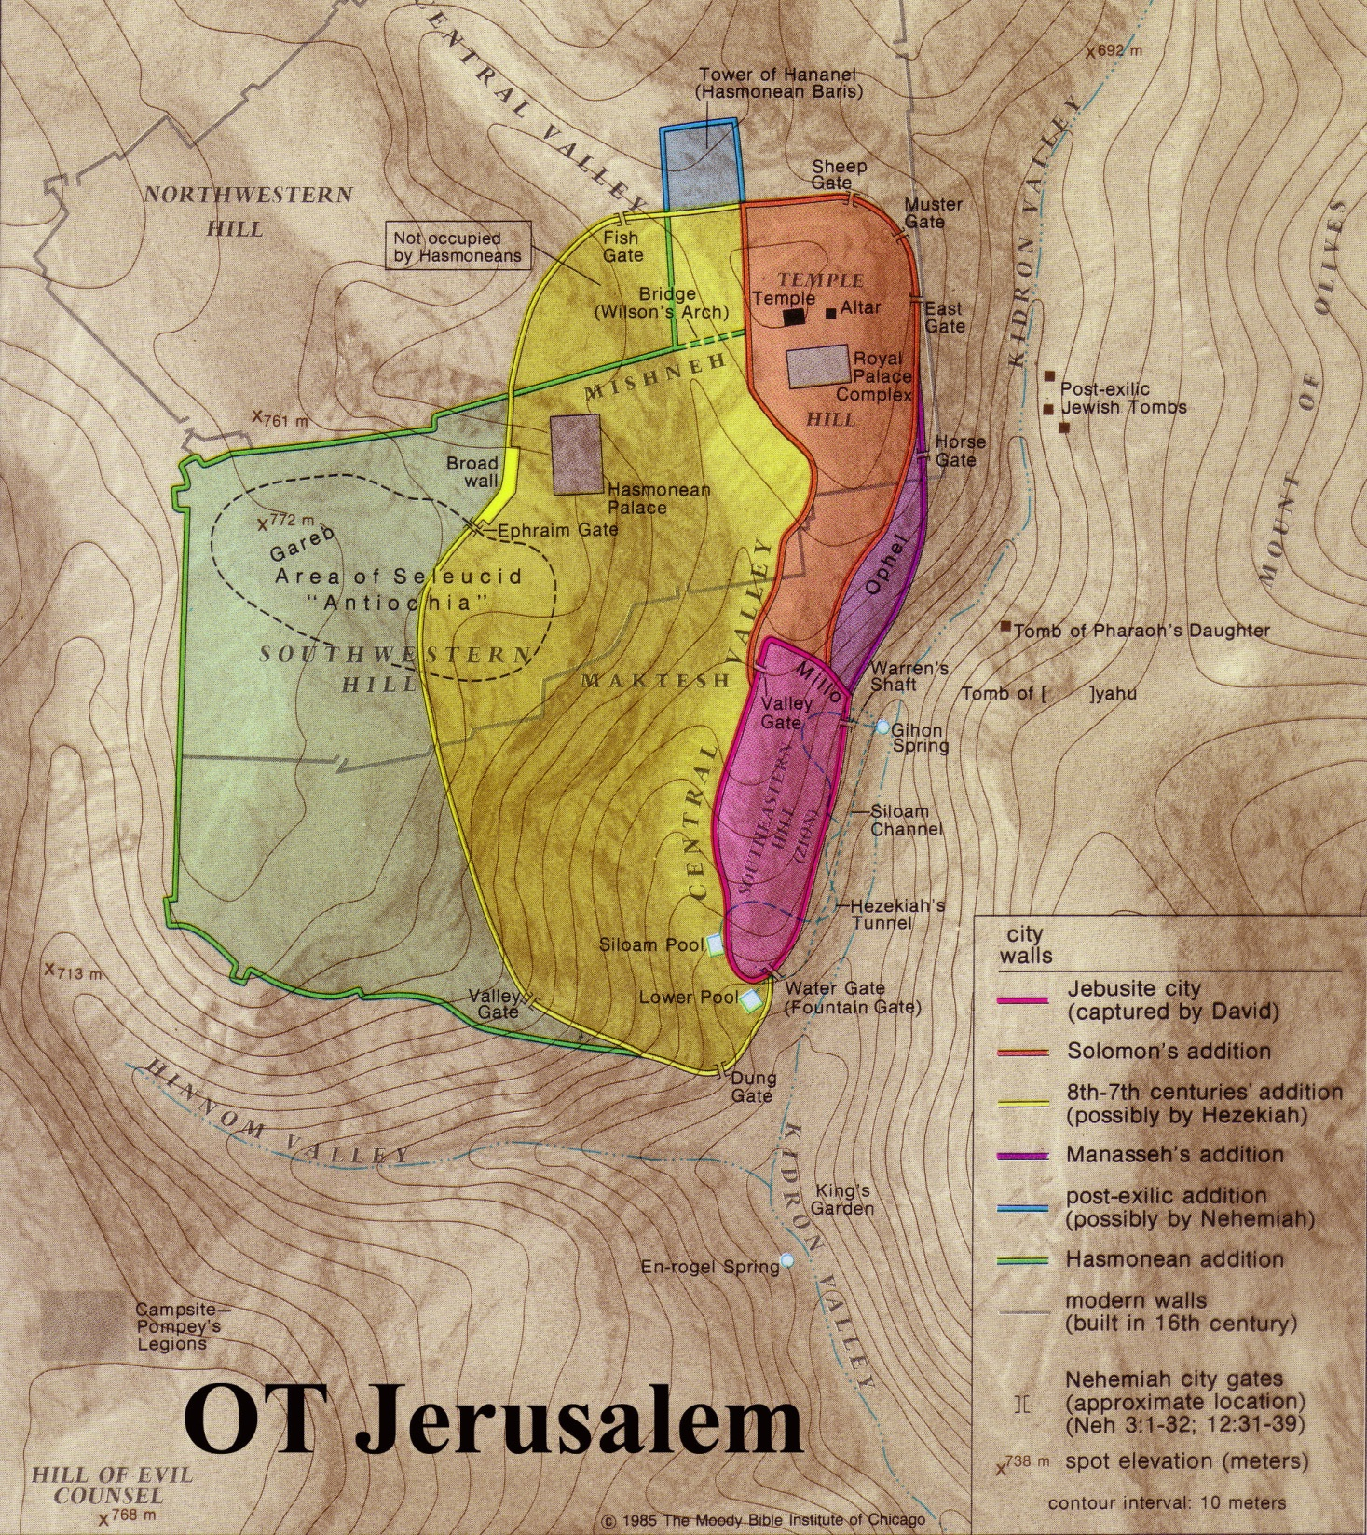
Jerusalem was a Border City.
The border between Benjamin and Judah ran just south of the city
Benjamin
Judah
Notes:
8

Slide 9
Nehemiah 7:4
At that time the city was large and spacious, but the population was small, and none of the houses had been rebuilt.
Notes:
9

Slide 10
Three groups of people
moved to the big city:
1) The leaders of the people.
2) Half the people were drafted.
3) Others volunteered out of patriotic motives.

Slide 11
I. A Revived People will Honor Fellow Partners with Open Recognition (11:1-12:26)
A. They Honored the People Moving to Jerusalem (11:1-24)
B. They Honored the People Dwelling Outside of Jerusalem (11:25-36)

Slide 12
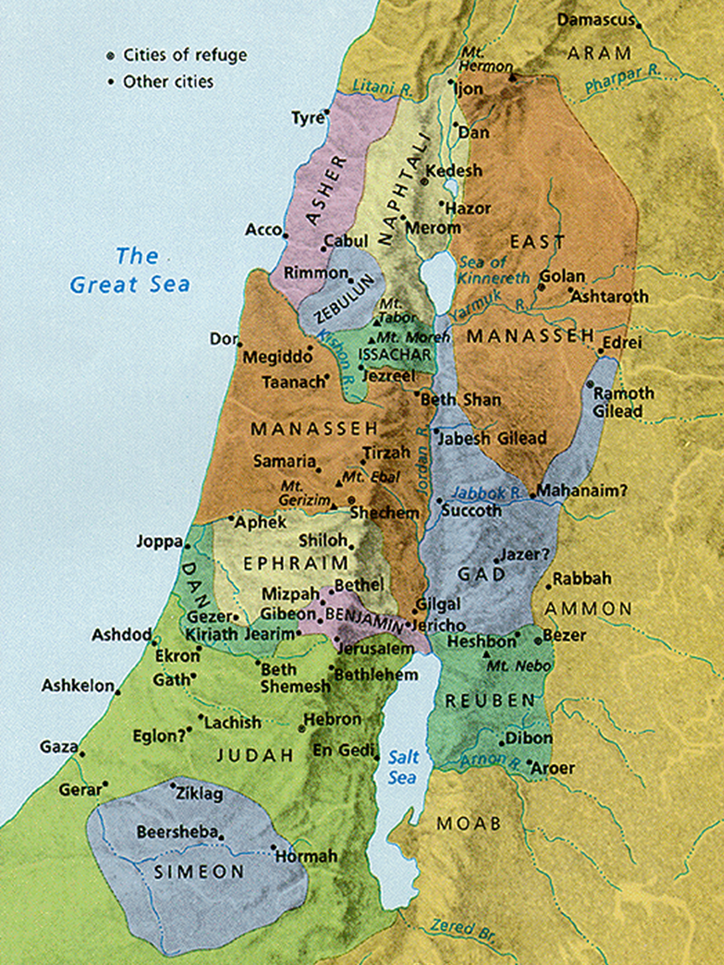
God calls some of us to go serve somewhere else (11:1-24).
“The leaders of the people were living in Jerusalem, the holy city.”
“A tenth of the people from the other towns of Judah and Benjamin were chosen by sacred lots to live there, too”
“while the rest stayed where they were” (11:1 NLT).
Notes:
Settlements of the Persian Province of Judah According to Ezra and Nehemiah (Logos Libronix Bible Maps, Mac edition, 2008)

Slide 13
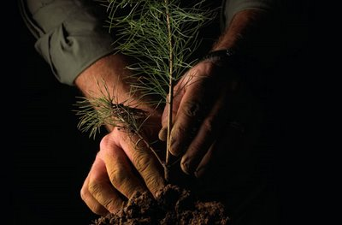
Make your commitment to God practical by following His individual plan for you!

Slide 14
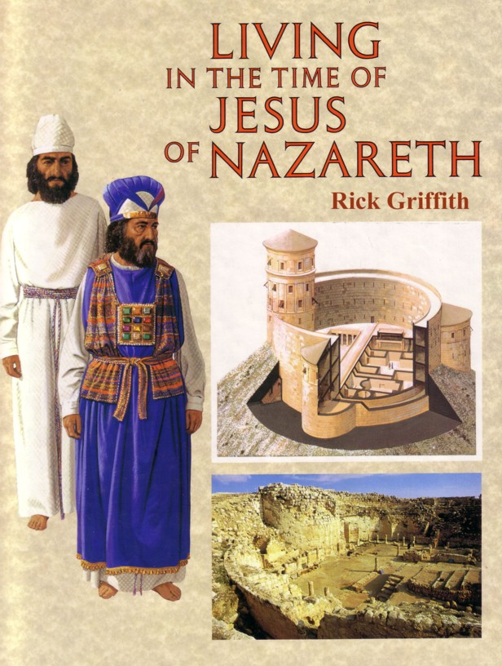

II. A Revived People will Honor God’s Leaders with Open Recognition
(12:1-26)

Slide 15
After all they had been through, Judah still had priests in the right family line: God was still faithful to give them leaders that they could follow!

Slide 16
QUICK
QUIZ
Nehemiah Chapter 11-12:26

Slide 17
1. Why were more people needed in Jerusalem?
Nehemiah Chapter 11
QUIZ
To help establish and defend the city.

Slide 18
2. What proportion of those living outside the city were needed to move into the city?
Nehemiah Chapter 11
QUIZ
One out of ten families

Slide 19
3. How did they determine who was to live in Jerusalem? (1)
Nehemiah Chapter 11
QUIZ
Lots were cast when more people were needed, over and above the volunteers.

Slide 20
4. Why would people not want to live in Jerusalem?
Nehemiah Chapter 11
Since Jerusalem had been devastated and was the point of great contention between the Jews and neighboring peoples, it was not an attractive nor a safe place. Additionally, people would not be anxious to abandon their farms and jeopardize their landholdings.
QUIZ

Slide 21
5. Where did the rest of the Israelites live? (20)
Nehemiah Chapter 11
QUIZ
In all the cities of Judah, each on his ancestral property.

Slide 22
6. Who is the king referred to in Nehemiah 11.23-24?
Nehemiah Chapter 11
QUIZ
King Artaxerxes l

Slide 23
Discussion
(Application Questions)

Slide 24
Discussion Questions
1. When you have given a job "your all," and no one shows appreciation, how do you feel? What do you do? Does it encourage you to know that God takes note of every individual and his/her service for Him? (See l Corinthians 15:58)

Slide 25
Discussion Questions
2. Have you been in a church where only a few seem to do almost much of the work? Can you suggest some ideas to solve or lessen this problem?

Slide 26
Discussion Questions
3. Would you be willing to move to a new location or a new ministry if you believed it was the Lord's plan for you?
4. Memorize "They willingly offered themselves..." (Nehemiah 11:2)

Slide 27
Discussion Questions
5. Who are the people who serve God in your church?
How can we show them recognition?

Slide 28
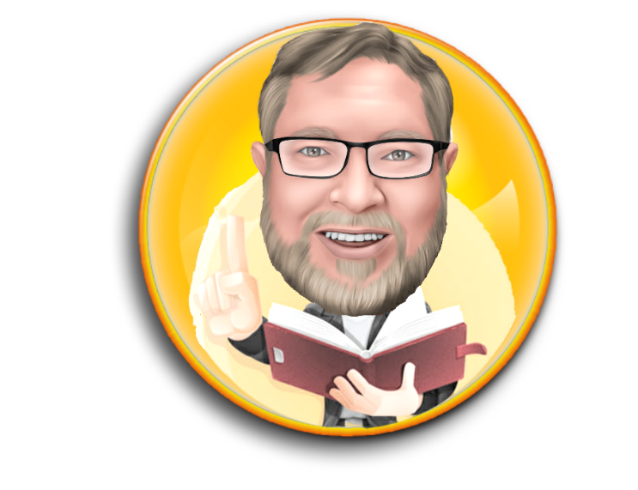
Dr. Ron Sheveland
www.i-training.info

Slide 29


TRAINING

