Slide 1

The Nehemiah Model
Of Successful Leadership
"Give your servant success today..." Neh. 1:11
"The God of Heaven will give us success..." Neh. 2:20

Slide 2
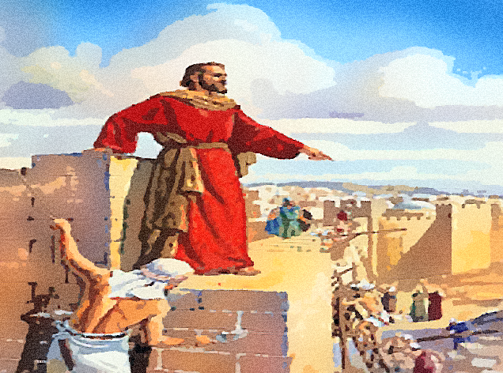

AN
INTRODUCTION
TO THE
BOOK OF NEHEMIAH

Slide 3
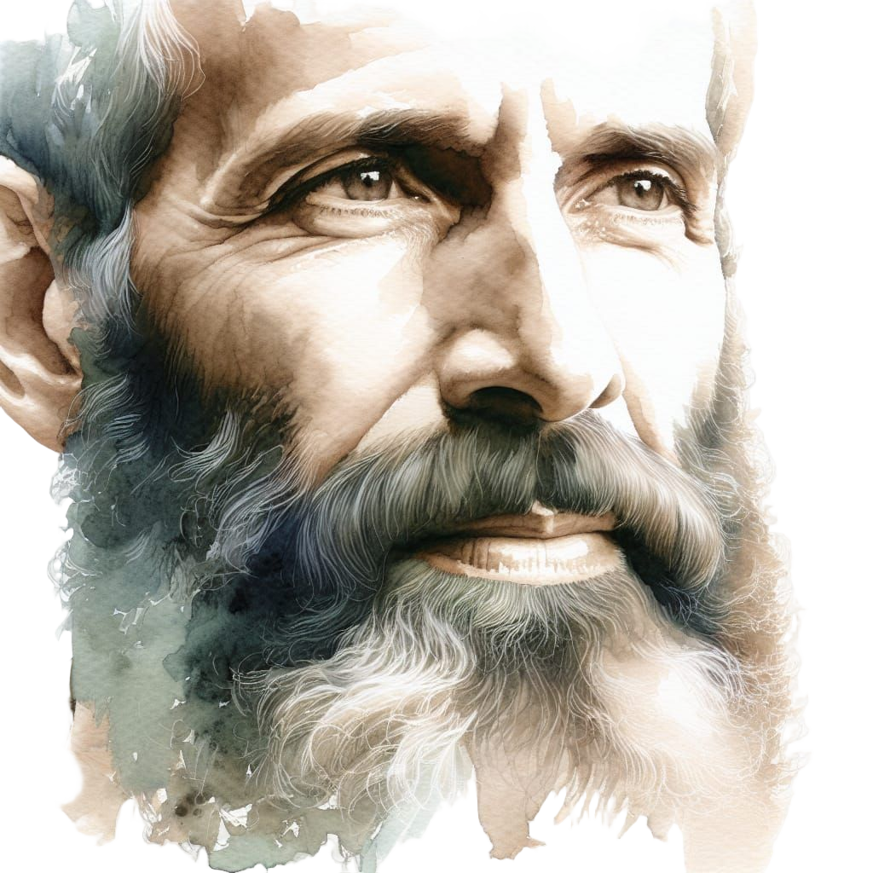
The Message of Nehemiah
The Nehemiah Model Of Successful Leadership
The Message of Nehemiah

Slide 4

The Nehemiah Model Of Successful Leadership
A Caution Flag

Slide 5
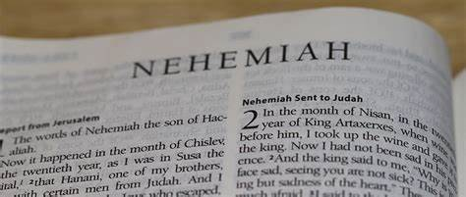
The Message of Nehemiah
The Nehemiah Model Of Successful Leadership
The Central Purpose of the Book

Slide 6
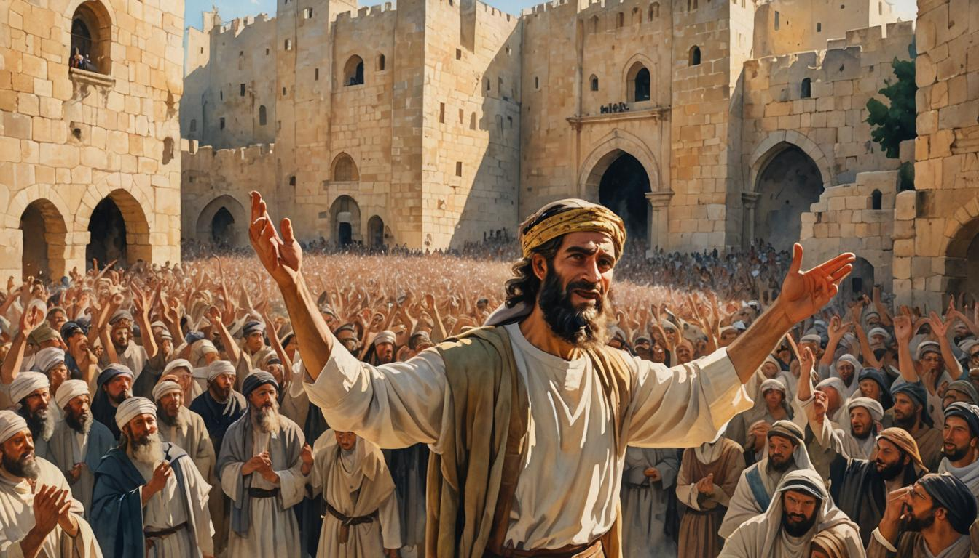
Learning from Nehemiah’s Example

Slide 7
The Nehemiah Model
Of Successful Leadership
The Both/And Balance

Slide 8
It would be wrong to think of the book of Nehemiah as merely a guidebook for successful leadership. Its larger purpose is to see how the Sovereign Lord fulfilled His plan of returning His people to the Promised Land and re-establishing His supreme, pre-eminent role in their worship and nation.
But He chose to do this through people—people like Nehemiah and Ezra, people we would be wise to emulate.

Slide 9

Nehemiah 6:3
“I am carrying on a great project…”

Slide 10
The Nehemiah Model Of:
Leading a Great Endeavor
– A Guide to Strategic Action (1-7)
Leading a Great Awakening
– A Guide to Spiritual Revitalization (8-13)

Slide 11
HISTORICAL AND BIBLICAL BACKGROUND

Slide 12

Nehemiah’s Place in the Old Testament Story
Nehemiah's Place in the Old Testament Story

Slide 13
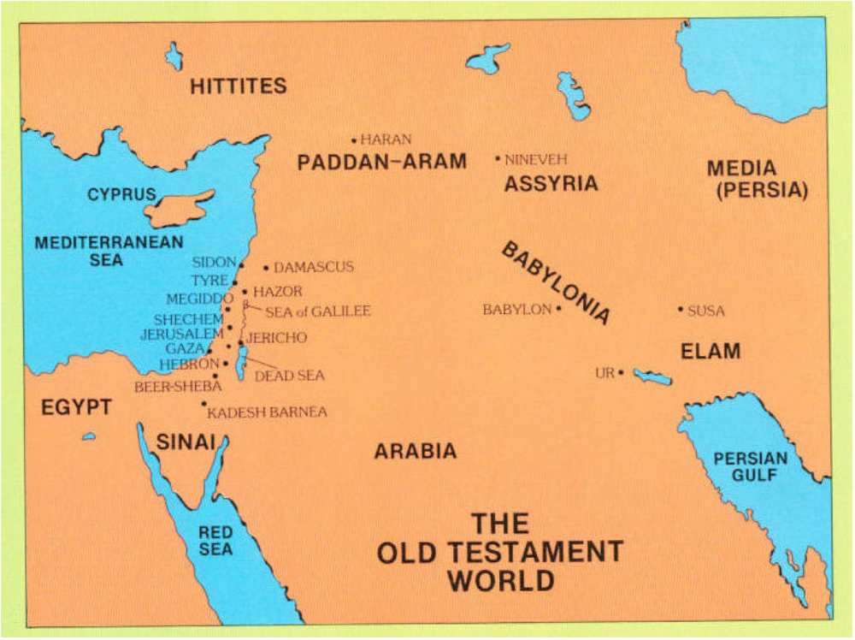
An O.T. Zoom Through

Slide 15
THE STORY’S 10 EPISODES
BEGINNINGS
PATRIARCHS
EXODUS
SETTLEMENT
JUDGES
6. UNITED KINGDOM
7. DIVIDED KINGDOM
8. CAPTIVITY
9. RESTORATION
10. SILENCE

Slide 16
BEGINNINGS
From Creation to Abraham

Slide 17
BEGINNINGS
Creation (1 & 2)
The Fall (3)
Cain Kills Abel (4)
Family Trees (5 & 10)
The Flood (6-8)
Promise of the Rainbow (9)
Tower of Babel (11)

Slide 18
PATRIARCHS
From Abraham to Moses

Slide 22
EXODUS
From Moses to Joshua

Slide 27
SETTLEMENT
From Joshua to Anarchy

Slide 29
JUDGES
Anarchy

Slide 30
UNITED KINGDOM
From Samuel to Jeroboam

Slide 31
DIVIDED KINGDOMS
Kings of Judah & Israel

Slide 33
CAPTIVITY
Exiled to Assyria & Babylon

Slide 35
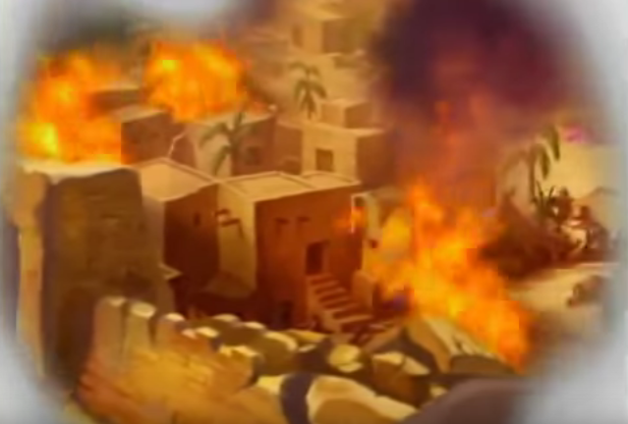

Slide 37
RESTORATION
Ezra & Nehemiah

Slide 39
SILENCE

Slide 40
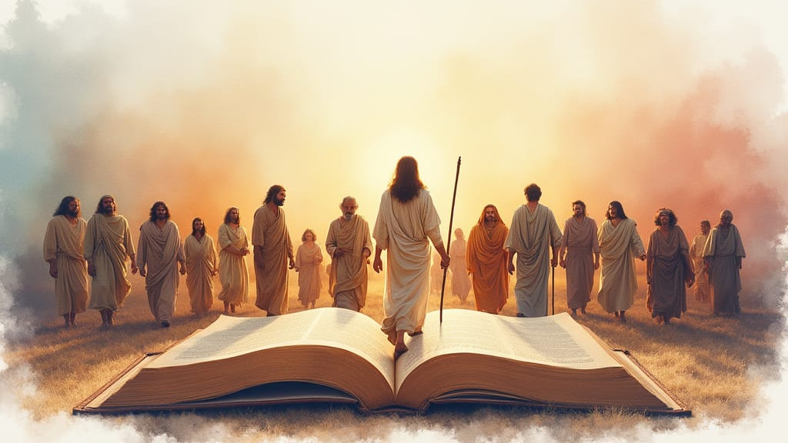
A Closer Look at the
Historical Context

Slide 41
The Nehemiah Model
Of Successful Leadership
A Biblical Study
by Ron Sheveland

